Slide 1
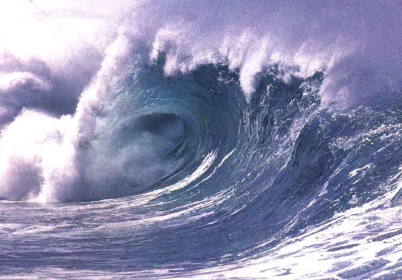
Wave interactions with matter

Slide 2

REFLECTION
Reflection is where a wave strikes an object and bounces off.
When a wave strikes a flat reflective surface it will reflect back at the same angle at which it struck the surface. This is called the Law of Reflection.
Reflection occurs when a wave hits another wave or object that it cannot pass through and bounces back.
All types of waves can be reflected: light, sound, water.

Slide 3
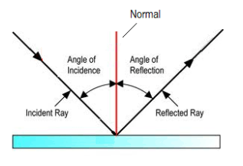
LAW OF REFLECTION
The Law of Reflection states that the angle of incidence is equal to the angle of reflection on a flat reflective surface.
Label your drawing.

Slide 4
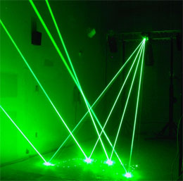
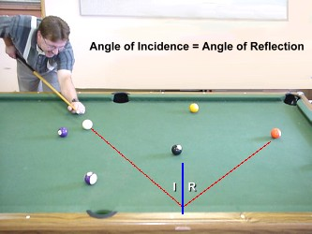
LAW OF REFLECTION
The angle of incidence equals the angel of reflection.

Slide 5
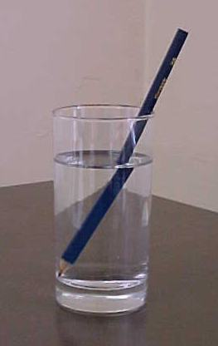
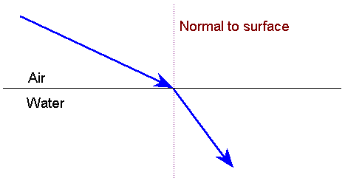
REFRACTION
In addition to reflection, a wave can experience refraction.
Refraction is the bending of a wave as it enters a different medium, due to a change in speed.

Slide 6
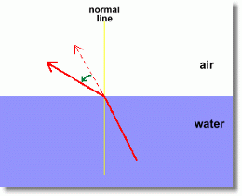
REFRACTION
Refraction occurs when a wave passes from one medium to another at an angle and bends (changes direction) due to a change in speed.
The amount of bending depends on
  the material,
  the wavelength,
  the incident angle.

Slide 7
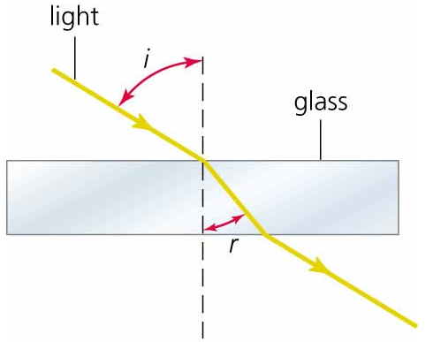
REFRACTION
Label your drawing.

Slide 8
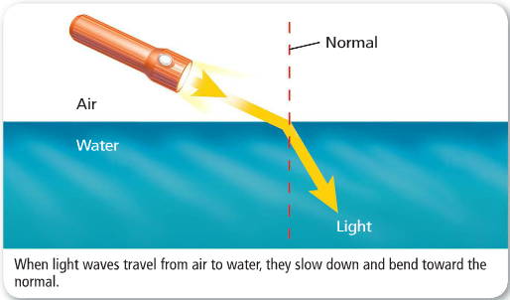
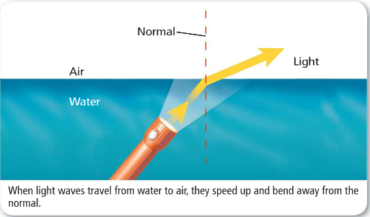
REFRACTION
Light waves travel more slowly in water than in air. This causes light waves to refract when they move from air to water or water to air

Slide 9
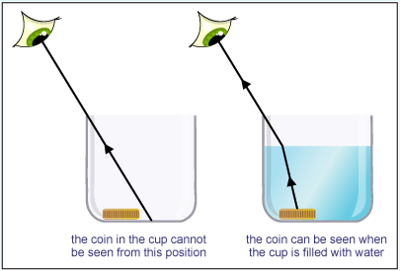
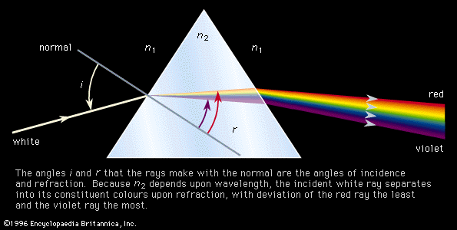
REFRACTION

Slide 10
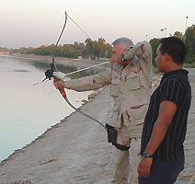
REFRACTION
Because of light refraction, a person bow fishing would not aim directly at the fish. Where should they aim?

Slide 11

REFRACTION
The South American archer fish shoots a stream of water which knocks unsuspecting prey down into the water where they are eaten. Would the fish in the picture need to aim higher or lower than where it perceives the bug to be?

Slide 12
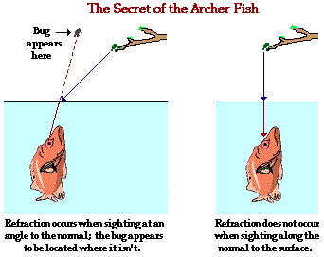
REFRACTION

Slide 13
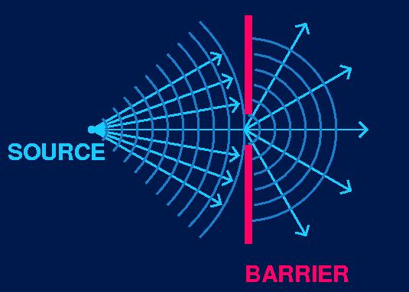
DIFFRACTION
Diffraction is the bending of a wave around a barrier.
Diffraction is a wave phenomenon that is dependent on wavelength.

Slide 14
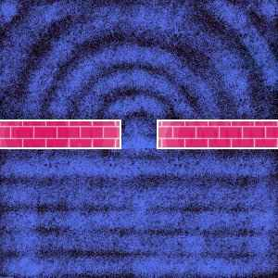
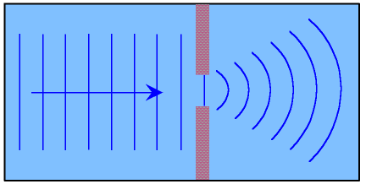
DIFFRACTION
Diffraction occurs when a wave passes through an opening and spreads out.
Light waves bend as they pass through the edge of a narrow aperture or slit.
Label your diagram.

Slide 15
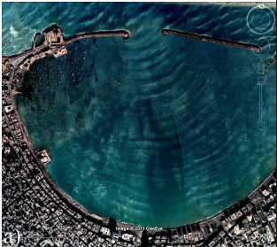
DIFFRACTION

Slide 16
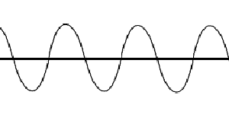
INTERFERENCE
Sometimes two or more waves may meet each other and overlap to form a new wave. This is called INTERFERENCE.
As these waves overlap, they can either multiply and enhance each other, or cancel each other out.

Slide 17
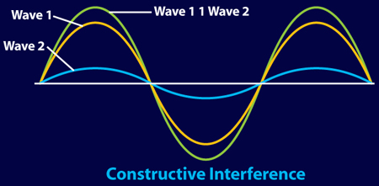
CONSTRUCTIVE
Constructive Interference occurs when two or more waves hit the same point and combine to produce a larger single wave.

Slide 18
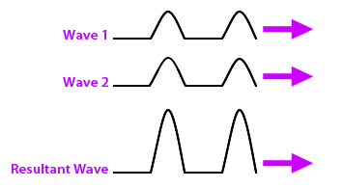
CONSTRUCTIVE
Constructive Interference occurs when the crests and troughs coincide and produce a larger amplitude - greater overall combined energy.

Slide 19
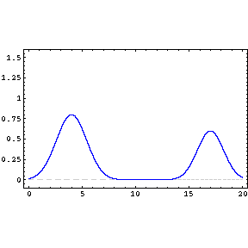
CONSTRUCTIVE

Slide 20
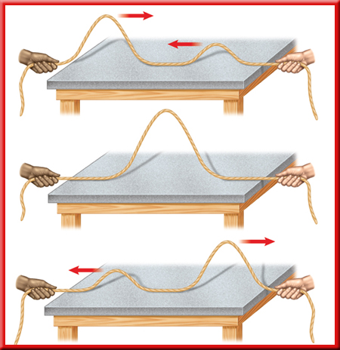

Slide 21
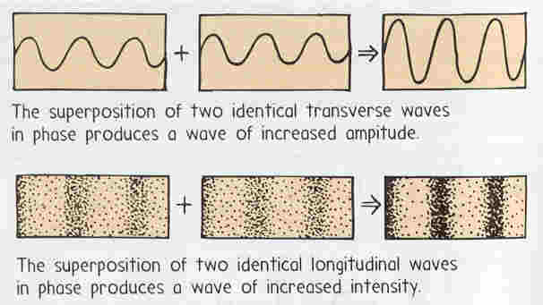
CONSTRUCTIVE

Slide 22

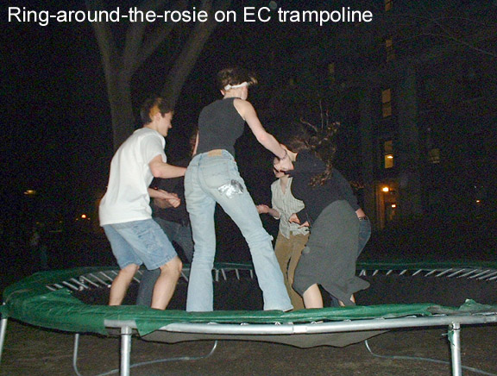
CONSTRUCTIVE
Examples:
  2 people on a trampoline at the same time.
  2 or more people singing together (in sync).

Slide 23
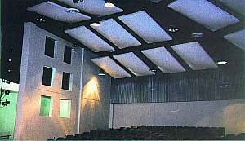
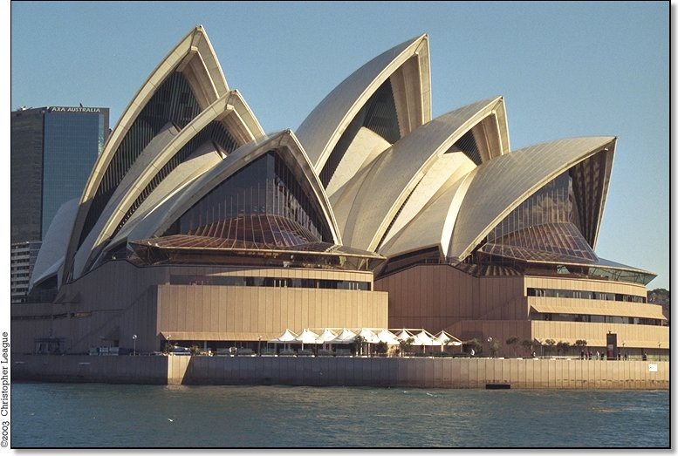
CONSTRUCTIVE
Many locations, such as auditoriums and modern stadiums, are specifically designed to produce constructive interference.

Slide 24

DESTRUCTIVE
Destructive Interference occurs when two or more waves hit the same point and combine to produce a smaller single wave.

Slide 25
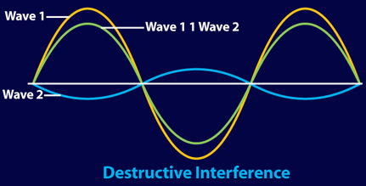
DESTRUCTIVE
Destructive interference occurs when the crests of one wave coincide with the troughs of another, creating a smaller amplitude.

Slide 26
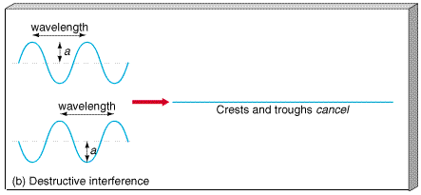
DESTRUCTIVE

Slide 27
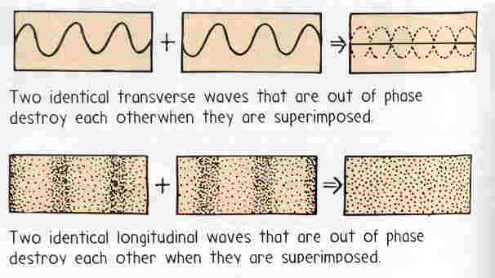
DESTRUCTIVE

Slide 28
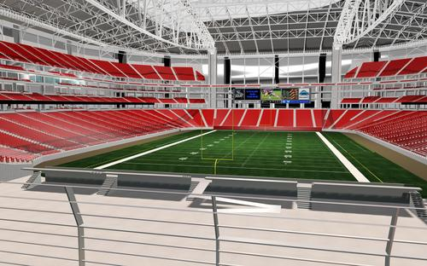
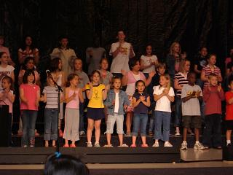
DESTRUCTIVE
Examples:
- excessive echoing in a stadium or arena,
which distorts the P.A. system
  - 2 or more people singing together (out of sync)

Slide 29
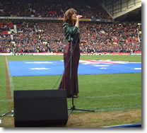
DESTRUCTIVE
Singers doing the National Anthem will often wear earplugs because the strong echo coming back through the stadium can interrupt their timing of the song.

Slide 30
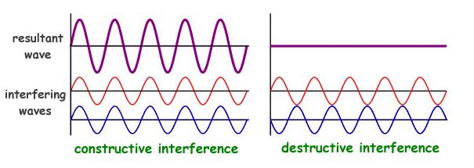
INTERFERENCE

Slide 31
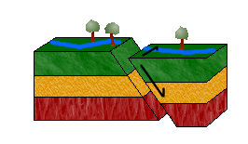
OTHER EXAMPLES
Waves created through and along the crust of the earth by shifting or breaking tectonic plates are called seismic waves.

Slide 32
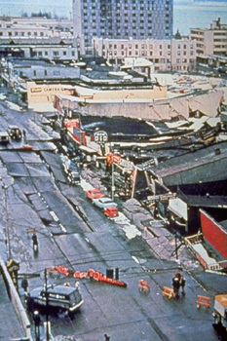
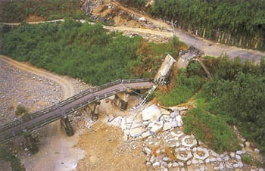
SEISMIC WAVES
These waves are comprised of both transverse and compressional waves, and can create very damaging earthquakes.

Slide 33
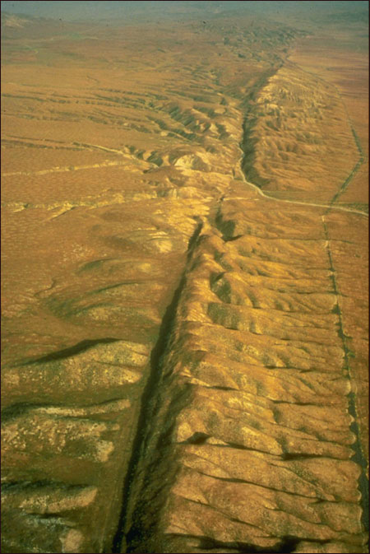
SEISMIC WAVES
The San Andreas Fault line in California and the New Madrid Fault in SE Missouri are two locations where plates come together, and are therefore more likely to slide or break.

Slide 34
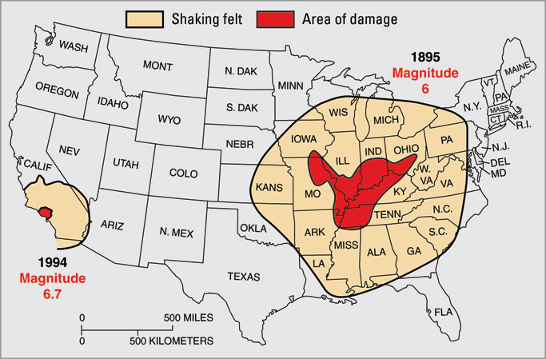
SEISMIC WAVES

Slide 35
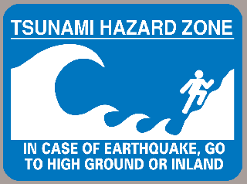
TSUNAMI WAVES
Underwater earthquakes can often produce tsunamis, giant ocean waves.

Slide 36
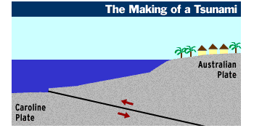
TSUNAMI WAVES

Slide 37
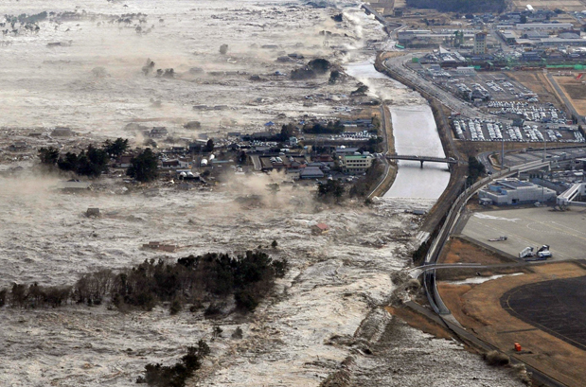
JAPANESE TSUNAMI, 2011

