Slide 1
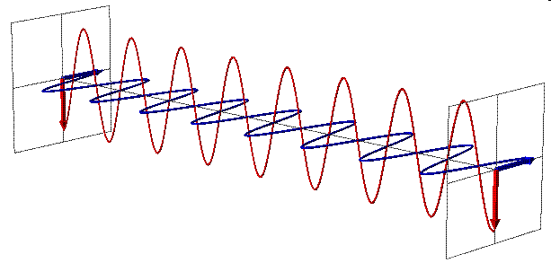
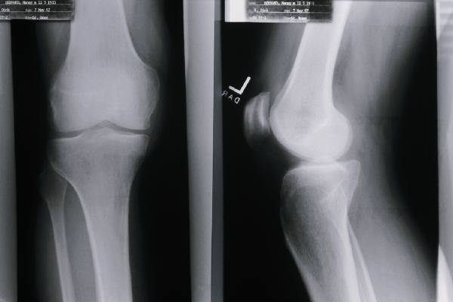
ELECTROMAGNETIC WAVES AND LIGHT

Slide 2
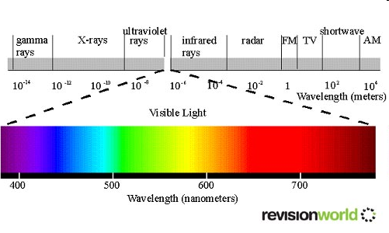
ELECTROMAGNETIC WAVES
Electromagnetic Waves travel through empty space or through matter and are produced by charged particles that are in motion.

Slide 3
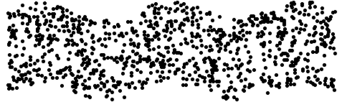
ELECTROMAGNETIC WAVES
They are transverse and non-mechanical waves.
Electromagnetic waves are produced by charged particles, such as electrons, that move back and forth or vibrate.
As a charged particle vibrates by moving up and down or back and forth, it produces changing electric and magnetic fields that move away from the vibrating charge in many directions.

Slide 4
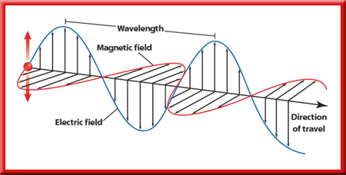
These changing fields travel in many directions.
They form an electromagnetic wave.

Slide 5
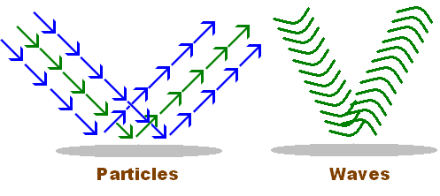
PARTICLE OR WAVE?
Light can
Behave as a particle called a PHOTON – whose energy depends on the frequency of light.
Behave as a wave – whose energy depends on its frequency.

Slide 6
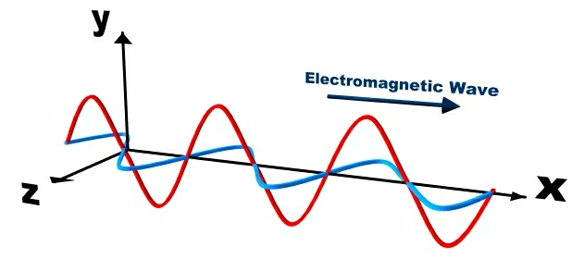
PROPERTIES OF EM WAVES
Electromagnetic waves have a wavelength and a frequency.
One complete vibration of the charged particle up and down creates one wavelength.
The number of wavelengths that pass by a point in one second is the frequency of the electromagnetic wave and is measured in hertz, Hz.

Slide 7
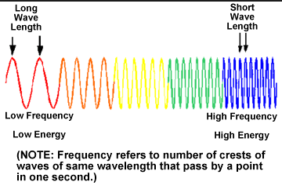
PROPERTIES OF EM WAVES
The amount of energy carried by an electromagnetic wave is determined by its frequency.
The higher the frequency, the more energy the electromagnetic (EM) wave has.

Slide 8
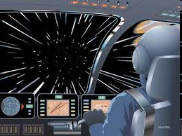
THE SPEED OF LIGHT
Electromagnetic waves travel at the speed of light, 300,000 km/s, in the vacuum of space.
Vacuum means “empty of matter”.
  Even though light travels incredibly fast, stars other than the Sun are so far away that it takes years for the light they emit to reach Earth.

Slide 9
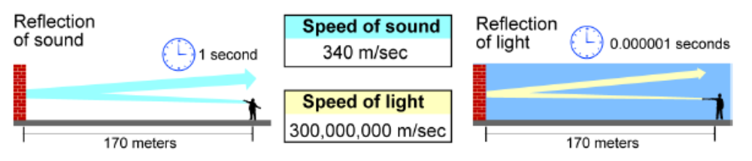
THE SPEED OF LIGHT
Light travels almost a million times faster than sound.
The speed of light is so important in physics that it is given its own symbol, a lower case c.

Slide 10
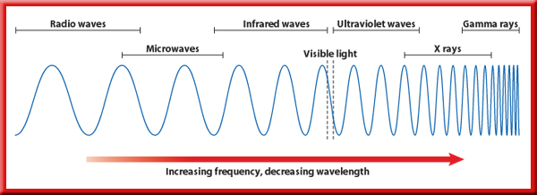
ELECTROMAGNETIC WAVES
Electromagnetic waves have a series of different frequencies and wavelengths called the electromagnetic spectrum.

Slide 11
ELECTROMAGNETIC WAVES
For waves that travel with the same speed, wavelength increases as frequency decreases.
We will look at radio, microwave, radar, infrared, visible, ultraviolet, x-rays, and gamma rays.

Slide 12


RADIO WAVES
The lowest frequency
The longest wavelength (longer than 0.3 m)
The least energy.
  AM and FM radio signals and TV signals are types of radio waves.
  They can be sent with radio waves using a transmitting and receiving antenna.

Slide 13
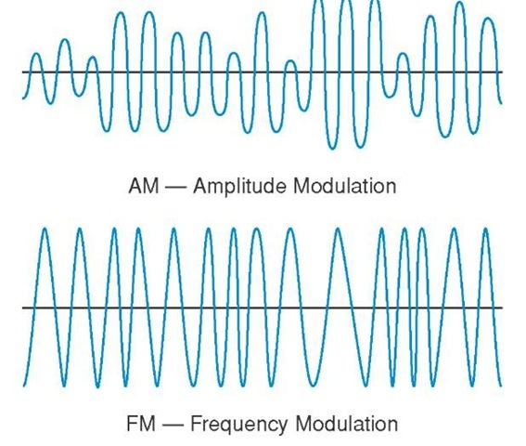
RADIO WAVES
AM radio waves are “amplitude modulated”.
FM radio waves are “frequency modulated”.

Slide 14
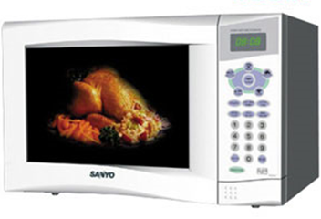
MICROWAVES
higher frequency than radio waves.
shorter wavelength than radio waves (between 0.3 m and 0.001m).
More energy than radio waves.
they are used for some phone calls and to heat food.

Slide 15
MICROWAVES
The idea of using microwave energy to cook food was accidentally discovered by Percy Spencer of the Raytheon Company.
He found that radar waves had melted a candy bar in his pocket.
Experiments showed that microwave heating could raise the internal temperature of many foods far more rapidly than a conventional oven.

Slide 16
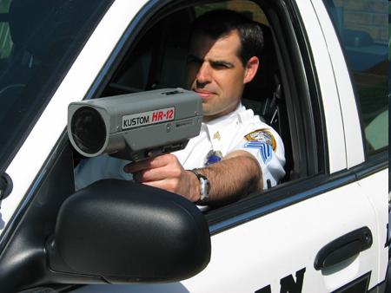
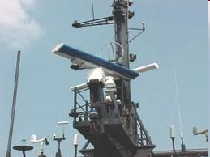
RADAR
RAdio Detection And Ranging
Similar to microwaves.
Uses electromagnetic waves to locate objects by measuring the time it takes for the waves to reach the object, be reflected, and return.

Slide 18
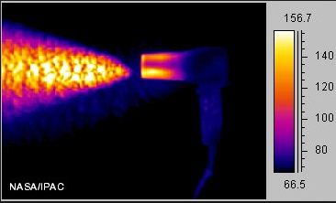
INFRARED, IR
has a greater frequency than microwaves.
has wavelengths between 0.001m and 0.000007m .
has more energy than microwaves.
feels warm or hot; basically this is thermal energy.
Infrared detectors sense objects that are warmer or colder than their environment; TV and VCR remotes also use IR waves.

Slide 19
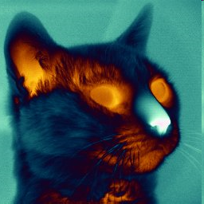
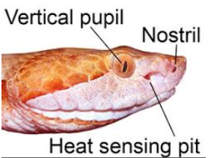
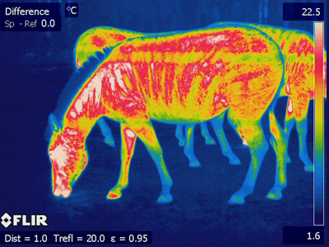
INFRARED, IR
Some animals, such as piranhas and rattlesnakes, can detect infrared waves, which helps them find prey.

Slide 20
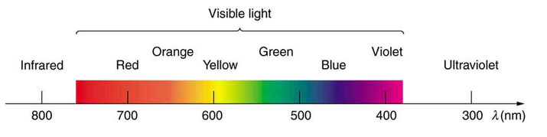
VISIBLE LIGHT
Higher frequency than IR.
Shorter wavelength than IR; between 0.7 and 0.4 millionths of a meter.
More energy than IR
“infra” means below – “below red”.

Slide 21
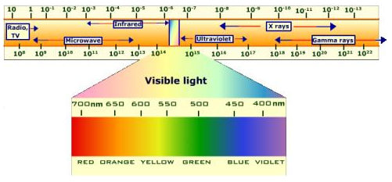
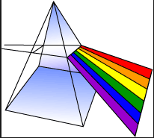
VISIBLE LIGHT
ROY G BIV - Red, orange, yellow, green, blue, indigo, violet
Red light has the longest wavelength and lowest frequency.
Violet light has the shortest wavelength and highest frequency.

Slide 22
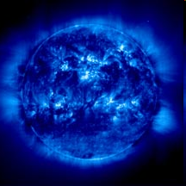
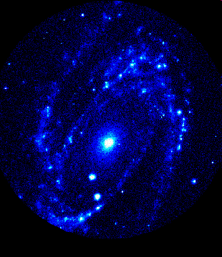
ULTRAVIOLET RADIATION, UV
higher frequency than visible light.
shorter wavelength than visible light.
More energy than visible light.
“ultra” means beyond – beyond violet.
Enough energy to penetrate the skin.
The sun

Slide 23
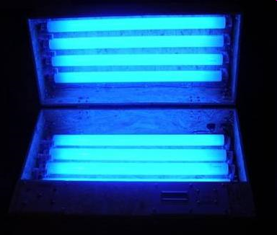
ULTRAVIOLET RADIATION, UV
Too much exposure to ultraviolet radiation from the Sun can cause sunburn and other health problems.
Since UV radiation can kill cells, it is sometimes used to sterilize equipment.
The ozone layer in Earth’s upper atmosphere helps protect the surface by absorbing much of the sun’s UV radiation.

Slide 24
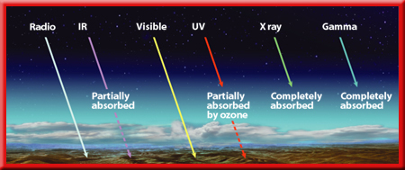
Much of the ultraviolet radiation arriving at Earth is absorbed in the upper atmosphere by ozone.
Ozone is a molecule that has three oxygen atoms and is formed high in the Earth’s atmosphere.
Chemical compounds called CFCs, which are used in air conditioners and refrigerators, can react with ozone molecules and break them apart.

Slide 26
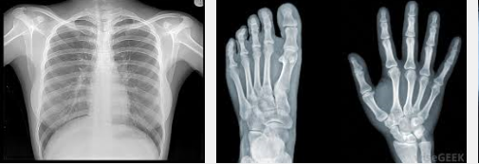
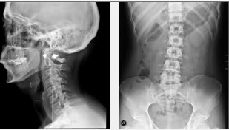
X RAYS
Higher frequency than UV.
Shorter wavelength than UV.
Higher energy than UV.
Enough energy to go through soft tissue.
Too much exposure to X-rays can damage or kill cells.
X-rays are useful in medical diagnosis if used with appropriate precautions.

Slide 27
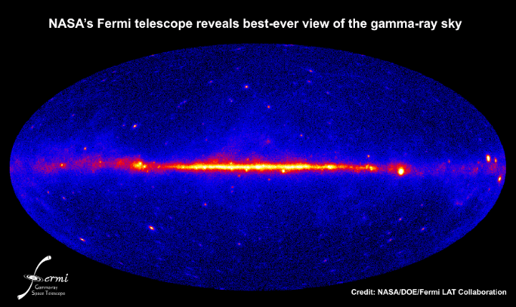
GAMMA RAYS
Higher frequency than UV.
Shorter wavelength than UV.
Higher energy than UV.
Enough energy to go through all tissue.
Too much exposure to gamma rays can damage or kill cells.
Gamma rays, which have the highest frequency, can be used to treat cancer and to kill bacteria in food.

Slide 28
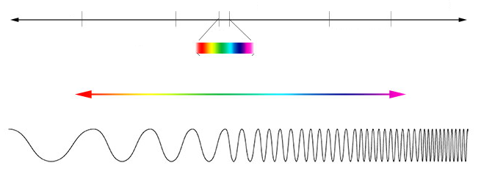
YOUR SPECTRUM
Radio
Microwave
Infrared
Ultraviolet
X-Ray
Gamma Ray
Highest Frequency
Shortest Wavelength
Highest Energy
Lowest Frequency
Longest Wavelength
Lowest Energy
Visible

Slide 29
YOUR SPECTRUM
Radio
Microwave
Infrared
Ultraviolet
X-Ray
Gamma Ray
Visible

