Slide 1
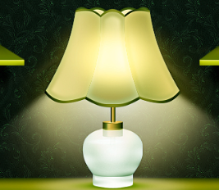
LIGHT
Light carries energy and power.
Light is a form of energy that travels.
The intensity of light is the amount of energy per second falling on a surface.
Most light sources distribute their light equally in all directions, making a spherical pattern.
Because light spreads out in a sphere, the intensity decreases the farther you get from the source.

Slide 2
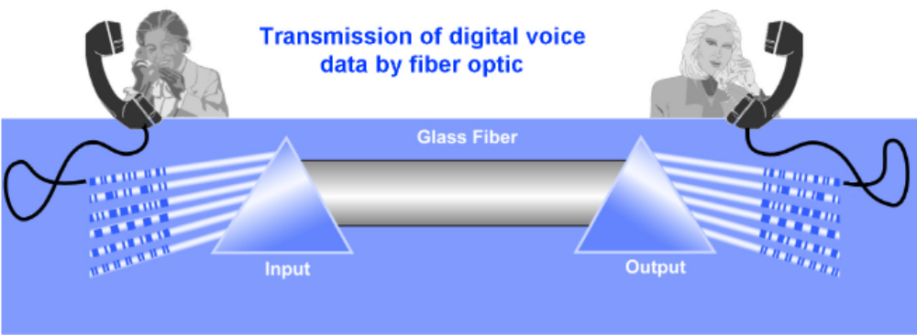
LIGHT
Light carries information.
The fiber-optic networks you read about are pipelines for information carried by light.

Slide 3
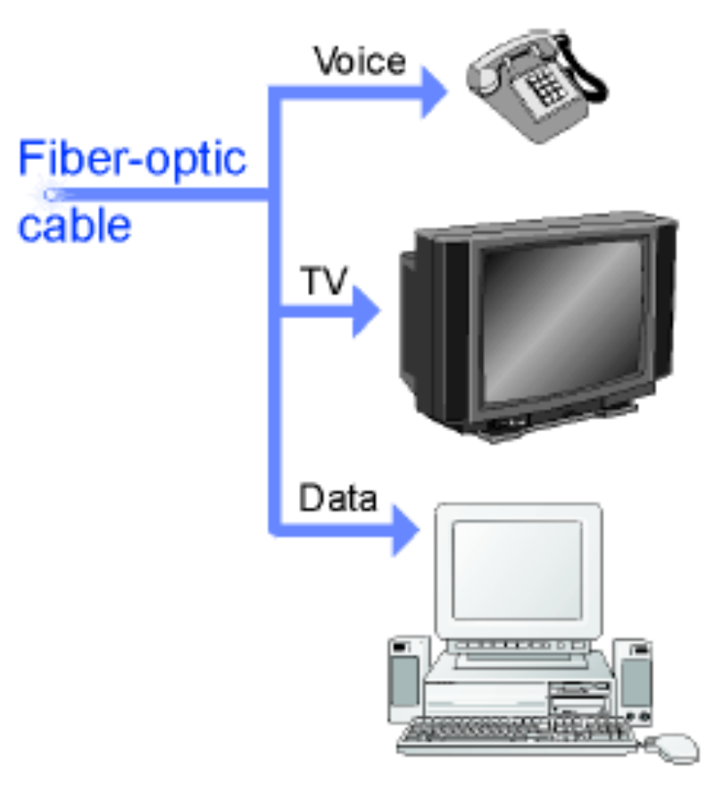
LIGHT
In some cities, a fiber-optic cable comes directly into homes and apartments carrying telephone, television, and Internet signals.

Slide 4
OPTICS
Branch of physics dealing with the nature and properties of light and vision.
  Reflection
  Mirrors
  Refraction
  Additive Color
  Subtractive Color
  Lenses

Slide 5
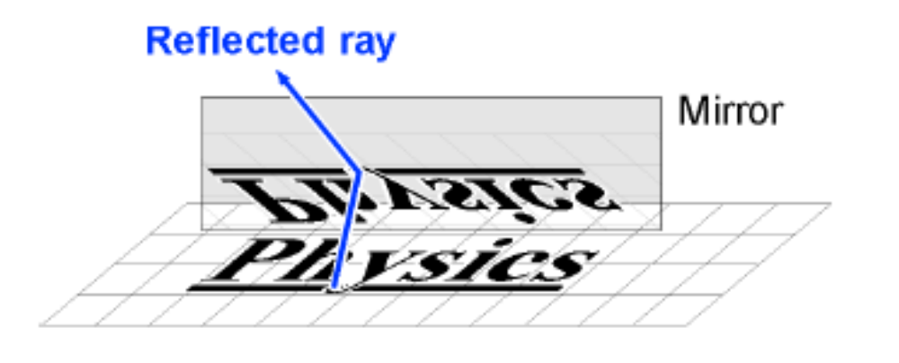
REFLECTION
When light moves through a material it travels in straight lines and when light rays travel from one material to another, the rays may reflect.

Slide 6
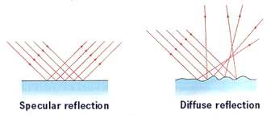
REFLECTION
There are two types of reflection:
  Regular/Specular – smooth surface
  Diffuse – rough surface

Slide 7
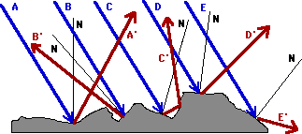
REFLECTION
Each individual ray follows the Law of Reflection.

Slide 8
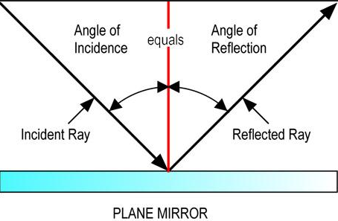
LAW OF REFLECTION

Slide 9
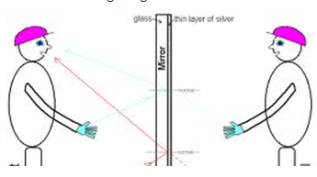
REFLECTION
Objects that are in front of a mirror appear as if they are behind the mirror.
This is because light rays are reflected by the mirror.
Your brain perceives the light as if it traveled in a straight line.

Slide 10
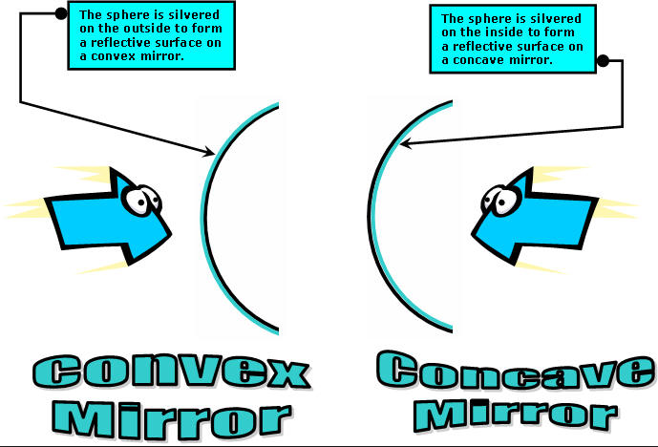
REFLECTION
Concave – mirror is curved inward (“cave).
Convex – mirror is curved outward.

Slide 11
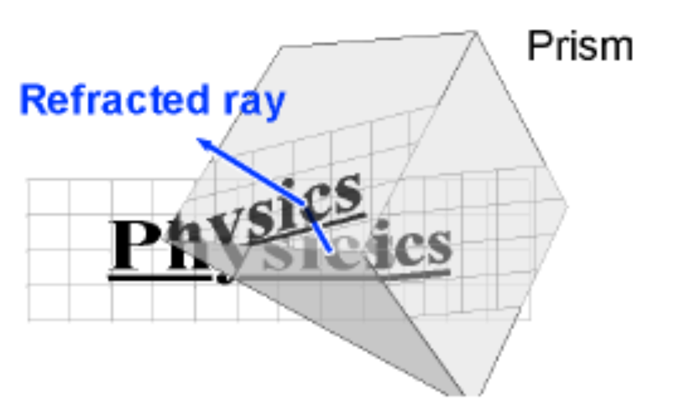
REFRACTION
The light that bends as it crosses a surface into a material refracts and is shown as a refracted ray.
Refraction occurs when light’s velocity changes
Remember: The speed of light is different in different materials.

Slide 12
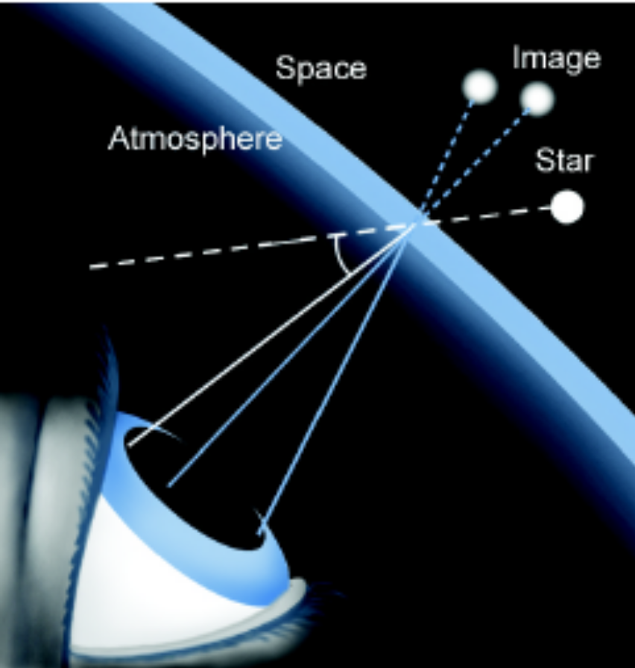
REFRACTION
Another example of refraction of light is the twinkling of a star in the night sky.
As starlight travels from space into the Earth’s atmosphere, the rays are refracted.
Since the atmosphere is constantly changing, the amount of refraction also changes.

Slide 13
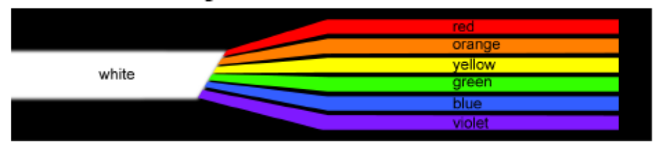
REFRACTION
When all the colors of the rainbow are combined, we do not see any particular color.
We see light without any color.
We call this combination of all the colors of light "white light".

Slide 14
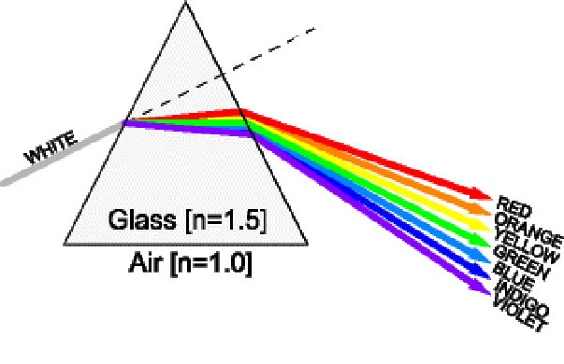
REFRACTION
White light is a mixture of all colors.
When white light is directed through a prism, the individual colors are refracted and we see a rainbow.

Slide 15
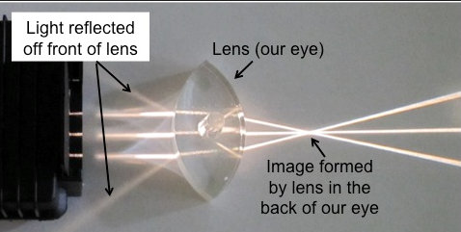
REFRACTION
A lens lets light travel through it.
It will bend the light since it is a different material from air.
Which way light bends depends on the type of lens.

Slide 16
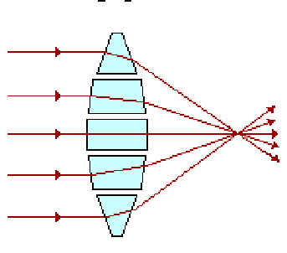
REFRACTION
Convex lens
Light bends toward the middle or center.
It is thicker in the middle, thinner on edges.

Slide 17
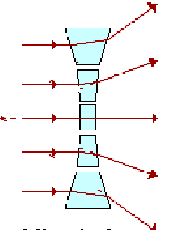
REFRACTION
Concave lens
Light bends toward the outside.
It is thinner in the middle, thicker on the edges.

Slide 18
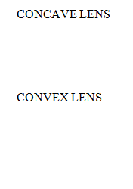


DRAW IT

Slide 19
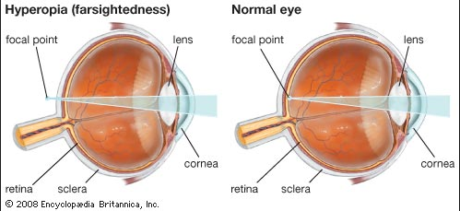
SIGHT
Farsightedness, or hyperopia, is the inability of the eye to focus on nearby objects.
The farsighted eye has no difficulty viewing distant objects.

Slide 20
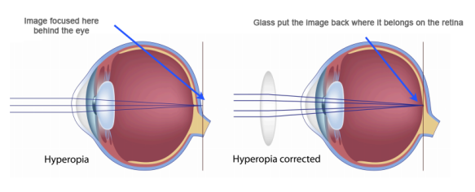
SIGHT
Correction for Farsightedness:
  Use a convex lens. Light refracts before reaching the cornea and is subsequently focused on the retina of the eye.

Slide 21
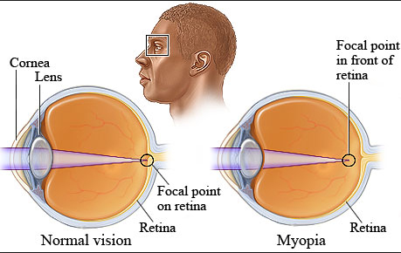
SIGHT
Nearsightedness, or myopia, is the inability of the eye to focus on far objects.
The nearsighted eye has no difficulty viewing close objects.

Slide 22
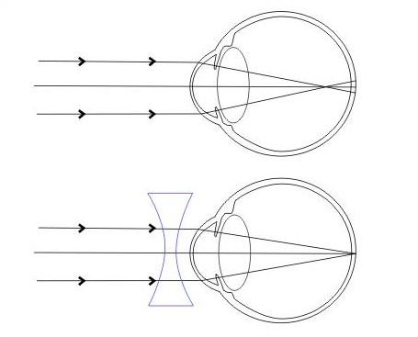
SIGHT
Correction for Nearsightedness:
  Use a concave lens. Light refracts before reaching the cornea and is subsequently focused on the retina of the eye.

Slide 23
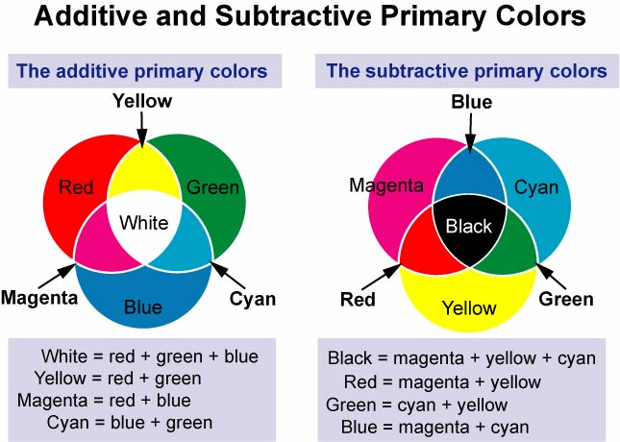
LIGHT AND COLOR
The three color receptors in the eye allow us to see millions of different colors.
The additive primary colors are red, green, and blue.

Slide 24
LIGHT AND COLOR
We don’t see everything white because the strength of the signal matters.
All the different shades of color we can see are made by changing the proportions of red, green, and blue.

Slide 25
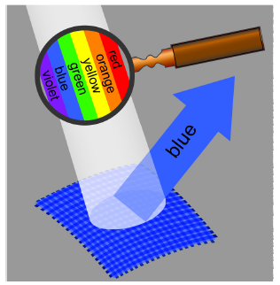
LIGHT AND COLOR
When we see an object, the light that reaches our eyes can come from two different processes:
The light can be emitted directly from the object, like a light bulb or glow stick.
The light can come from somewhere else, like the sun, and we see the objects by reflected light.

Slide 26
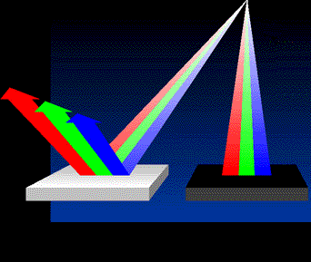
LIGHT AND COLOR

Slide 27
LIGHT AND COLOR
Colored fabrics and paints get color from a subtractive process.
Chemicals, known as pigments, in the dyes and paints, absorb some colors and allow the color you actually see to be reflected.
Magenta, yellow, and cyan are the three subtractive primary colors.

Slide 28
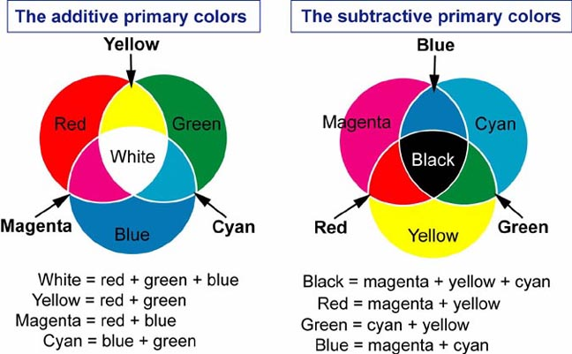

Slide 29
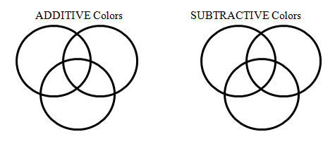
DRAW IT
YELLOW
RED
MAGENTA
GREEN
CYAN
WHITE
BLUE
CYAN
RED
BLUE
YELLOW
GREEN
MAGENTA
BLACK

