Slide 1
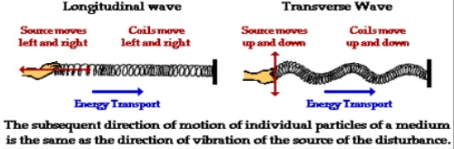
SOUND AND LIGHT
A Review

Slide 2
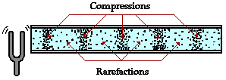
REVIEW
1. Describe a compressional/longitudinal wave and label its parts.

Slide 3
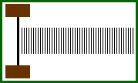
REVIEW
2. Explain how sound travels through different mediums.
Sound is produced by a vibrating object which causes a disturbance.
This disturbance is passed from one particle to the next.
The result is that energy is transported without the actual transport of matter.

Slide 4
REVIEW
Identify what influences the speed of sound.
Speed of sound depends on the
  Elasticity – the ability of an object to bounce back to its original shape.
  - more elastic, faster speed
  Medium (Density) – in material of the same state of matter (solid, liquid or gas) the denser the medium, the slower the sound travels.
  - the denser the material, the slower it travels.
  Temperature – warmer particles vibrate faster.
  - the higher the temperature, the faster the speed of sound.

Slide 5
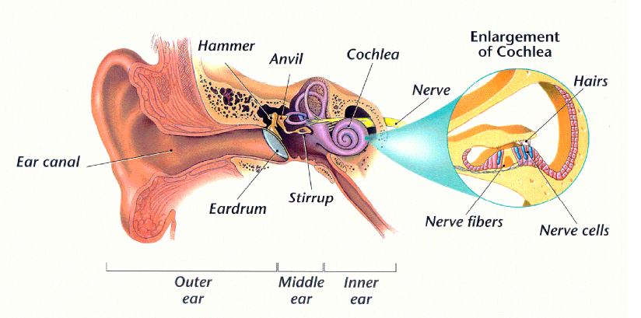
REVIEW
4. Describe how the ear enables you to hear.
Auricle
Auditory
Nerve
Oval Window

Slide 6
REVIEW
5. Recognize how amplitude, intensity, and loudness are related.
The amplitude of a wave indicates the energy.
The energy is measured by intensity (in dB).
We perceive different intensities as how loud or soft a sound is.

Slide 7
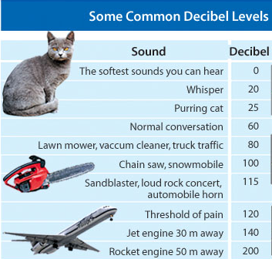
REVIEW
6. Describe how sound intensity is measured and what levels can damage hearing.
Sound intensity is measured in decibels (dB)

Slide 8
REVIEW
7. Explain the relationship between frequency and pitch.
Frequency – the number of wavelengths per second, hertz, Hz.
Pitch - the highness or lowness of sound; determined by frequency.
  High frequency yields high pitch sounds.
  Low frequency yields low pitch sounds.

Slide 9
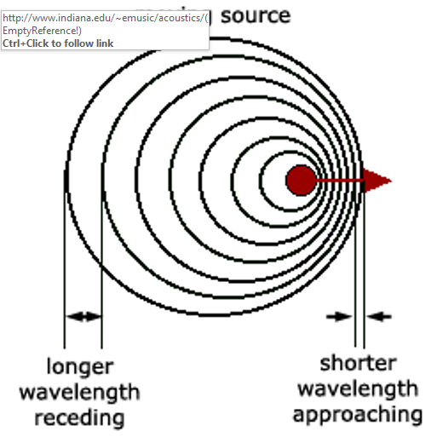
REVIEW
8. Discuss the Doppler Effect.
Doppler Effect - Train
The Doppler Effect occurs due to variations in the perceived pitch of a sound due to a moving sound source.
The sound bunches up in front of the source and spreads out behind the source.

Slide 10
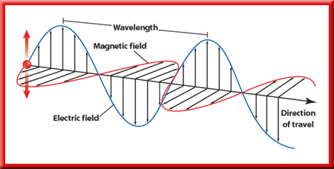
REVIEW
9. Explain how vibrating charges produce electromagnetic waves.
Electromagnetic waves are produced by charged particles, such as electrons, that move back and forth or vibrate.
As a charged particle vibrates it produces changing electric and magnetic fields that move away from the vibrating charge in many directions.

Slide 11
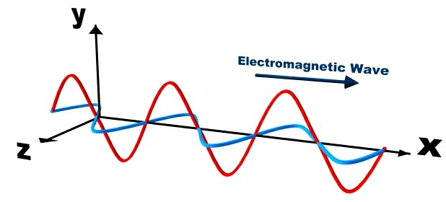
REVIEW
10. Describe the frequency, wavelength, and speed of electromagnetic waves.
Light is a transverse, non-mechanical wave.
A complete up and down creates one wavelength.
The number of wavelengths in one second is the frequency and is measured in hertz, Hz.
A wavelength increases, frequency decreases.

Slide 12
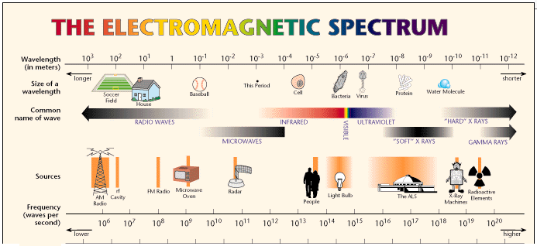
REVIEW
11. Compare the various types of electromagnetic waves.
12. Be able to list some helpful and harmful properties of electromagnetic waves.

Slide 13
REVIEW
RADIO WAVES
MICROWAVES
The lowest frequency
The longest wavelength (longer than 0.3 m)
The least energy.
  AM and FM radio signals and TV signals are types of radio waves.
higher frequency than radio waves.
shorter wavelength than radio waves (between 0.3 m and 0.001m).
More energy than radio waves.
they are used for some phone calls and to heat food.
Include RADAR.

Slide 14
REVIEW
INFRARED
VISIBLE LIGHT
has a greater frequency than microwaves.
has a shorter wavelength than microwaves.
has more energy than microwaves.
feels warm or hot; thermal energy.
Higher frequency than IR.
Shorter wavelength than infrared.
More energy than infrared.
ROY G BIV
Red light: longest wavelength and lowest frequency.
Violet light: shortest wavelength and highest frequency.

Slide 15
REVIEW
ULTRAVIOLET
X-RAYS
Higher frequency than visible light.
Shorter wavelength than visible light.
More energy than visible light.
Enough energy to penetrate the skin.
Can cause burns to the skin or skin cancer.
Used to sterilize equipment.
Much of the ultraviolet radiation arriving at Earth is absorbed in the upper atmosphere by ozone.
Higher frequency than UV.
Shorter wavelength than UV.
Higher energy than UV.
Enough energy to go through soft tissue.
Too much exposure to X-rays can damage or kill cells.
X-rays are useful in medical diagnosis.

Slide 16
REVIEW
GAMMA WAVES
Higher frequency than UV.
Shorter wavelength than UV.
Higher energy than UV.
Enough energy to go through all tissue.
Too much exposure to gamma rays can damage or kill cells.
Used to treat cancer and to kill bacteria in food.

Slide 17
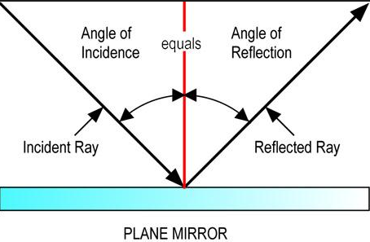
REVIEW
Explain how light is reflected.
When light moves, it travels in straight lines.
When light rays travel from one material to another, the rays may reflect.

Slide 18
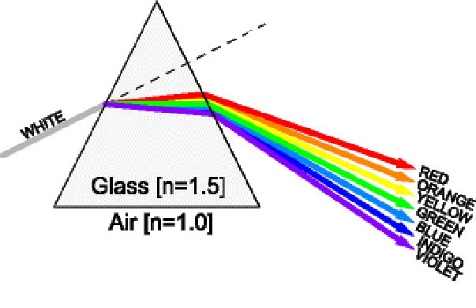
REVIEW
14. Discuss how refraction separates white light.
Light waves are bent when they travel from one medium to a different medium.

Slide 19
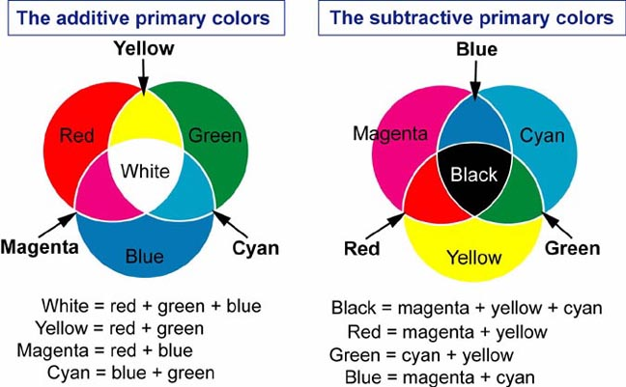
REVIEW
15. Describe the different between light (additive) color and pigment (subtractive) color.

Slide 20
REVIEW
16. Know the eleven vocabulary words.
Acoustics
Decibel
Doppler Effect
Echolocation
Electromagnetic Wave
Intensity
Loudness
Pitch
Resonance
Sonar
Ultrasonic

