Slide 1
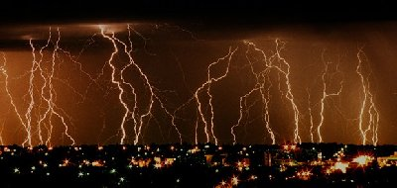
ELECTRICITY

Slide 2

ELECTRIC CHARGES
Atoms are composed of three main parts:
  Proton, p⁺, positive, located in the nucleus
  Neutron, nº, neutral, located in the nucleus
  Electron, e⁻ , negative, located outside the nucleus in the electron cloud.
Everything is made of atoms.

Slide 3
ELECTRIC CHARGES
Protons and electrons have a property called electric charge.
An atom has equal numbers of positive and negative charges so they cancel each other out.
Electrons can move from one atom to another atom.
This movement is called electric current.

Slide 4
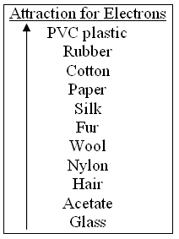
STATIC ELECTRICITY
Some atoms hold their charges more tightly.
Latin word “stasis” which means “stays”.
Static electricity is the temporary building up of charge on an object.
Protons DON’T move.
Only electrons move.
In static electricity, the charges build up and stay – they do not flow.

Slide 5
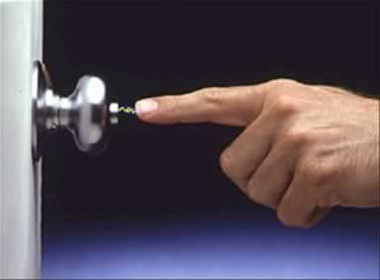
STATIC ELECTRICITY
When you walk across a carpet, FRICTION causes electrons to move from the carpet to your shoe. This is a build-up of static electricity.
You discharge the electricity by touching an electrical conductor.

Slide 6

LAW OF CONSERVATION OF CHARGE
When an object becomes charged, the electric charge is neither created nor destroyed – it just came from another object.
Static electricity is an imbalance in the amounts of positive and negative charges on the surface of an object.

Slide 7
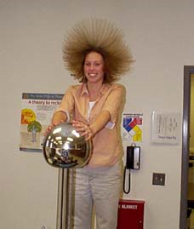
STATIC ELECTRICITY
Another way to generate static electricity is with a Van de Graaf generator.
American physicist Robert Jemison Van de Graaf invented the Van de Graaf generator in 1931.
Van de Graaf generator

Slide 8
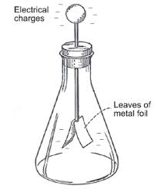
STATIC ELECTRICITY
There are several ways to charge on object:
  Friction
  Induction
  Conduction (contact)

Slide 9
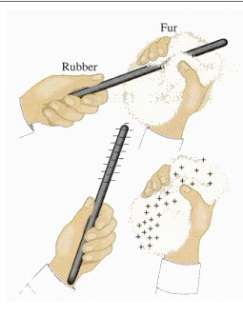
STATIC ELECTRICITY
Charging by Friction
    The charge is transferred because of rubbing two objects together.
    Example: shoes on a carpet
    Animation

Slide 10
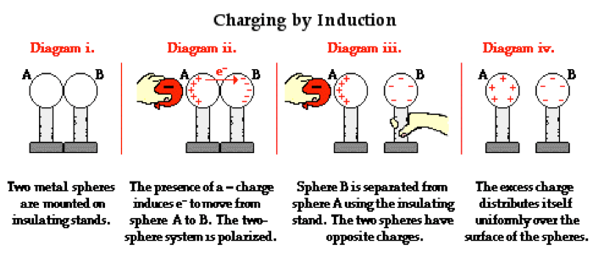
STATIC ELECTRICITY
Charging by Induction
  Involves the charging of one object by another object without direct contact.
  Example: balloon and rice cereal/electroscope

Slide 11
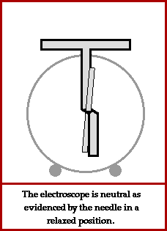
Video:
Electric Charges

Slide 12
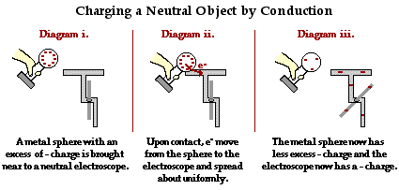
STATIC ELECTRICITY
Charging by Conduction
  Involves the direct contact of a charged object to a neutral object.
  Example: Van de Graaf generator

Slide 13
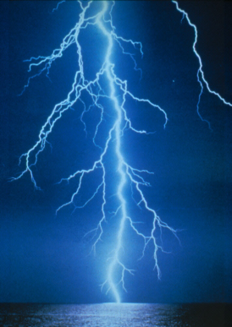
STATIC DISCHARGE
Objects do not hold a static charge forever – objects tend towards equilibrium – they want to be neutral.
When electrons move toward this equilibrium – static discharge occurs.
  Humidity – water vapor in the air (a polar molecule) pulls electrons off negatively charged objects, preventing static charges to build up.
  Sparks and Lightning - objects reaching static equilibrium

Slide 14
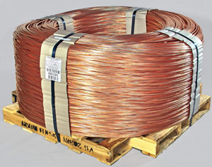
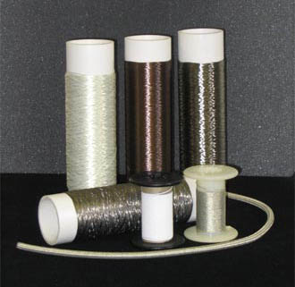
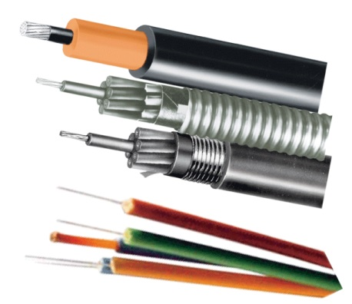
CONDUCTORS
Allow the easy flow of electricity.
Loosely bound electrons that are free to move from atom to atom
Examples: metals like aluminum, gold, copper and silver .

Slide 15
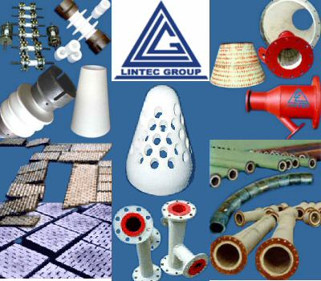
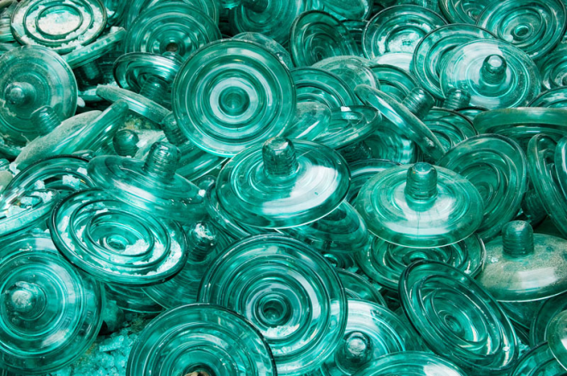
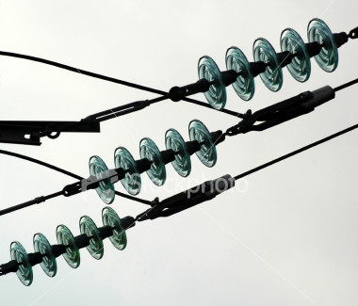
INSULATORS
Insulators – resists the flow of electrons
  hold more tightly to their valence electrons.
  Examples: plastic, rubber, glass
  Static Electricity

