Slide 1
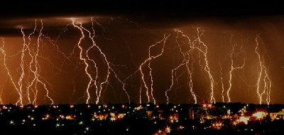
VOCABULARY
Electric field - the electric force per unit charge; it is radially outward from a positive charge and radially in toward a negative point charge.

Slide 2

ELECTRIC
CURRENT

Slide 3
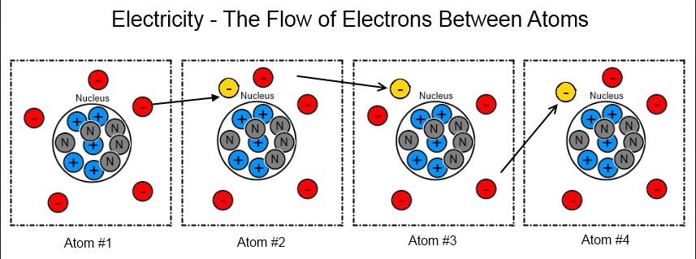

ELECTRIC CURRENT
The constant flow of electrons.

Slide 4
ELECTRIC CURRENT
REMEMBER:
Conductors let electrons move easily.
Insulators do not let electrons move easily.
A SEMICONDUCTOR has conductivity somewhere between an insulator and a conductor. Devices made of semi-conductors, notably silicon, are essential components of most electronic circuits.

Slide 5

ELECTRIC CURRENT
There are three parts to an electric charge
Voltage
Current
Resistance

Slide 6
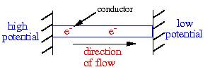
VOLTAGE
Voltage - For electrons to flow there must be a potential difference between two places.
This is called voltage, which is the “push” that causes electrons to flow.
It is electrical “pressure”.
Charges flow from high voltage to low voltage.
Units: Volts, V

Slide 7
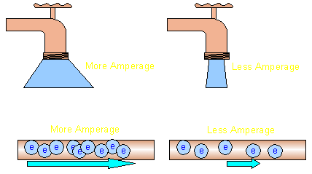
CURRENT
Current - the measure of how many electrons per second are flowing through the wire is the amperage.
Units: amps
The number of electrons flowing per second.

Slide 8
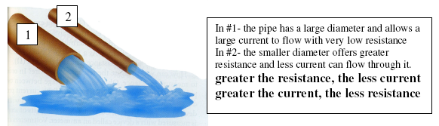
current
Electrical current is like the amount or volume of water flowing through the hose.

Slide 9


There are two types of current:
AC – alternating current
DC – direct current

Slide 10
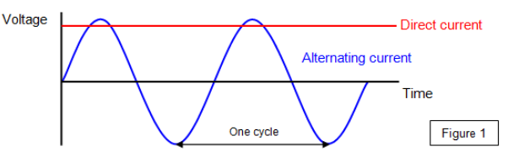
CURRENT
Alternating Current is an electrical current where the flow repeatedly changes direction.
Direct Current is an electrical current that flows in one direction from the negative to positive terminal.

Slide 11
RESISTANCE
Resistance - the tendency for a material to oppose the flow of electrons.
Different materials have different amounts of resistance to the flow of electrons.
Unit: ohm, R.

Slide 12
RESISTANCE
EXAMPLES:
gold, silver, and copper have low resistance, which means that current can flow easily through these materials.
Glass, plastics, and wood have very high resistance, which means that current cannot pass through these materials easily.
Resistance

Slide 13
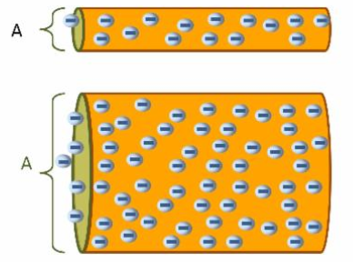
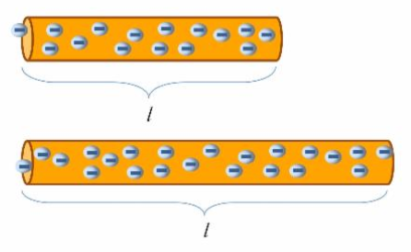
RESISTANCE
Thin wires provide more resistance than do thick wires because there are fewer electrons to carry the charge.
Resistance in wires produces a loss of energy (usually in the form of heat), so materials with no resistance produce no energy loss when currents pass through them.
Resistance also depends on temperature, usually increasing as the temperature increases.

Slide 14
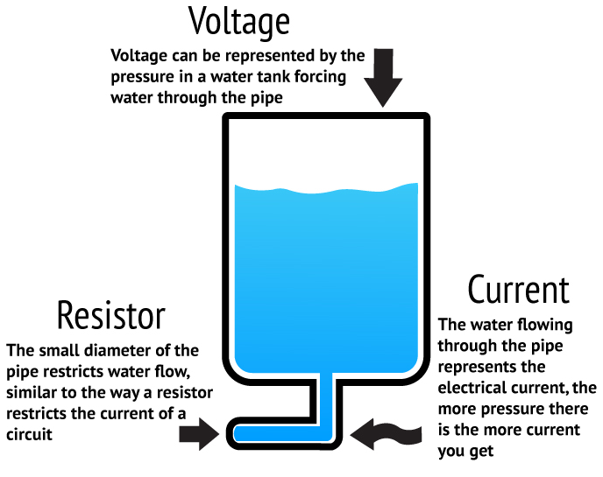
ELECTRIC CURRENT

Slide 15
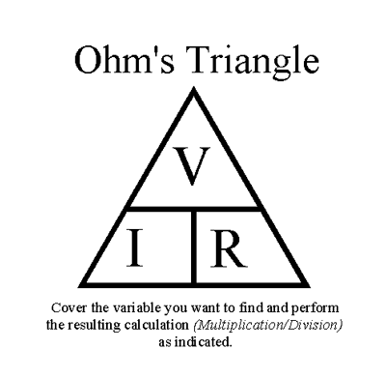
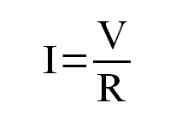
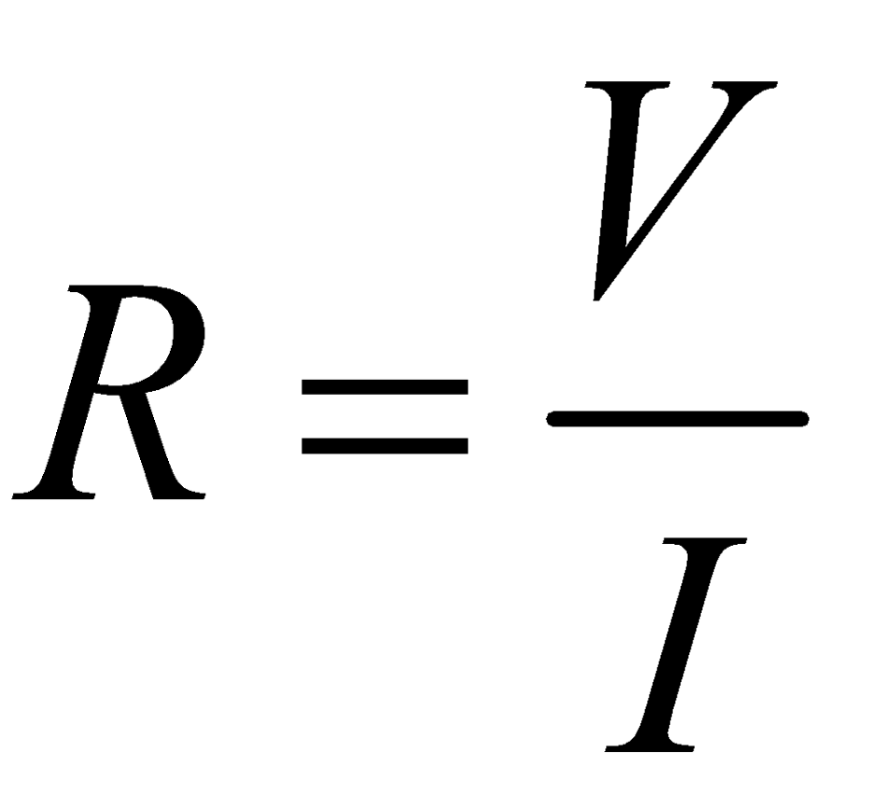
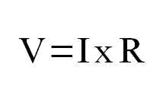
OHM’S LAW
In a material, the current (I) is directly proportional to the voltage (V) and inversely proportional to the resistance.
Ohm’s LAW
OR OR

Slide 16
ANALOGY
Water in a Hose
Direct Current in a Wire
Electrical Units
pressure
voltage (V)
Volts, V
volume
current (I)
Amps, A
friction
resistance (R)
Ohms, R
Charge, Current, and Voltage review

Slide 17
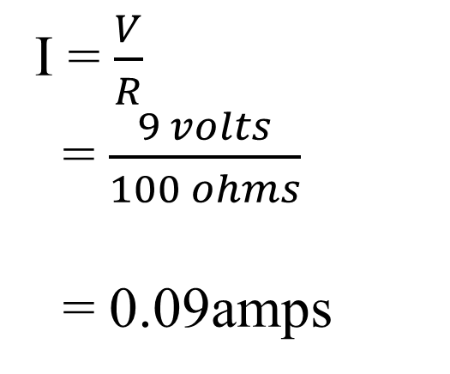
PRACTICE
What is the current produced with a 9-volt battery through a resistance of 100 ohms?
I = ?
R = 100 ohms
V = 9 volts
I = $\frac{V}{R}$
= $\frac{9 volts}{100 ohms}$
= 0.09amps

