Slide 1
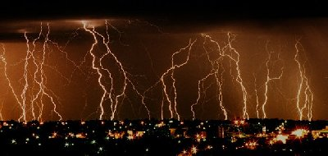
BATTERIES
And
ELECTRICAL CIRCUITS

Slide 2

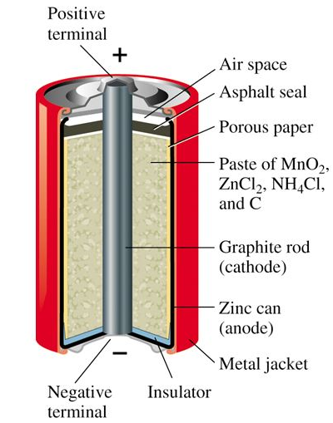
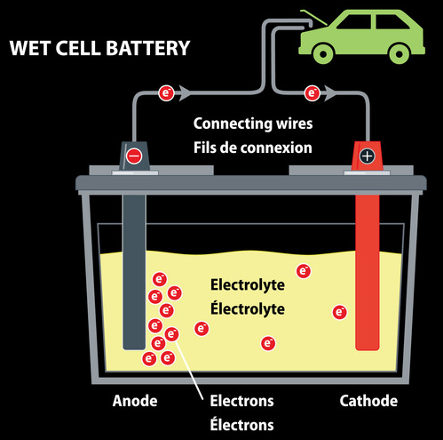
BATTERIES
TWO TYPES:
1. Dry Cell – the electrolyte is not really dry; but is a paste.
  Standard AA, C, D type batteries, electrolyte is a paste. The “+” terminal is carbon.
2. Wet Cell – the electrolyte is a liquid (car battery)
  In a car battery, the electrolyte is sulfuric acid.

Slide 3
VOCABULARY
Dry Cell – a type of chemical cell, commonly used today, in the form of batteries, for many electrical appliances. It uses a paste electrolyte, with only enough moisture to allow current to flow.
Wet Cell – An electric battery is a device consisting of two or more electrochemical cells that convert stored chemical energy into electrical energy using a liquid electrolyte

Slide 4
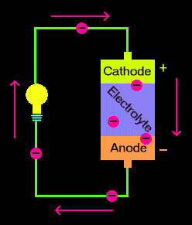
BATTERIES
Batteries have three parts.
A cathode (+)
An anode (-)
An electrolyte.
The cathode (positive) and anode (negative) at either end of a traditional battery) are hooked up to an electrical circuit.

Slide 5
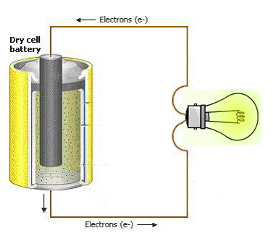
BATTERIES
The chemical reactions in the battery cause a build up of electrons at the anode.
This results in an electrical difference between the anode and the cathode - an unstable build-up of the electrons.
The electrons wants to rearrange themselves to get rid of this difference. They do this in a certain way. Electrons repel each other and try to go to a place with fewer electrons.

Slide 6
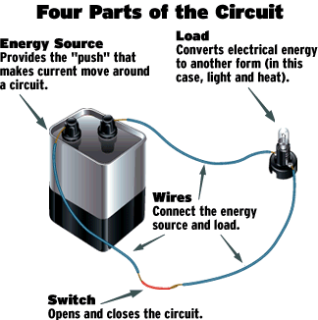
ELECTRICAL CIRCUIT
An electrical circuit provides a pathway for electrons to flow.
Four Parts:
Energy Source
Load
Wires
Switch

Slide 7
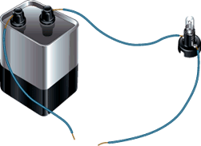
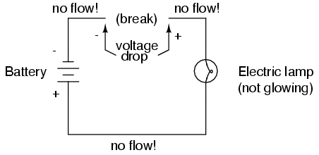
ELECTRICAL CIRCUIT
OPEN circuit – pathway is broken.

Slide 8
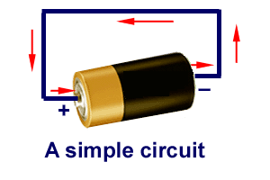
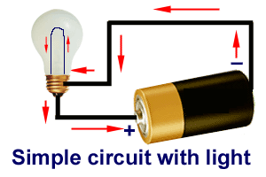
ELECTRICAL CIRCUIT
Closed circuit– pathway is complete.

Slide 9
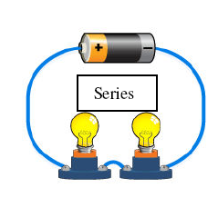
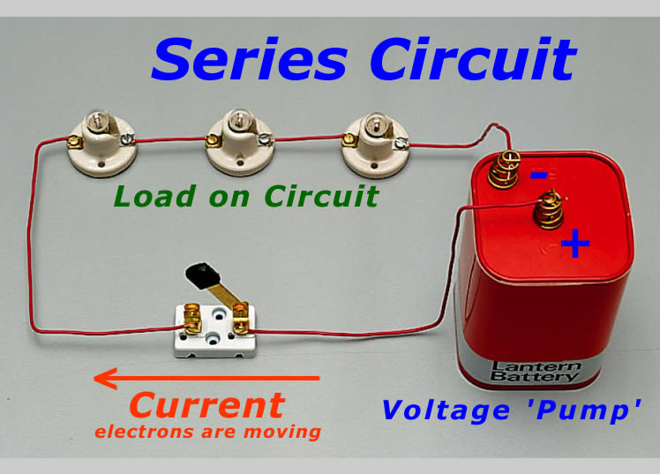
SERIES CIRCUIT
Provides only one path for the electrons to follow.
  A break in the circuit stops the flow of electricity to all other parts of the circuit.
  With multiple light bulbs (more resistance), the current reduces and the lights become dimmer.
  Ammeters should be wired in series.

Slide 10
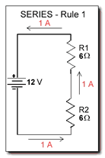
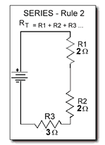
SERIES CIRCUIT
RULES
The same current flows through each part of a series circuit.
The total resistance of a series circuit is equal to the sum of individual resistances.

Slide 11
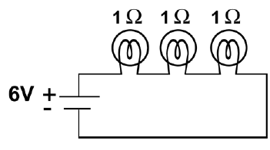
a. What is the total voltage across the bulbs?
b. What is the total resistance of the circuit?
c. What is the current in the circuit?
d. What is the voltage drop across each light bulb?
6V
3Ω
6V/3Ω = 2A
6V ÷ 3 resistors (bulbs) = 2V
e. What happens to the brightness of each bulb in a series circuit as additional bulbs are added? Why?
With multiple light bulbs (more resistance), the current reduces and the lights become dimmer.

Slide 12
PARALLEL CIRCUIT
The different parts of the circuit are on separate branches.
A break (like a burned out light bulb) in the circuit does not stop the flow to the remaining devices.
Multiple light bulbs will remain the same brightness since the resistance is not decreasing as it does in a series circuit.
Each pathway can be separately switched off without affecting the others.

Slide 13
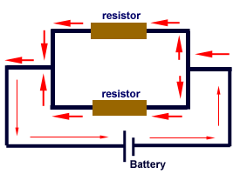
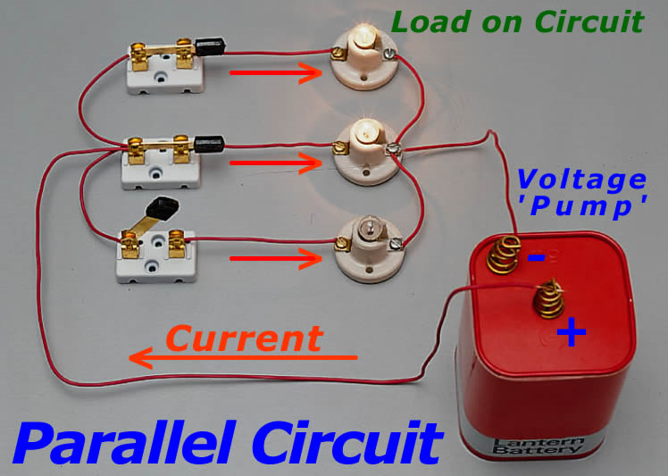
PARALLEL CIRCUIT
Household circuits – Wired in parallel, with a standard of 120 volts.
Voltmeters are wired in parallel.

Slide 14
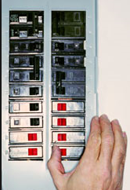
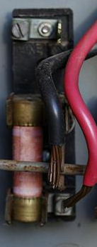
HOUSEHOLD CIRCUITS
Many appliances draw electricity from the same circuit.
If the wires get too hot due to too much electricity, a fuse can blow or circuit breaker can flip.
Circuit Breaker – a piece of metal bends when it gets hot and “flips” the breaker to the off position.
Fuse - a piece of metal melts when it gets hot and causes a break in the circuit.

Slide 15
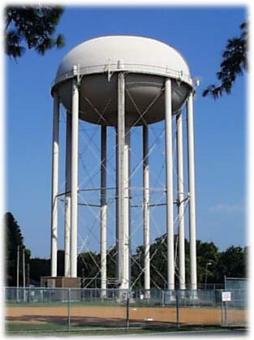
PARALLEL CIRCUIT
The more paths, the LESS the resistance.
  Water example: adding pipes coming from a large tank will allow more water to flow out that a single pipe.
  Therefore, as resistance decreases, current increases; they are inversely proportional.

Slide 16
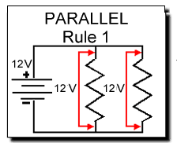
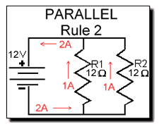
PARALLEL CIRCUIT
RULES
Voltage is the same across each component of the parallel circuit.
The sum of the currents through each path is equal to the total current that flows from the source.

Slide 17
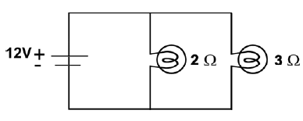
What is the voltage across each resistor?
What is the current in each branch?
c. What is the total current provided by the battery?
12V
12V/2Ω = 6 A
12V/3Ω = 4 A
6 A + 4 A = 10 A

Slide 18
CIRCUITS
Series and Parallel Review
Question: What is the major difference between a series circuit and a parallel circuit – in your own words – put in your notes.

Slide 19
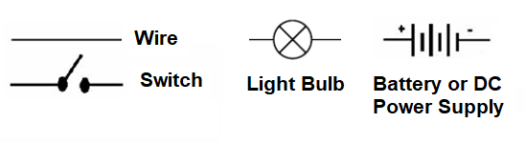
SCHEMATIC DIAGRAMS
All circuit drawings need at least the following:
  Power supply, wire, resistors, switches, other items include connectors, meters, etc.
There is a set of standard symbols used to represent these items in a diagram of the circuit.

Slide 20
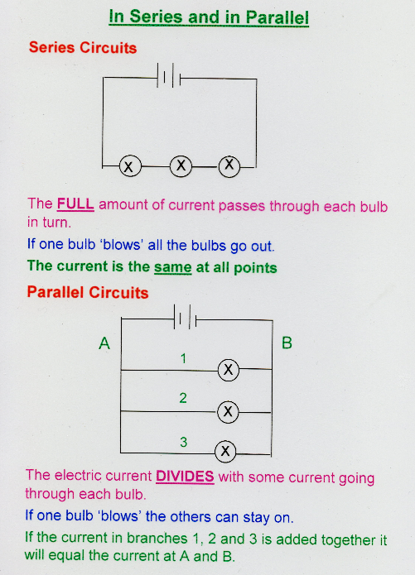
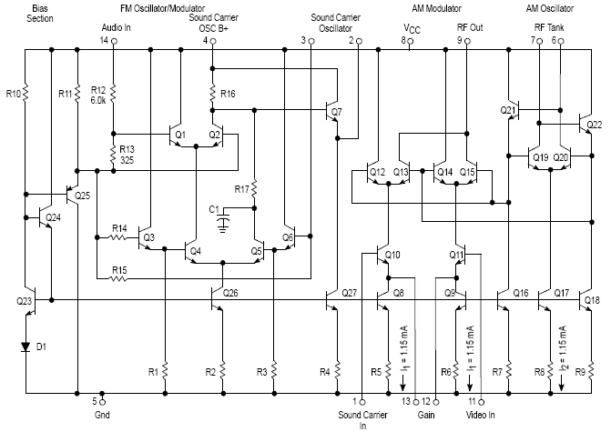
SCHEMATIC DIAGRAMS

Slide 21
SCHEMATIC DIAGRAMS
Draw a series circuit. Include a power source, wires, several resistors (light bulbs) and a switch.

Slide 22
SCHEMATIC DIAGRAMS
Draw a parallel circuit. Include a power source, wires, several resistors (light bulbs) and a switch.

Slide 23
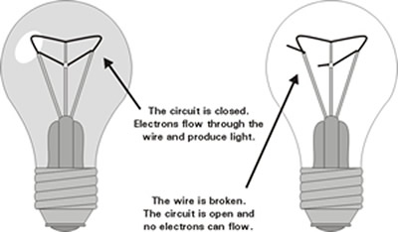
LIGHT BULB
Electricity flows through the circuit. If the bulb is broken, so is the circuit.

Slide 24
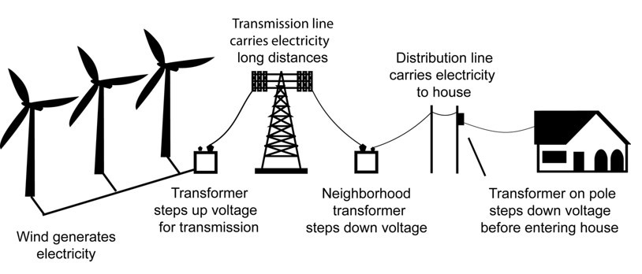
TRANSPORTING ELECTRICITY
A transformer is a device that increases of decreases alternating current generated by a power plant so it can enter homes safely.

Slide 25
VOCABULARY
Lightning Rod - a metal rod or metallic object mounted on top of an elevated structure, such as a building, a ship, or even a tree, electrically bonded using a wire to interface with the through an electrode, engineered to protect the structure in the event of lightning strike.

Slide 26
ELECTRICAL POWER
The rate at which electrical energy is transferred by an electric circuit.
Use Joule’s Law: Power = current x voltage.
Unit: watt, W
A kilowatt hour is what the power company uses to determine how much electricity or energy you used.
Energy used = Power (kW) x Time (hours).
E= P x t
To find cost, you would multiply the energy by the amount per kilowatt hour.

Slide 27
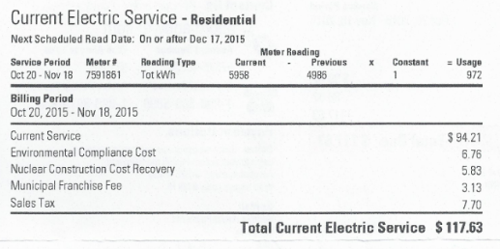
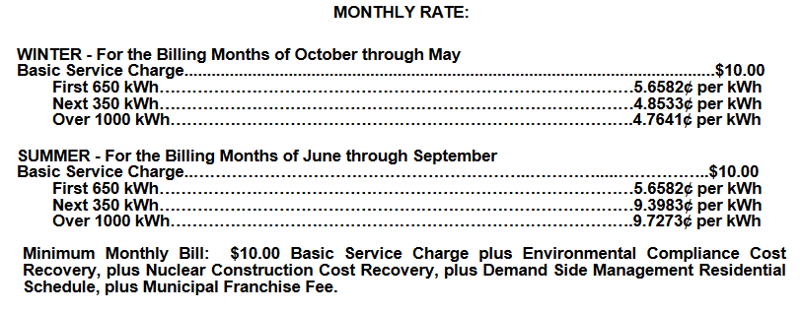
ELECTRICAL POWER

Slide 28
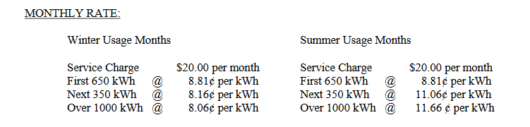
ELECTRICAL POWER
Jackson EMC Rates

Slide 29
ELECTRICAL POWER
PRACTICE
105 V are used to power an appliance that needs 15.0 amps. What is the power used?
V = 105V
P = ?
I = 15.0amp
P = I x V
P = I x V
= (15.0amp)(105V)
= 1575 W
= 1.575 kW

Slide 30
ELECTRICAL POWER
PRACTICE
2. How much energy is used when this appliance is used for 30.0 days, 24 hours per day?
E = ?
Time = 30 days x 24 hours/day
= 720hr
P = 1.575kW
E = Power x time
E = P x t
= (1.575kW)(720hr)
= 1134 kW hour

Slide 31
ELECTRICAL POWER
PRACTICE
If the power company charges 8¢/kWh, what is the cost of the energy above.
Cost = Energy x price per kWh
E = 1134kWh
Cost = ?
Price = $0.08/kWh
Cost = E x price
= (1134kWh)($0.08/kWh)
= $90.72

