Slide 1
MAGNETISM
Magnets and Electromagnets

Slide 2
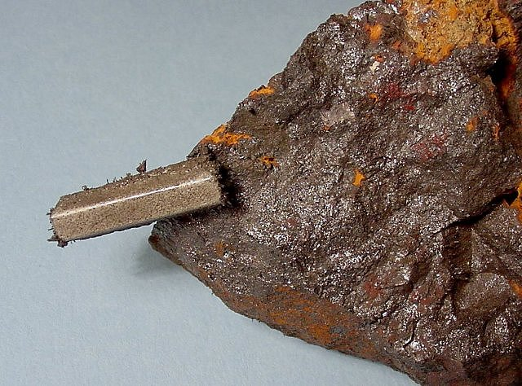
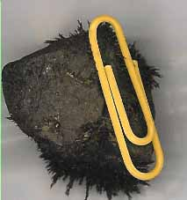
MAGNETS
A special stone was first discovered more than 2000 years ago in Greece, in a region called Magnesia; it attracted iron; they called it magnetite, hence the magnet name.
About 1000 years ago they noticed that a hanging magnet always pointed to the North Star or Lodestar. So another name for naturally occurring magnets is lodestone.

Slide 3
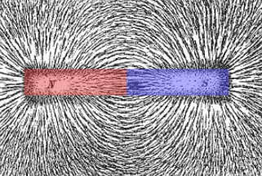
MAGNETISM
Magnetism is the force of attraction or repulsion due to electron motion.

Slide 4
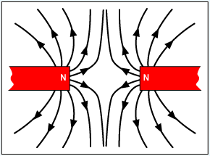
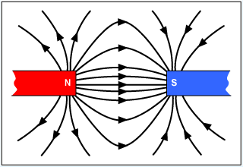
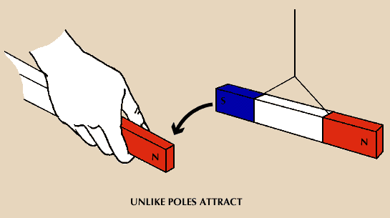
MAGNETISM
Magnetic Poles – the ends of the magnet, area where the magnetic effect is the strongest.
If a bar magnet is suspended by a thread or string, it will align itself so that one strong end points north and the other points south, hence the names for the “North” and “South” poles of the magnet.

Slide 5
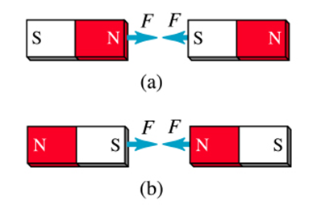
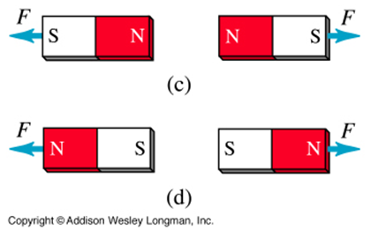
MAGNETISM
Like poles of separate magnets repel – push away from – each other
Unlike poles attract each other.

Slide 6
MAGNETISM
The moving electron acts as a mini electrical charge and therefore has a magnetic field associated with it.
Groups of atoms with magnetic poles aligned are called magnetic domains.
Materials with most of the domains lined up are considered magnetized.
The more domains that are aligned, the stronger the magnetic field in the material.

Slide 7
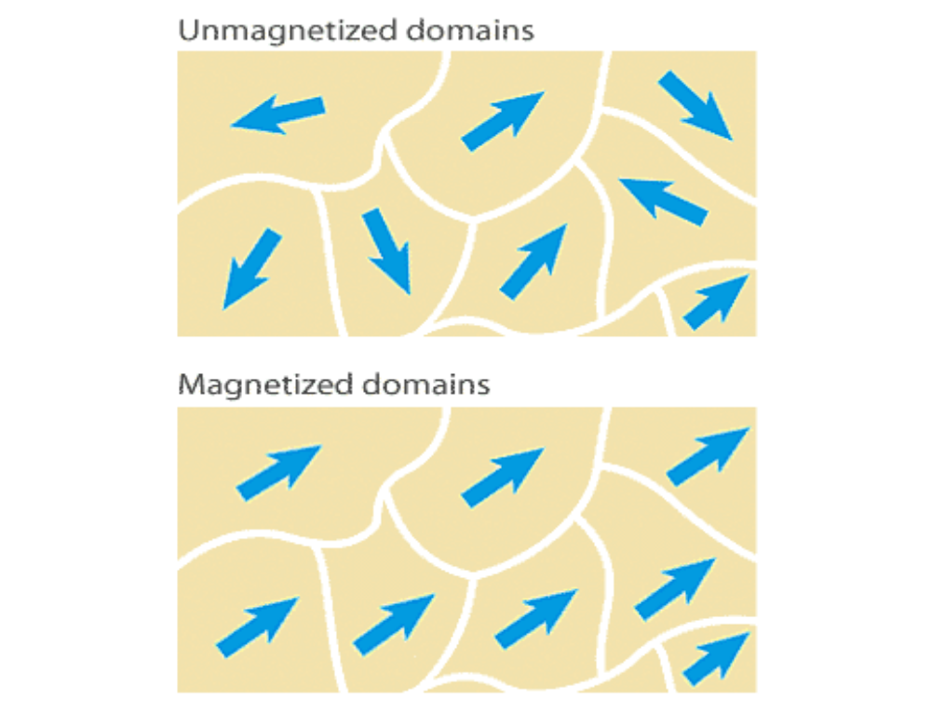
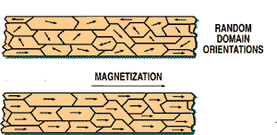
MAGNETISM

Slide 8
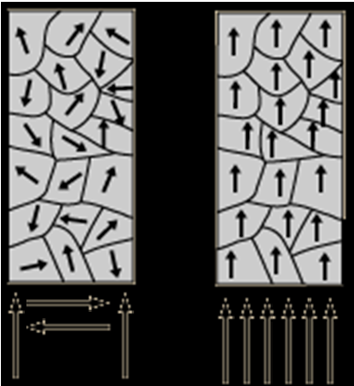
MAGNETISM
When domains are randomly arranged, their forces cancel each other out and there is no net magnetic effect.
When domains have their magnetic effect in alignment, their forces are additive and create a strong magnetic effect.

Slide 9
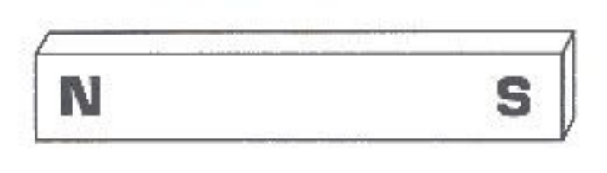
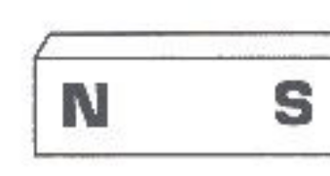
MAGNETS
If you snap a magnet in half, the inside pieces become the opposite poles:

Slide 10
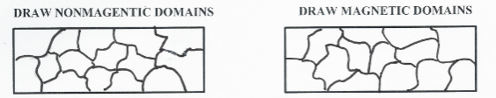
DRAW THE DOMAINS

Slide 11
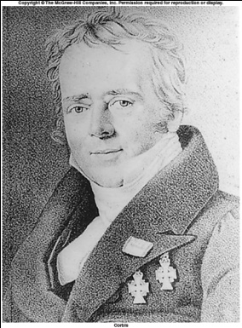
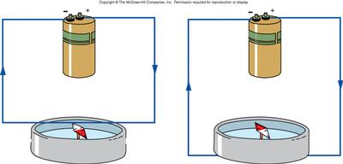
MAGNETISM AND ELECTRICITY
A connection between electricity and magnetism was discovered (accidentally) over 100 years ago.
Hans Christian Oersted discovered in 1820 that an electric current near a compass causes the compass needle to be deflected.
Oersted's experiment showed that every electric current has a magnetic field surrounding it.
A magnetic field causes a magnet to align in the direction of the opposite pole.
Hans Christian Oersted
(1777-1851)

Slide 12
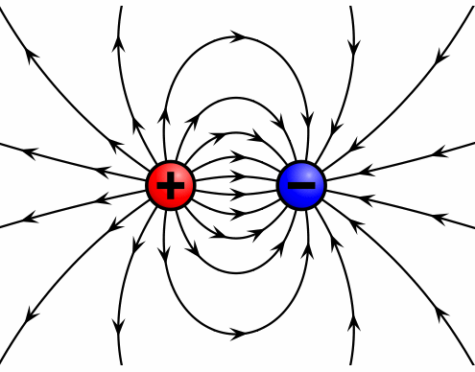
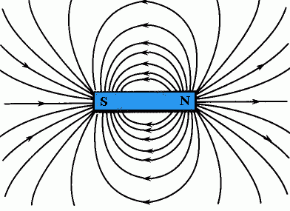
MAGNETISM AND ELECTRICITY
See how a magnetic field compares to an electric field.
ELECTRIC FIELD MAGNETIC FIELD

Slide 13
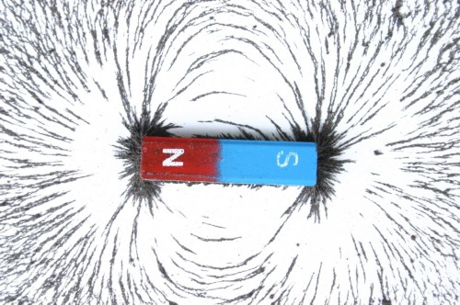
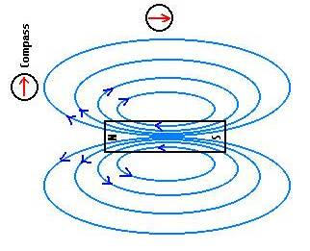
MAGNETIC FIELD
Field lines were introduced by Michael Faraday , who named them “lines of force’’. All magnetic fields originate from moving electric charges.
A magnetic field is the magnetic effect of electric currents and magnetic materials. A magnetic field appears only when relative motion is present between an electric charge and an observer. Electric and magnetic fields are different aspects of a single electromagnetic field.

Slide 14
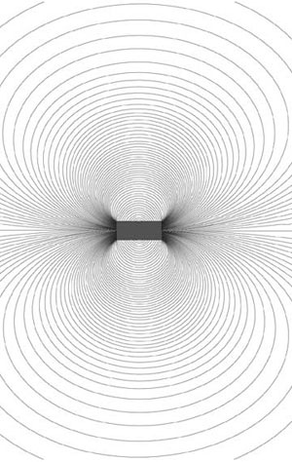
MAGNETIC FIELD
A magnetic field is that region around a magnet that is affected by the magnet.
Strongest at the poles, the Force forms lines that go out of the North Pole and wrap back around to enter in at the South Pole.

Slide 15
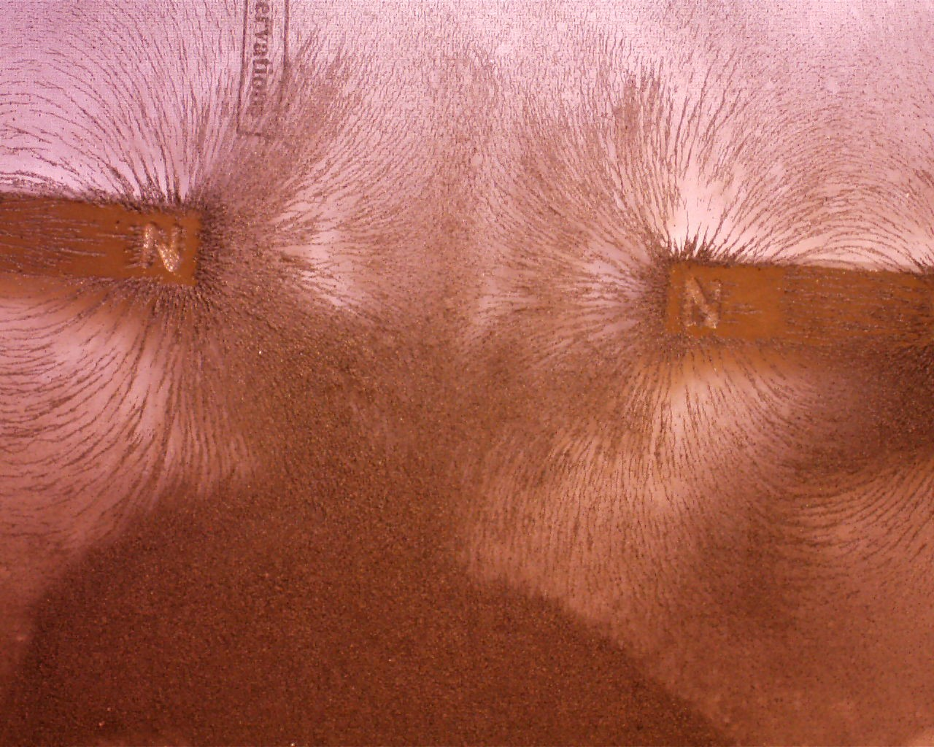

Slide 16
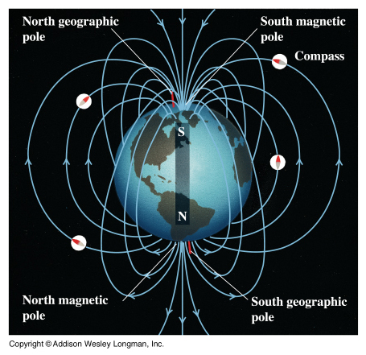
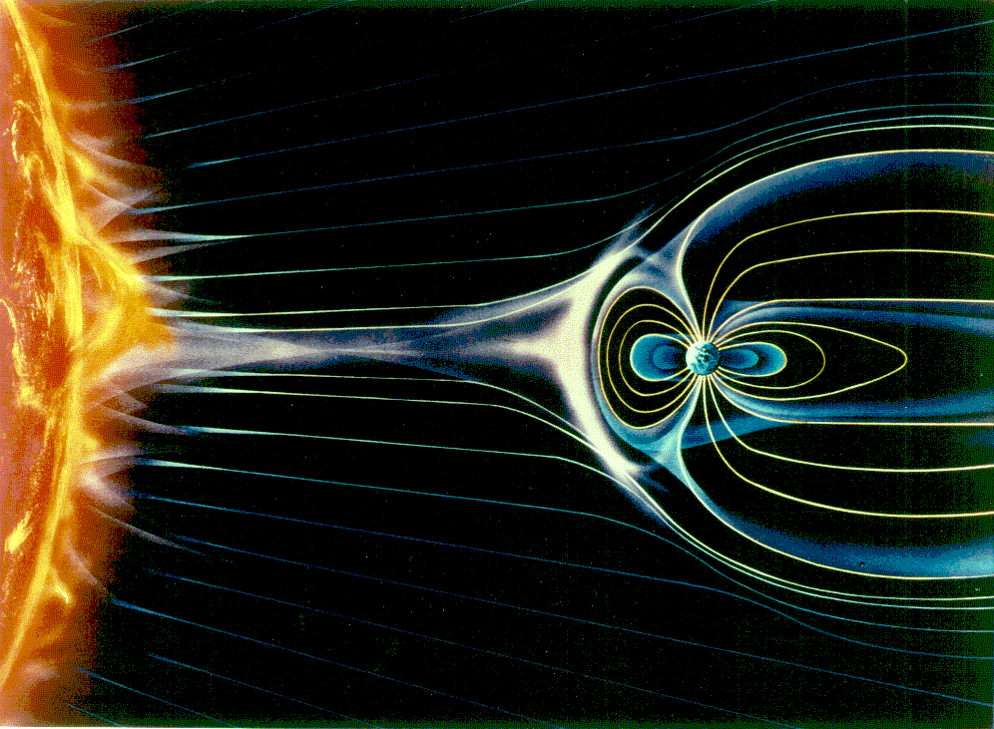
THE GIANT MAGNET
The Earth’s core is iron, so Earth is a giant magnet.

Slide 17
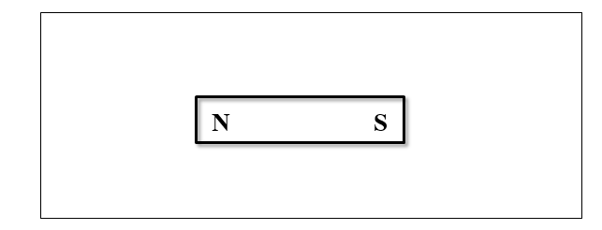
DRAW THE MAGNETIC FIELD LINES

