Slide 1
MAGNETISM
ELECTROMAGNETISM

Slide 2
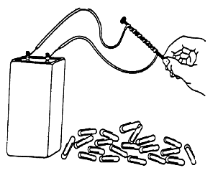
ELECTROMAGNETISM
An electromagnet consists of an iron core placed inside a wire coil.
The magnetic field strength of a wire coil carrying an electric current increases in direct proportion to the number of turns of the coil.
Electric current gives rise to magnetic fields, just as electric charge gave rise to electric fields.

Slide 3
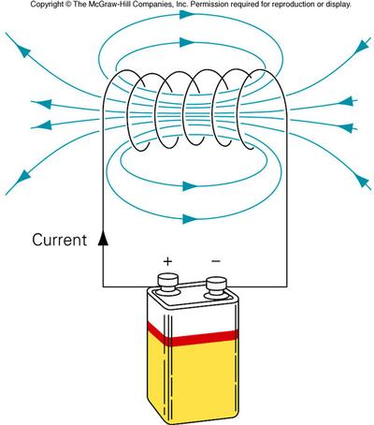
ELECTROMAGNETISM
ELECTROMAGNET
The basic idea behind an electromagnet is extremely simple: By running electric current through a wire, you can create a magnetic field.
Electricity through the coiled wire creates a magnetic field which induces magnetism in the iron core. The domains in the core become aligned with the magnetic field of the coil.

Slide 4
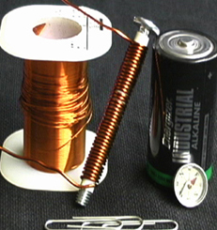
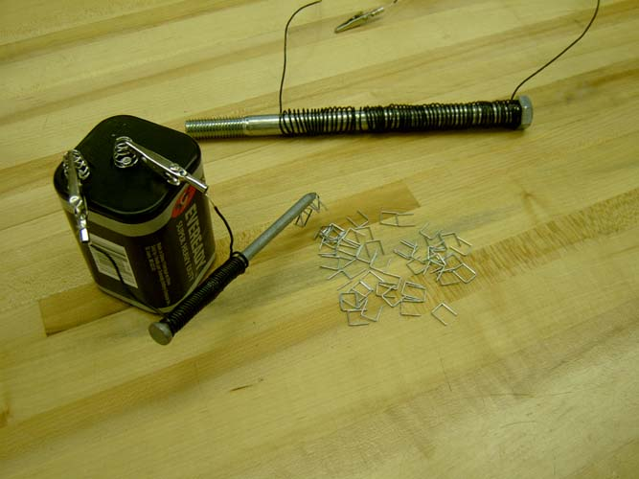
ELECTROMAGNETISM

Slide 5
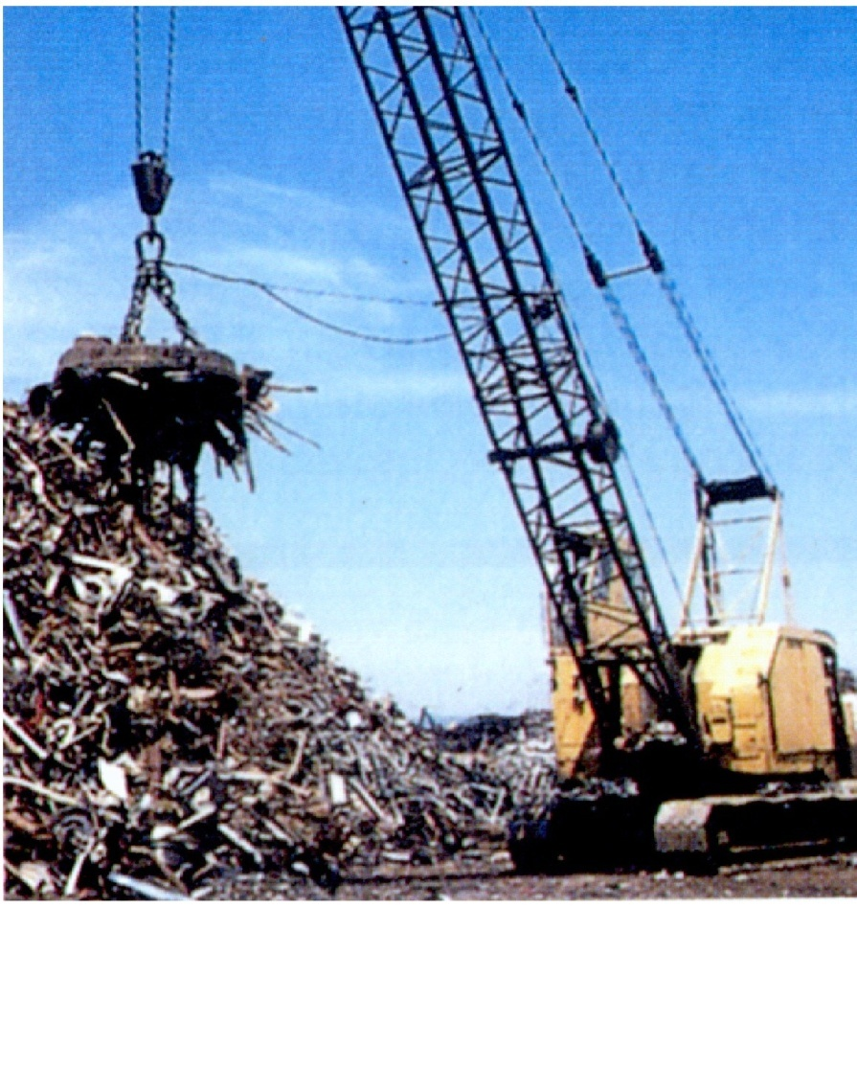
ELECTROMAGNETISM
An electromagnet can be used to move large quantities of metal.
When the current is on, the magnet will pick up the metal.
When you want to drop it, you turn off the power and the electromagnet is disabled and the metal drops.
ANIMATION

Slide 6
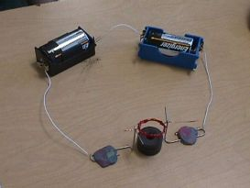
ELECTROMAGNETISM
ELECTRIC MOTOR
A rotating electromagnet is used in an electric motor to convert electrical energy to mechanical energy.

Slide 7
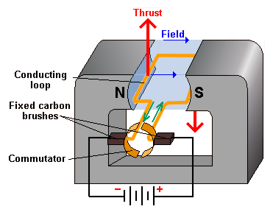
ELECTRIC MOTOR
Electric motors convert electrical energy to mechanical energy.
An electromagnet turns inside of a permanent magnet.
Electromagnet

Slide 8
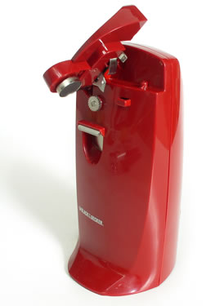
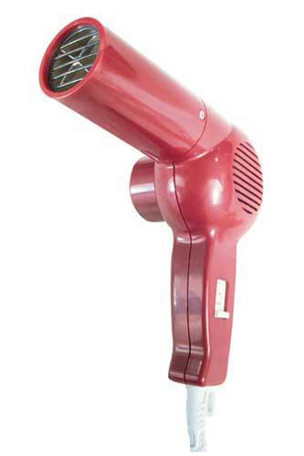
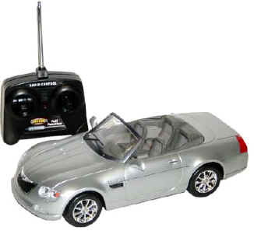
ELECTRIC MOTOR
By changing the direction of the current, the poles will keep switching between N and S, and therefore cause the electromagnet to continually rotate.
Electric motors are used in most household appliances which convert electricity into motion.

Slide 9
ELECTROMAGNETIC INDUCTION
ELECTROMAGNETIC INDUCTION
When a magnet is moved near a wire, an electric current can be created.
This process is called electromagnetic induction.
The direction of the induced current can be reversed by reversing the motion of the wire or reversing the field direction.
The strength of the current depends on the strength of the magnetic field and the speed of the wire's motion.
This is the basis for electric generators.

Slide 10
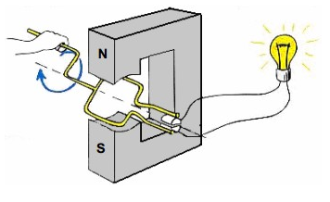
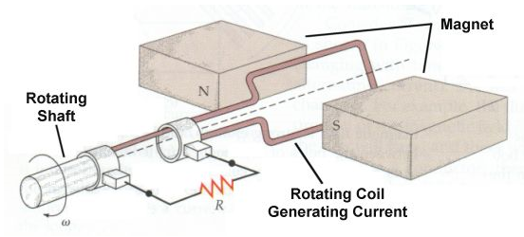
ELECTRIC GENERATOR
ELECTRIC GENERATOR
Electromagnetic induction is used in the operation of a generator, a device that converts mechanical energy to electrical energy.
In a generator, an electric current is produced when a coil of wire is mechanically rotated in a magnetic field.

Slide 11
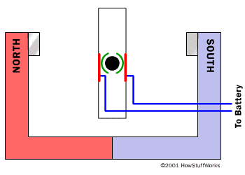
ELECTRIC GENERATOR VS ELECTRIC MOTOR
Electric Generator Electric Motor
Animation
mechanical to electrical electrical to mechanical.

Slide 12
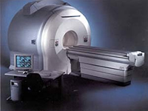
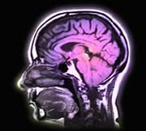
USES OF ELECTROMAGNETISM
MRI
The use of magnetic waves to make pictures of the inside of the body.
Using a large magnet, radio waves, and a computer, a Magnetic Resonance Image, or MRI, produces two-dimensional and three-dimensional pictures.

Slide 13
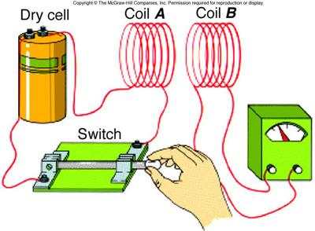
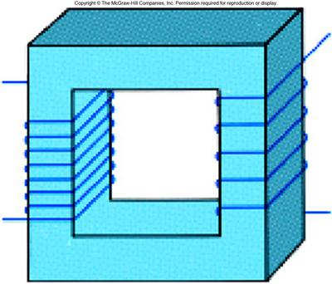
USES OF ELECTROMAGNETISM
TRANSFORMER
A transformer is a device composed of two unconnected coils, usually wrapped around a soft iron core, that can increase or decrease the voltage of AC current.

Slide 14
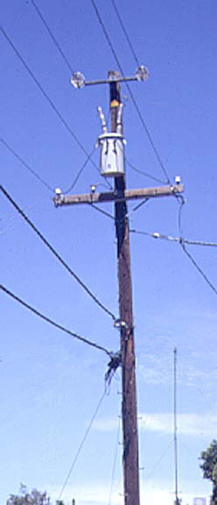
USES OF ELECTROMAGNETISM
A transformer is used to step the voltage down and the current up (P=IV) so that we can use it.
Low power is desired for the transport of electricity over long distances to avoid loss of energy to heat loss.

Slide 15
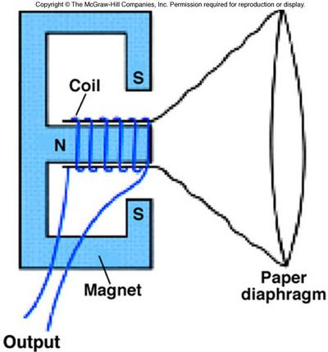
USES OF ELECTROMAGNETISM
MICROPHONE
A moving coil activated by voice vibrations is used as a microphone.
The coil induces a current in the magnet that can be amplified or recorded.

Slide 16
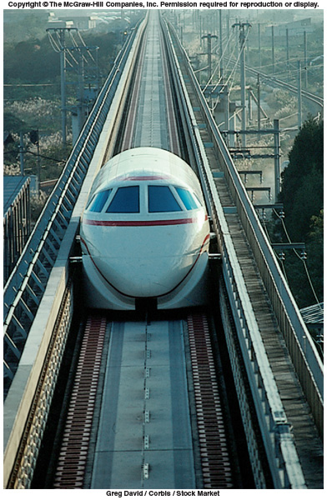
USES OF ELECTROMAGNETISM
MAGLEV TRAIN
The experimental Japanese Maglev train uses magnetic forces for both support and propulsion.
It is a magnetic levitation (maglev) railway system based on the principle of magnetic repulsion between the track and the cars.
In April 2015, a manned seven-car Maglev train reached a speed of 603 km/h (375 mph).

Slide 17
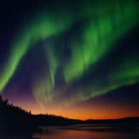
USES OF ELECTROMAGNETISM
AURORA
An Aurora is an electric discharge through the atmosphere connected with magnetic disturbance.
Most aurora are green and red emission from atomic oxygen.
Molecular nitrogen and nitrogen ions produce some low level red and very high blue/violet aurora.
Northern Hemisphere: Aurora Borealis
Southern Hemisphere: Aurora Australis

Slide 18
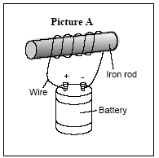
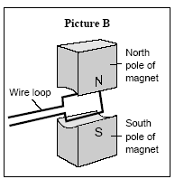
EOC PRACTICE
1. Which of these correctly identifies both devices illustrated?
Picture A: electric generator; Picture B:electromagnet
Picture A: electromagnet; Picture B: electric motor
Picture A: electric motor; Picture B: electromagnet
Picture A: electric generator; Picture B: electric motor

Slide 19
EOC PRACTICE
2. A magnetic field can be found in which of the following?
electric motor
sound wave
plastic cord
glass rod

