Slide 1
REVIEW
ELECTRICITY AND MAGNETISM

Slide 2
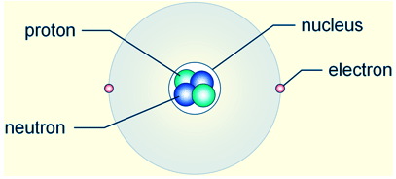
REVIEW
Know what subatomic particles have charge.

Slide 3
REVIEW
Describe the properties of static electricity.
Static electricity is the temporary building up of charge on an object.
Protons DON’T move.
Only electrons move.
In static electricity, the charges build up and stay – they do not flow.

Slide 4
REVIEW
Know how to charge something with static electricity using friction, induction, and conduction.
Charging by Friction
    The charge is transferred because of rubbing two objects together. Example: shoes on a carpet
Charging by Induction
  Involves the charging of one object by another object WITHOUT direct contact. Example: balloon and rice cereal/electroscope
Charging by Conduction
  Involves the DIRECT CONTACT of a charged object to a neutral object. Example: Van de Graaf generator

Slide 5
REVIEW
Distinguish between conductors and insulators.
Insulators – resists the flow of electrons
  hold more tightly to their valence electrons.
  Examples: plastic, rubber, glass
Conductors - Allow the easy flow of electricity
  loosely bound electrons that are free to move from atom to atom
  Examples: metals like aluminum, gold, copper and silver .

Slide 6
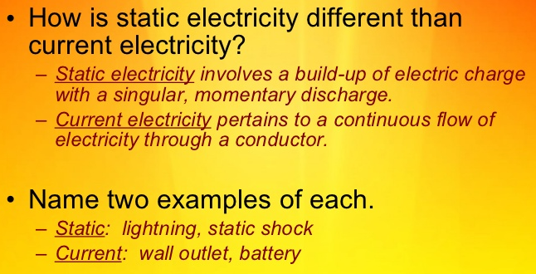
REVIEW
5. Describe how electric current is different from static electricity.

Slide 7
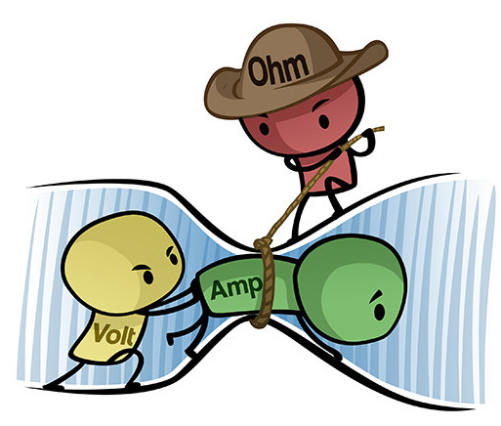
REVIEW
6. Describe current, resistance, and voltage and know their relationships to each other.
Voltage = current x resistance
V = IR

Slide 8
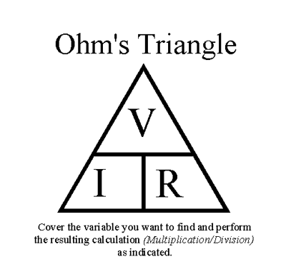
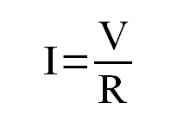
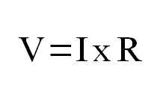
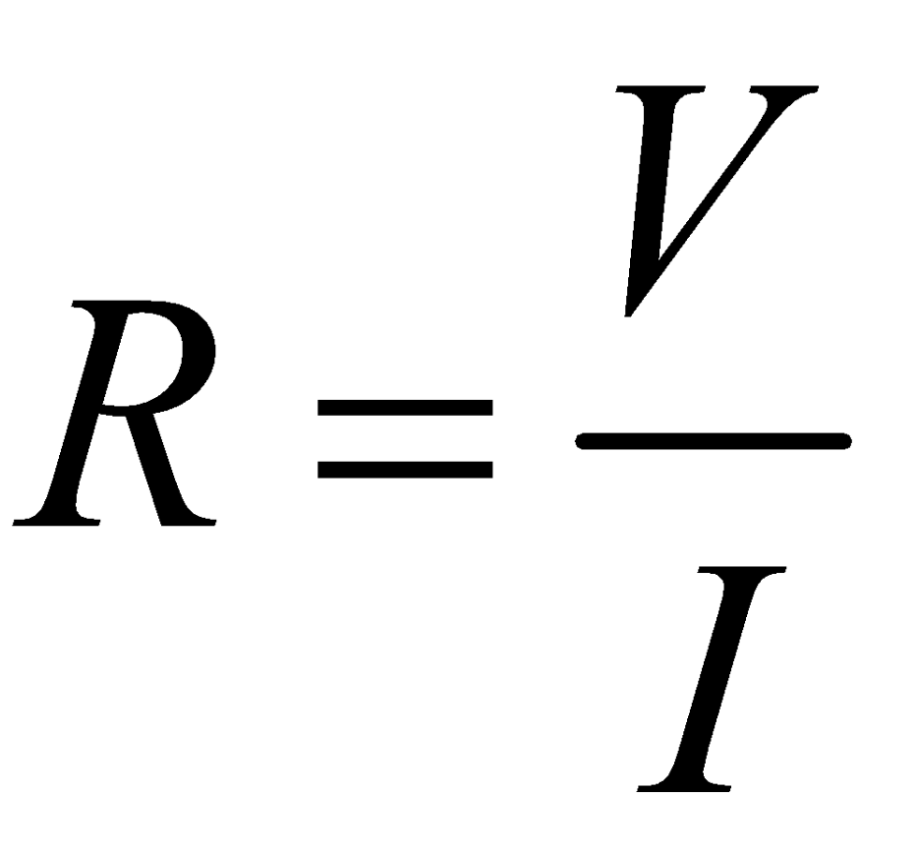
REVIEW
OHM’S LAW
In a material, the current (I) is directly proportional to the voltage (V) and inversely proportional to the resistance.
OR OR

Slide 9
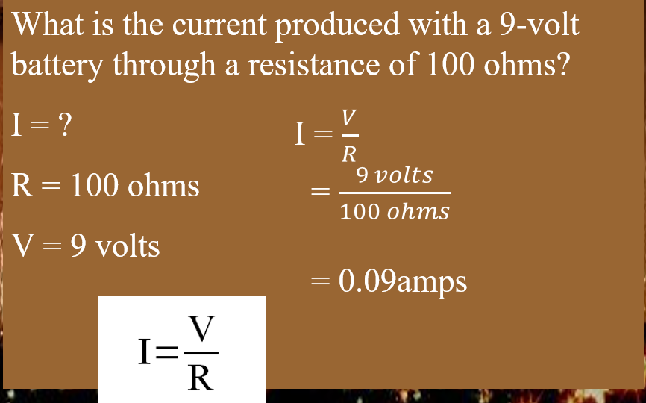
REVIEW

Slide 10
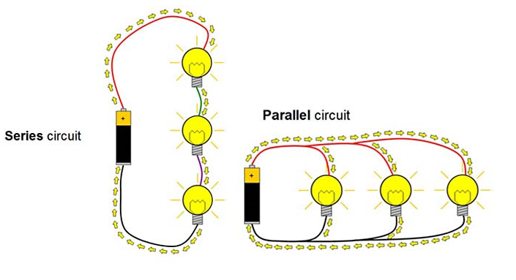
REVIEW
7. Compare and contrast series and parallel circuits.
Remember the flow of electrons is from positive to negative!

Slide 11
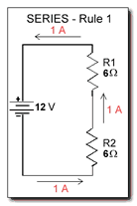
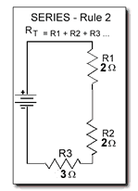
SERIES CIRCUIT
RULES
The same current flows through each part of a series circuit.
The total resistance of a series circuit is equal to the sum of individual resistances.

Slide 12
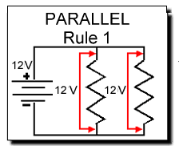
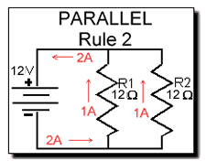
PARALLEL CIRCUIT
RULES
Voltage is the same across each component of the parallel circuit.
The sum of the currents through each path is equal to the total current that flows from the source.

Slide 13
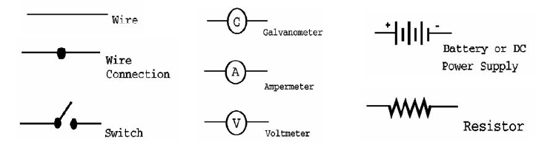
SCHEMATIC DIAGRAMS
All circuit drawings need at least the following:
  Power supply, wire, resistors, switches, other items include connectors, meters, etc.
There is a set of standard symbols used to represent these items in a diagram of the circuit.

Slide 14
REVIEW
8. Explain and calculate electrical power.
Electric Power = The rate at which electrical energy is transferred by an electric circuit;
Electric Power = current x voltage; in watts, W
Energy used = Power (kilowatt) x Time (hour); E= P x t

Slide 15
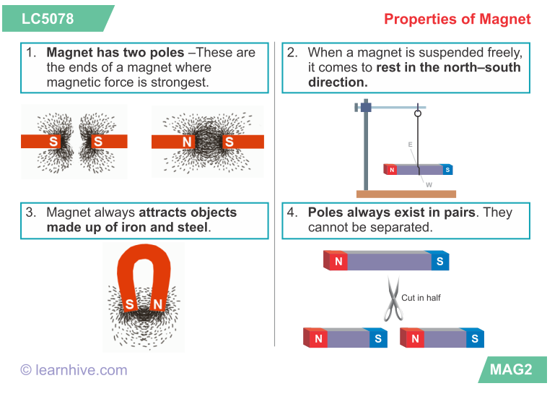
REVIEW
9. Describe the properties of a magnet.

Slide 16
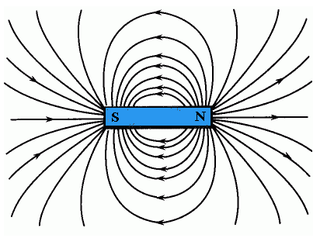
REVIEW
The force is exerted over a distance and includes forces of attraction and repulsion. North and south poles of two magnets attract each other, while two north poles or two south poles repel each other.
A magnet can exert force over a distance because the magnet is surrounded by a magnetic field.
10. Explain how a magnet exerts a force on an object.

Slide 17
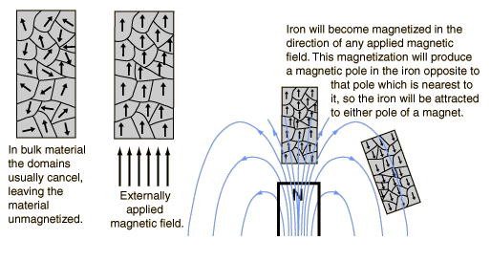
REVIEW
11. Explain why some materials are magnetic and others are not – be sure to mention magnetic domains.

Slide 18
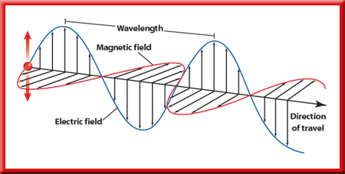
REVIEW
12. Understand the relationship between electric current and magnetism.
- every electric current has a magnetic field surrounding it.
Electric and magnetic fields are different aspects of a single electromagnetic field.
Current gives rise to magnetic fields, just as electric charge gave rise to electric fields.

Slide 19
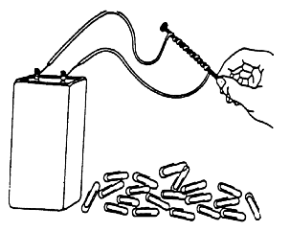
REVIEW
Explain how electromagnets are constructed and describe how they are used.
An electromagnet consists of an iron core placed inside a wire coil.
The magnetic field strength of a wire coil carrying an electric current increases in direct proportion to the number of turns of the coil.

Slide 20
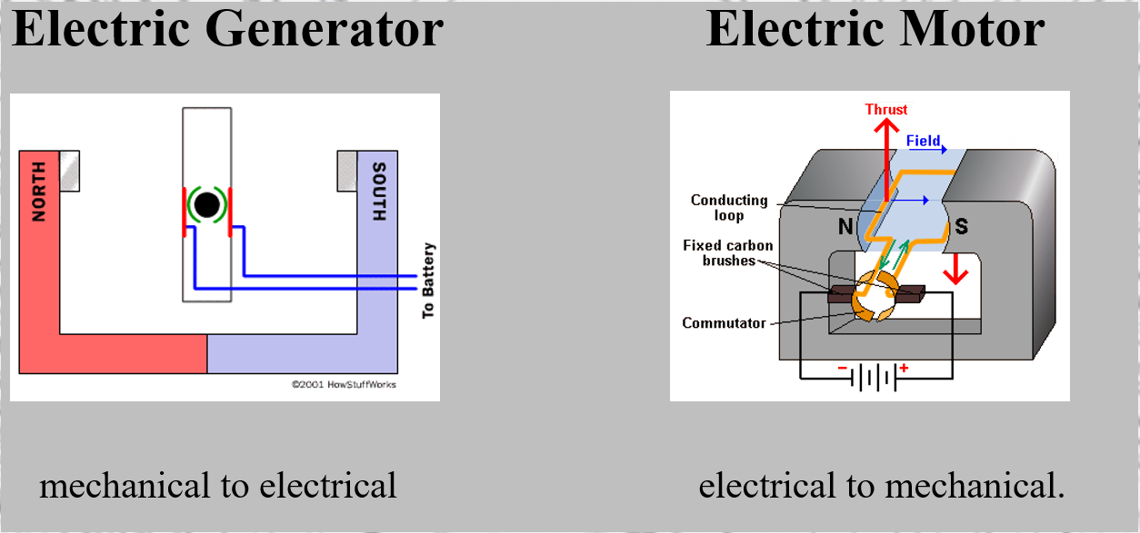
REVIEW
14. Compare and contrast an electric motor and an electric generator.

Slide 21
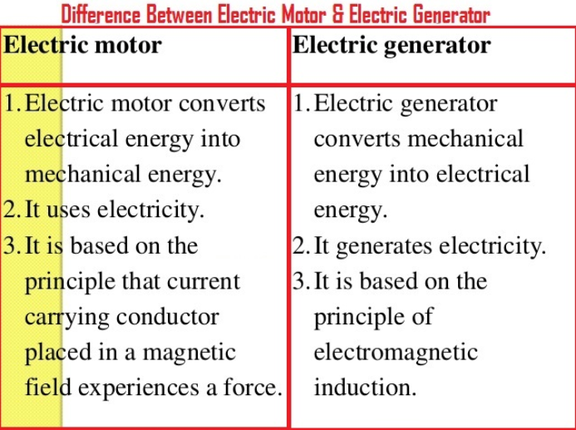
REVIEW
14. Compare and contrast an electric motor and an electric generator.

Slide 22


REVIEW
15. Distinguish between alternating and direct current; know what produces each.
Alternating current – AC – switches back and forth regularly.
Direct current – DC – always goes in one direction.

Slide 23
REVIEW
16. Know the thirty vocabulary words.

