Slide 1
ATOMIC THEORY AND
THE PERIODIC TABLE
SPS1. Obtain, evaluate, and communicate information from the Periodic Table to explain the relative properties of elements based on patterns of atomic structure.
a. Develop and use models to compare and contrast the structure of atoms, ions and isotopes. (Clarification statement: Properties include atomic number, atomic mass and the location and charge of subatomic particles.)
b. Analyze and interpret data to determine trends of the following: Number of valence electrons, Types of ions formed by main group elements, Location and properties of metals, nonmetals, and metalloids, Phases at room temperature
c. Use the Periodic Table as a model to predict the above properties of main group elements.

Slide 2
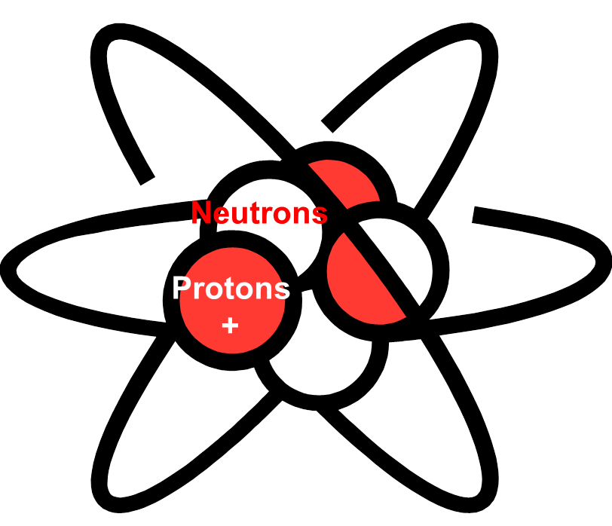
STRUCTURE OF THE ATOM
All matter is made up of atoms.
Subatomic Particle | Charge | Location | Size
Proton (p⁺) | 1+ | Nucleus | Equal to size of neutron
Neutron (n) | 0 | Nucleus | Equal to size of proton
Electron (e⁻) | 1- | Outside nucleus | Smallest subatomic particle

Slide 3

STRUCTURE OF THE ATOM
Protons (+) equals Electrons (-)
Electrons (- charge) and protons (+ charge) to make the atom electrically neutral.
Protons(+)
Electrons (-)

Slide 4
STRUCTURE OF THE ATOM
The atomic number of an element is what distinguishes it from all other elements.
The atomic number is the number of protons there are in the nucleus.
Hydrogen's atomic number is 1.
Helium's atomic number is 2.
Atomic Number
1
H
Hydrogen
1.0079
Atomic Number
2
He
Helium
4.0026

Slide 5
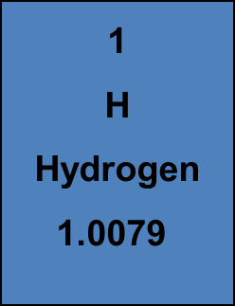
STRUCTURE OF THE ATOM
The atomic mass is the larger number on the periodic table.
It is the average of the masses of the isotopes of that element.
2
He
Helium
4.0026
Atomic Mass
Atomic Mass

Slide 6
STRUCTURE OF THE ATOM
The mass number is the number of neutrons added to the number of protons.
In other words, the total number of particles in the nucleus.
2
He
Helium
4.0026
Take atomic mass and round to a whole number
1 4

Slide 7
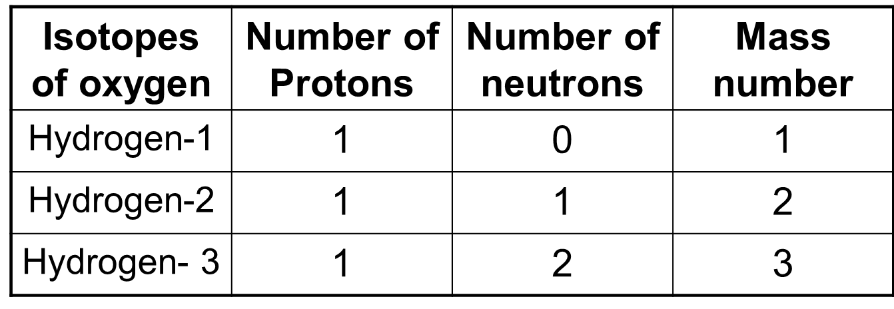
STRUCTURE OF THE ATOM
Isotopes are atoms of the same element that have different numbers of neutrons and different mass numbers.
To distinguish one isotope from another, the isotopes are referred by their mass numbers.
hydrogen

Slide 8
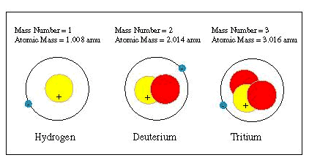
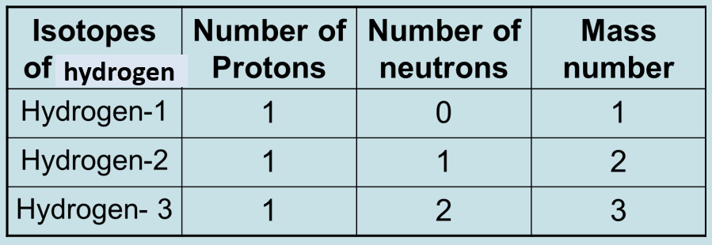
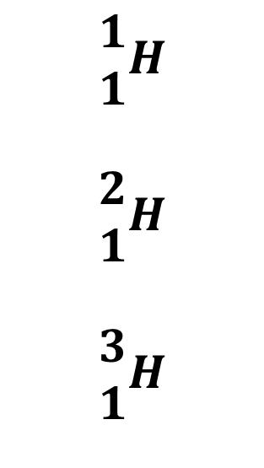
$$\begin{matrix}1 \\ 1\end{matrix}H$$
$$\begin{matrix}2 \\ 1\end{matrix}H$$
$$\begin{matrix}3 \\ 1\end{matrix}H$$

Slide 9
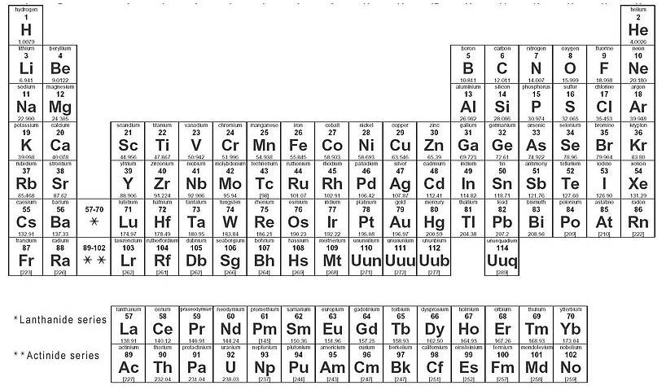
PERIODIC TABLE
The Periodic Table is organized into
  Rows (periods)
  Columns (groups)

Slide 10
PERIODIC TABLE
Horizontally into Periods- Total of 7
Each row in the table of elements is a period.
  Elements in period 1 have one energy level.
  Elements in period 2 have two energy levels.
  Elements in period 3 have three energy levels.
  Elements in period 4 have four energy levels.
  Elements in period 5 have five energy levels.
  Elements in period 6 have six energy levels.
  Elements in period 7 have seven energy levels.
Horizontally Into Periods

Slide 11
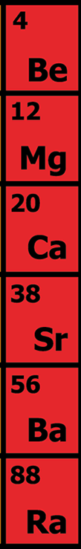
PERIODIC TABLE
There are 18 GROUPS
Vertically into Groups
Groups
Each column in the periodic table is called a group.
  The elements in a group have the same number of valence electrons.
  Therefore members of a group in the periodic table have similar chemical properties.

Slide 12
PERIODIC TABLE
Vertically into Groups
Elements in group 1 have one valence electron.
Elements in group 2 have two valence electrons.
Elements in group 13 have three valence electrons.
Elements in group 14 have four valence electrons.
Elements in group 15 have five valence electrons.
Elements in group 16 have six valence electrons.
Elements in group 17 have seven valence electrons.
Elements in group 18 have eight valence electrons; except Helium (2).

Slide 13

ELECTRON DOT DIAGRAMS
Each ‘side’ of the symbol represents an orbital. Draw the dots on the appropriate sides to represent the electrons in that orbital.
Dots correspond to the number of valence electrons.

Slide 14
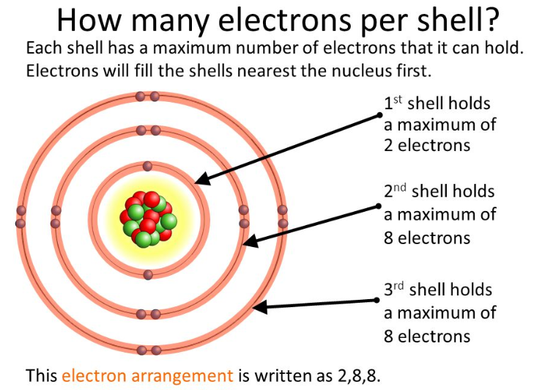
PERIODIC TABLE
Each horizontal row is also the electron shell.

Slide 15
PERIODIC TABLE
Elements in group 1 form a 1+ ion
Elements in group 2 form a 2+ ion
Elements in group 13 form 3+ ion
Elements in group 14 form a 4+ or 4- ion
Elements in group 15 form a 3- ion
Elements in group 16 form a 2- ion
Elements in group 17 form a 1- ion
Elements in group 18 form NO ions.

Slide 16


PERIODIC TABLE
Classes of Elements
What categories are used to classify elements on the periodic table?
Elements are classified as metals, nonmetals, and metalloids.

Slide 17
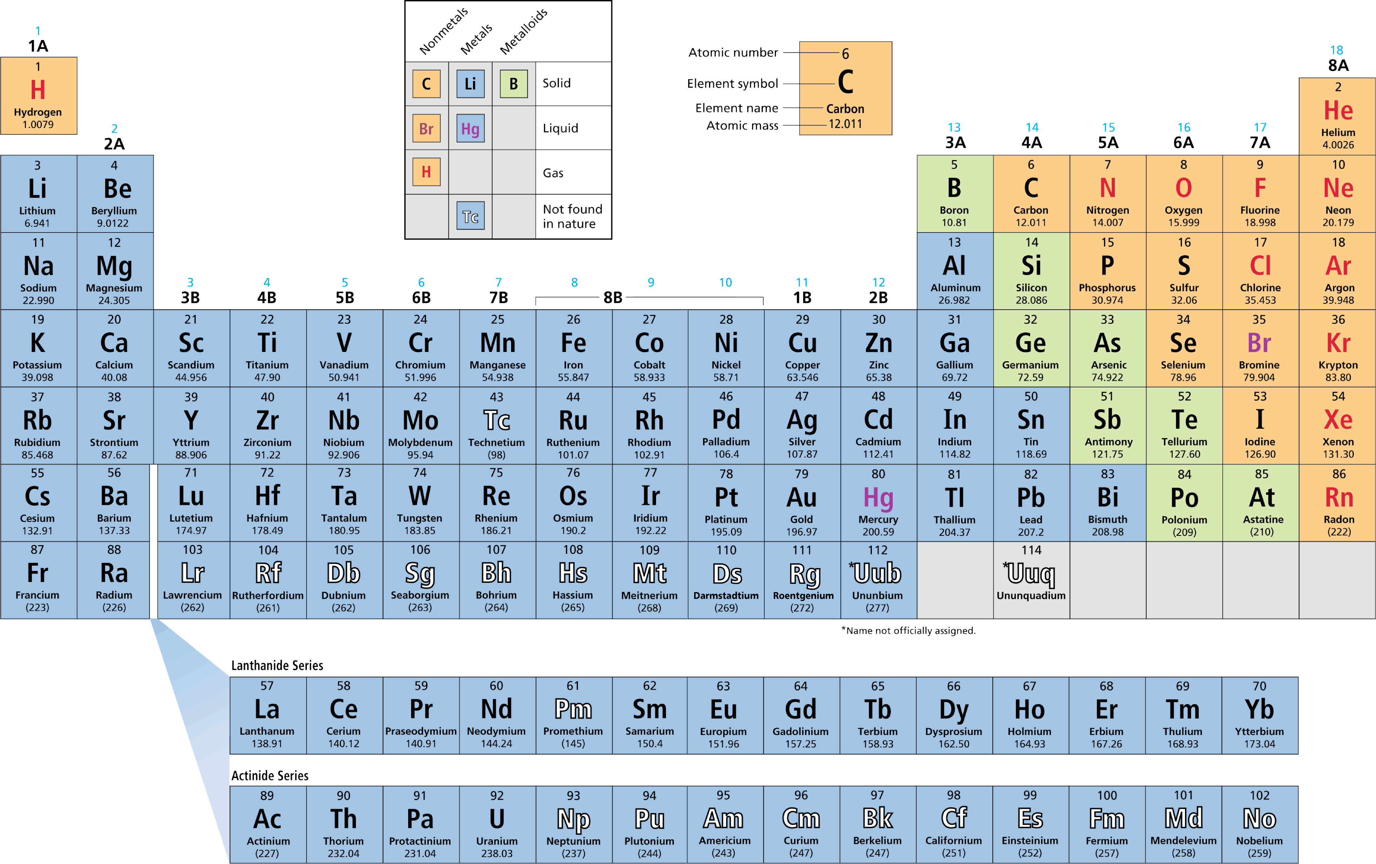
PERIODIC TABLE

Slide 18
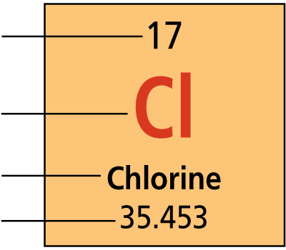
PERIODIC TABLE
There are four pieces of information for each element.
1. Atomic number
2. Element symbol
3. Element name
4. Atomic mass

Slide 19
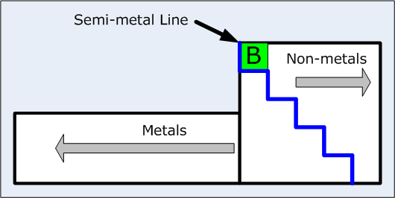
Elements to the left of the blue stair case line are metals.
Elements to the right of the staircase line are nonmetals
Elements along the staircase line are metalloids/semi-conductors.

Slide 20
PERIODIC TABLE
METALS
The majority of the elements on the periodic table are classified as metals. Metals are elements that are good conductors of electric current and heat.
  Except for mercury (liquid), metals are solids at room temperature.
  Most metals are malleable.
  Many metals are ductile; that is, they can be drawn into thin wires.

Slide 21
PERIODIC TABLE
The metals in groups 3 through 12 are called transition metals. Transition metals are elements that form a bridge between the elements on the left and right sides of the table.
  Transition elements, such as copper and silver, were among the first elements discovered.
  One property of many transition metals is their ability to form compounds with distinctive colors.

Slide 22
PERIODIC TABLE
Nonmetals
Nonmetals generally have properties opposite to those of metals.
  Nonmetals are elements that are poor conductors of heat and electric current.
  Nonmetals have low boiling points–many nonmetals are gases at room temperature.
  Nonmetals that are solids at room temperature tend to be brittle. If they are hit with a hammer, they shatter or crumble.

Slide 23
PERIODIC TABLE
Metalloids
Metalloid elements are located on the periodic table between metals and nonmetals.
  Metalloids are elements with properties that fall between those of metals and nonmetals.
  For example, a metalloid’s ability to conduct electric current varies with temperature. Silicon (Si) and germanium (Ge) are good insulators at low temperatures and good conductors at high temperatures.

Slide 24
PERIODIC TABLE
Some groups have specific names
  Group 1- alkali metals (most reactive metals)
  Group 2- alkaline earth metals
  Groups 3-12- transition metals
  Group 17- halogens (most reactive nonmetals)
  Group 18- noble gases (unreactive)
Group 1 and Group 17 are the most reactive elements.
Group 18, the noble gases, are unreactive.

