Slide 1
RADIOACTIVITY
SPS4. Obtain, evaluate, and communicate information to explain the changes in nuclear structure as a result of fission, fusion and radioactive decay. (Clarification statement: Limited to calculations that include whole half-lives.)
a. Develop a model that illustrates how the nucleus changes as a result of fission and fusion.
b. Use mathematics and computational thinking to explain the process of half-life as it relates to radioactive decay.
c. Construct arguments based on evidence about the applications, benefits, and problems of nuclear energy as an alternative energy source.

Slide 2
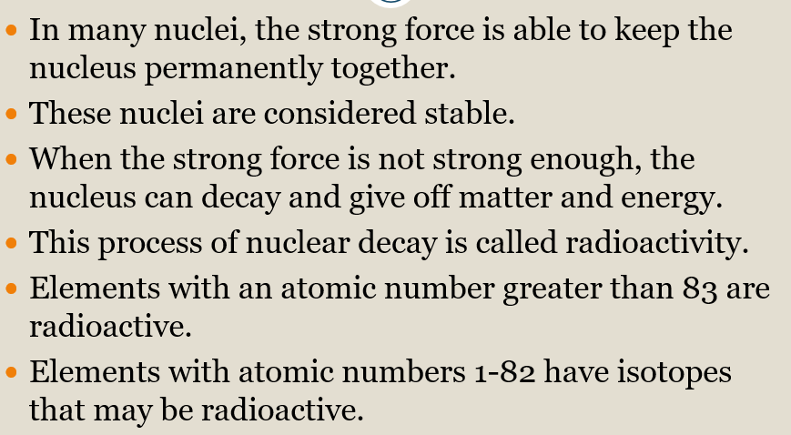
RADIOACTIVITY
Radioactivity is the spontaneous emission of radiation from an element because the strong force cannot hold the nucleus together.

Slide 3
RADIOACTIVITY
 | ALPHA | BETA | GAMMA
Type | Particle | Particle | energy
Charge | Positive | Negative | Neutral
Composition | Two protons and two neutrons | One electron | Pure energy
Mass | 4 amu | 1/1840 amu | none
Symbol | α | β | γ
Stopped by | Paper | Thin metal | Thick lead or concrete
Size | Largest | Smaller | Smallest
New element? | Atomic # drops by two | Atomic # goes up by one | No change

Slide 4
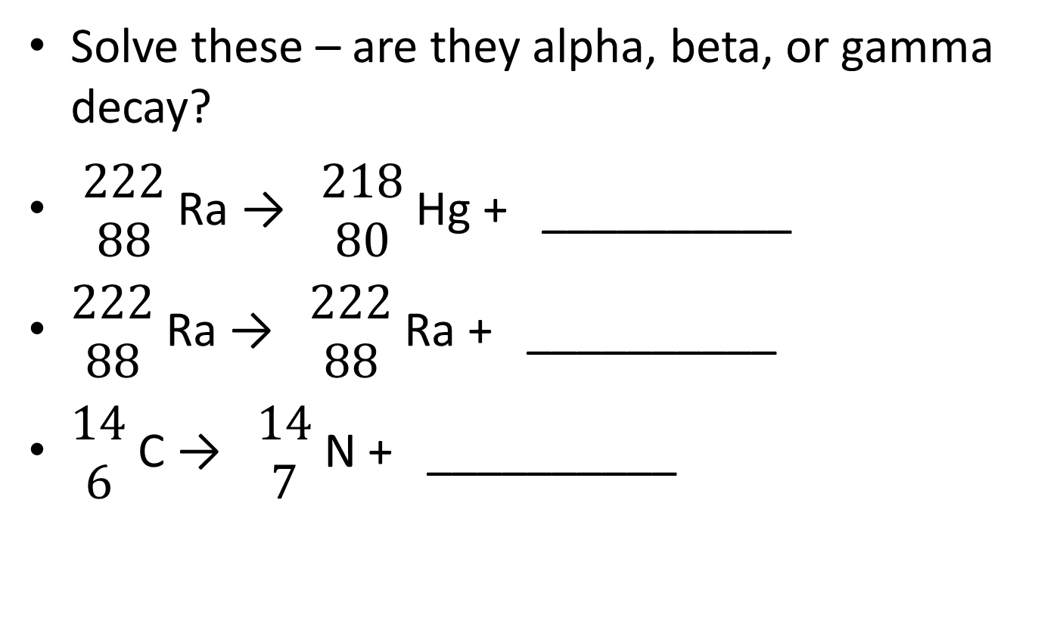
RADIOACTIVITY
Solve these – are they alpha, beta, or gamma decay?
$\begin{matrix}222 \\ 88\end{matrix}$ Ra → $\begin{matrix}218 \\ 80\end{matrix}$ Hg + __________
$\begin{matrix}222 \\ 88\end{matrix}$ Ra → $\begin{matrix}222 \\ 88\end{matrix}$ Ra + __________
$\begin{matrix}14 \\ 6\end{matrix}$ C → $\begin{matrix}14 \\ 7\end{matrix}$ N + __________

Slide 5
RADIOACTIVITY
Unstable nuclei lose energy by emitting matter and energy in a spontaneous (does not require energy) process called radioactive decay.
The atom undergoes radioactive decay until it becomes stable.
Radioactive decay rates are measured in half-lives.
A HALF-LIFE is the time it takes for one half of the radioactive sample to decay.
Different isotopes have different half-lives.

Slide 6
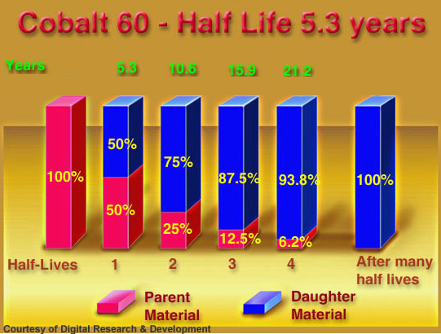
RADIOACTIVITY

Slide 7
RADIOACTIVITY
The half-life of Zn-71 is 2.4 minutes. If one had 100.0 g at the beginning, how many grams would be left after 7.2 minutes has elapsed?

Slide 8
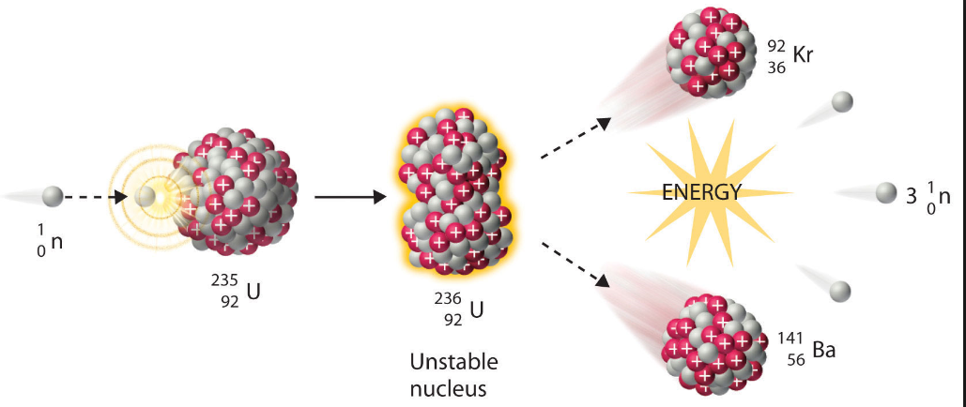
RADIOACTIVITY
NUCLEAR FISSION
Large nucleus splits into two smaller one, releasing energy
A CHAIN REACTION can occur is there are enough nuclei present to be split and the reaction keeps going.

Slide 9
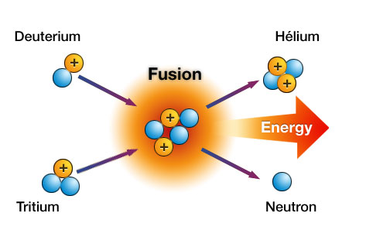
RADIOACTIVITY
NUCLEAR FUSION
Two small nuclei fuse creating one larger nucleus, releasing energy.
In the sun, several hydrogen fuse to form one helium.

Slide 10
RADIOACTIVITY
Fusion fuses atomic nuclei together and Fission splits nuclei apart.
 | FISSION | FUSION
Involves | One nucleus becoming two | Two nuclei becoming one
Energy released | Less | 3-4 times more
Where does it occur | Nuclear power generators, bombs | Sun

Slide 11
RADIOACTIVITY
Advantages and disadvantages of using nuclear energy to produce electricity.
ADVANTAGES | DISADVANTAGES
No fossil fuels | Mining can damage environment
No air pollutants | Produces heat pollution in the water used to cool
Cheap to produce electricity | Expensive to build plants
More energy available | Accidental radiation leaks
 | No place for the waste to go to finish decaying

