Slide 1
BONDING, NOMENCLATURE, AND CHEMICAL REACTIONS
EOC Review

Slide 2
STANDARDS
SPS2. Obtain, evaluate, and communicate information to explain how atoms bond to form stable compounds. (Clarification statement: Properties are limited to types of bonds formed, elemental composition, melting point, boiling point, and conductivity.)
Analyze and interpret data to predict properties of ionic and covalent compounds.
Develop and use models to predict formulas for stable, binary ionic compounds based on balance of charges.
Use the International Union of Pure and Applied Chemistry (IUPAC) nomenclature for translating between chemical names and chemical formulas. (Clarification statement: Limited to binary covalent and binary ionic, containing main group elements, compounds but excludes polyatomic ions.)

Slide 3
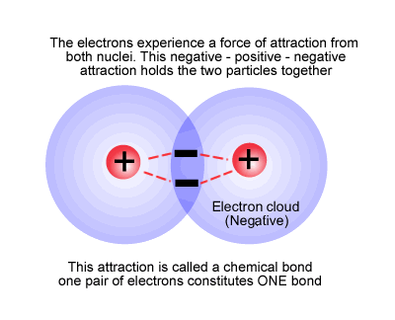
CHEMICAL BONDING
A Chemical Bond is the force that holds atoms together in a compound.
They are formed because it makes the atom more stable.

Slide 4
IONIC BONDS
involves a TRANSFER of electrons from one atom to another.
happens between positive ions and negative ions.
high melting and boiling points
tend to be soluble in water
Solids are poor conductors of heat and electricity.
When dissolved in a liquid or melted, they become good conductors.
Generally forms between elements on opposite sides of the periodic table.

Slide 5
COVALENT BONDS
Atoms with similar electron affinities tend to SHARE electrons.
Neither atom wants to lose electrons; both want to gain them.
Usually forms between nonmetals.
low melting points compared to ionic
many exist as gases or vaporize easily at room temperature
relatively soft, brittle
Poor conductors of electricity.

Slide 6
NOMENCLATURE
A chemical formula tells:
what type of atoms are present.
the number of each type of atom present.
ratio of one atom to another.
Can tell you if the compound is ionic or covalent (molecular)
H₂O Cl₂ Al₂O₃

Slide 7
NOMENCLATURE
IONIC
contains cations and anions.
Includes metals and nonmetals.
Metals go first in name and formula.
Naming compounds
  Write the name of the cation (metal)
  Write the name of the anion and change the ending to “ide”.

Slide 8
NOMENCLATURE
IONIC
Writing Formulas
  Write the charge for the element over the name. You determine the charge by looking at your periodic table or the list of ions in your notes.
  Write the symbol for the cation, followed by the symbol for the anion.
  Crisscross the numbers only (not the signs), writing the oxidation number as a subscript for the other. Do not write the number 1. Balance the charges by placing the subscripts. Net charges must be zero.
  Make sure the formula is in its simplest form. Mg₂O₂ is reduced to MgO, but MgCl₂ cannot be reduced.

Slide 9
NOMENCLATURE
IONIC
Some cations (positive ions) can have more than one charge.
Most are transition elements. Lead and tin are exceptions.
It is important to distinguish which ion is in the compound. – using a Roman numeral in the NAME ONLY. Ex. Copper(II) sulfide

Slide 10
NOMENCLATURE
Covalent
Called molecular
usually binary;
called a molecule
usually contain two nonmetals; or a metalloid and a nonmetal

Slide 11
NOMENCLATURE
COVALENT/MOLECULAR:
Use prefixes to identify the number of atoms present.
If only one of the first atom (nonmetal), then NO prefix is used.
Last element ends in “ide”.
* Can combine in different ratios so MUST use prefixes.

Slide 12
NOMENCLATURE
COVALENT
Prefixes:
1 - mono 6 - hexa
2 - di 7 - hepta
3 - tri 8 - octa
4 – tetra 9 - nona
5 - penta 10 - deca

Slide 13
NOMENCLATURE
COVALENT
Write the symbol of the first element adding a subscript of the number of atoms present. If only one of the first atom (nonmetal), then NO number is used.
2. Write the symbol of the second element adding a subscript of the number of atoms present.

Slide 14
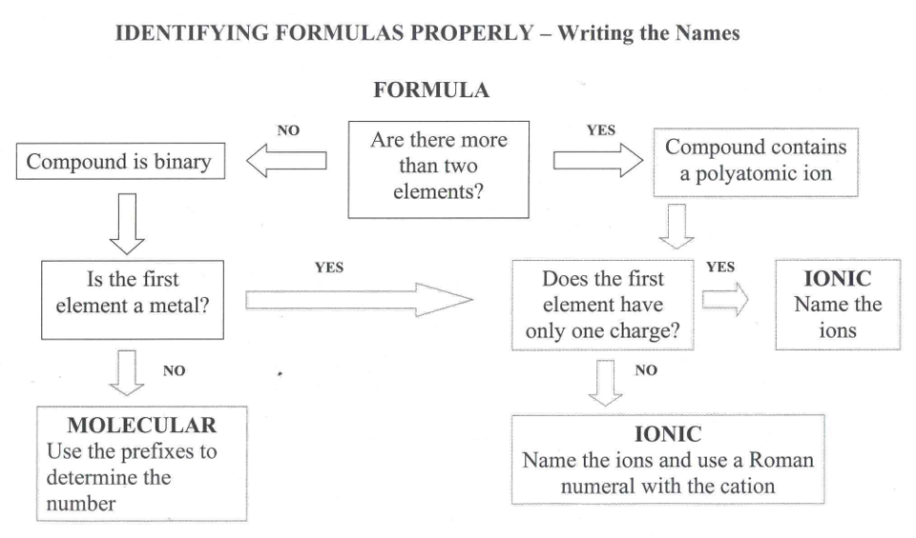

Slide 15
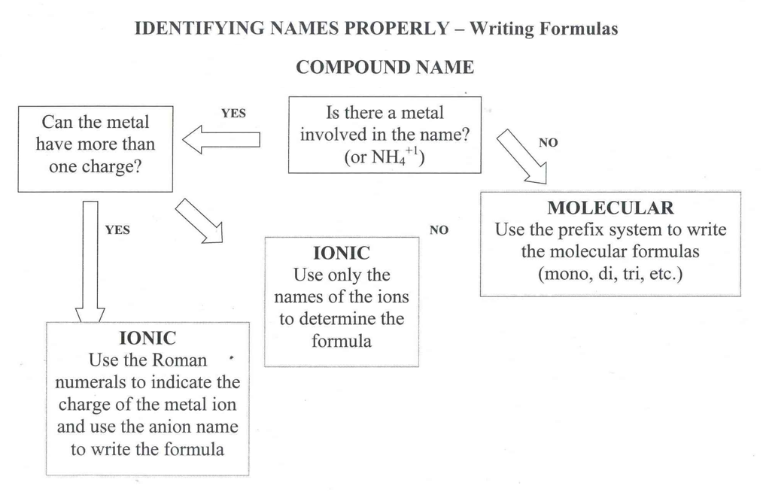

Slide 16
STANDARDS
SPS3. Obtain, evaluate, and communicate information to support the Law of Conservation of Matter.
Plan and carry out investigations to generate evidence supporting the claim that mass is conserved during a chemical reaction. (Limited to synthesis, decomposition, single replacement, and double replacement reactions.)
Develop and use a model of a chemical equation to illustrate how the total number of atoms is conserved during a chemical reaction. (Limited to chemical equations that include binary ionic and covalent compounds and will not include equations containing polyatomic ions.)

Slide 17
CHEMICAL REACTIONS
Conservation of Mass
Atoms (matter) cannot be created or destroyed. The number of reactant atoms must equal the number of product atoms.
H₂ + I₂ → 2HI
H = 2 H = 2
I = 2 I = 2

Slide 18
CHEMICAL REACTIONS
There are always two kinds of substances:
1. Reactant - substance that enters into a chemical reaction; substance that reacts.
2. Product - substance produced by a chemical reaction; the substance that is made or produced.
Reactants → Products

Slide 19
CHEMICAL REACTIONS
1. Count the number of atoms of each element on both sides of the arrow.
Balance the equation using coefficients. A coefficient is a whole number placed in front of a chemical formula to indicate the number of molecules present. Look for the least common multiple (LCM). Balance metals, then nonmetals, then hydrogen, then oxygen.
3. Check your work by recounting the number of atoms on each side of the arrow.
4. Continue adding coefficients and counting atoms until the equation is balanced.

Slide 20
CHEMICAL REACTIONS
______Li + ______H₂O → ______LiOH + ______H₂
Li – Li -
H – H -
O - O –
H –
______H₂O → ______H₂ + ______O₂
H – H -
O - O -

Slide 21
CHEMICAL REACTIONS
SYNTHESIS Reaction
Two or more substances combine to form a different substance.
What to look for: one product
EX. 2 Mg _{(s)} + O_{2 (g)} → 2 MgO _{(s)}

Slide 22
CHEMICAL REACTIONS
DECOMPOSITION Reaction
one substance breaks down into two or more substances.
What to look for: one reactant
H₂SO₄
Ex. C₁₂H₂₂O_{11(s)} → 11 H₂O_{(g)} + 12 C_{(s)}
sucrose → water and carbon

Slide 23
CHEMICAL REACTIONS
SINGLE REPLACEMENT Rxn
Also called single displacement reaction
one element replaces another element in a compound.
What to look for: uncombined elements on
both sides of the arrow
Cu _{(s)} + AgNO_{3 (aq)} → Cu(NO₃) _{2 (aq)} + Ag _{(s)}

Slide 24
CHEMICAL REACTIONS
DOUBLE REPLACEMENT Rxn
Also called double displacement reaction
Produces a precipitate, water, or a gas when to ionic compounds in a solution are combined.
What to look for: two compounds on each side
Ex. HCl _{(aq)} + NaOH _{(aq)} → NaCl _{(aq)} + H₂O _{(l)}

