Slide 1
MATTER, SOLUTIONS, and ACIDS AND BASES

Slide 2
MATTER
SPS5. Obtain, evaluate, and communicate information to compare and contrast the phases of matter as they relate to atomic and molecular motion.
Ask questions to compare and contrast models depicting the particle arrangement and motion in solids, liquids, gases, and plasmas.
Plan and carry out investigations to identify the relationships among temperature, pressure, volume, and density of gases in closed systems. (Clarification statement: Using specific Gas laws to perform calculations is beyond the scope of this standard; emphasis should focus on the conceptual understanding of the behavior of gases rather than calculations.)
SPS7. Obtain, evaluate, and communicate information to explain transformations and flow of energy within a system.
d. Analyze and interpret data to explain the flow of energy during phase changes using heating/cooling curves.

Slide 3
DENSITY
Density is a measure of the amount of mass in a certain volume.
The heavier an object, the more dense it is.
This physical property is often used to identify and classify substances.
It is usually measured in g/cm³.
SAMPLE PROBLEM: What is the density of a billiard ball that has a volume of 100 cm³ and a mass of 250 g?

Slide 4
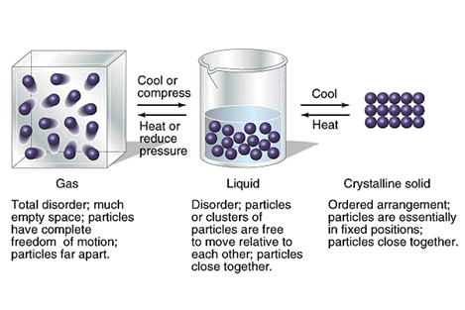
STATES OF MATTER

Slide 5
MATTER
Common States of Matter | Volume | Shape | Molecular Attraction | How the molecules move
Solids | yes | yes | strong | Vibrate around a fixed spot
Liquids | yes | no | medium | Can flow past each other
Gases | no | no | weak | Behave independently
Plasma | No | No | Weak | Electrons are stopped off atoms

Slide 6
GASES
Factors that affect Gas Pressure
TEMPERATUE
  Increase in temperature increases volume.
  DIRECTLY Proportional
VOLUME
  Decrease in volume increases pressure
  INDIRECTLY/INVERSELY Proportional

Slide 7
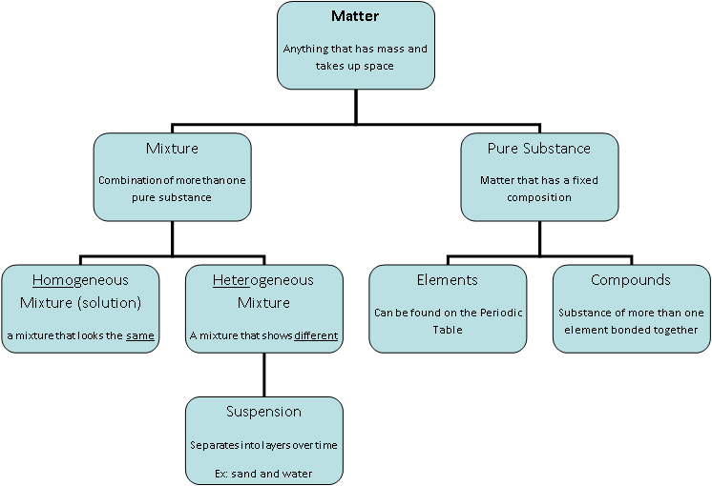

Slide 8
PHYSICAL PROPERTIES AND CHANGES
Physical Property Characteristic that can be observed or measured using the 5 senses. | Physical Change Change in the form of matter but not in identity.
Density Shape Color Odor Texture Viscosity Conductivity Malleability Hardness Melting and Boiling Points | Phase changes (melting, freezing) Beating an egg Stirring milk Bending wire Folding a paper Crushing sugar Dissolving Slicing a tomato Boiling water

Slide 9
CHEMICAL PROPERTIES AND CHANGES
Chemical Property Way a substance reacts with another substance to produce a new substance | Chemical Change Occurs when a substance reacts and forms one or more new substances
Reactivity Flammability Combustion Fermentation Oxidation Corrosion | Baking a cake Mixing baking soda and vinegar Burning a candle Iron rusting Making wine Milk souring Banana ripening/rotting Digestion Breathing Evidence of chemical change: change in color production of a gas formation of precipitate

Slide 10
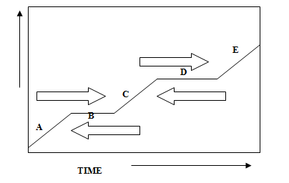
HEATING CURVE
TEMPERATURE

Slide 11
HEATING CURVE
As heat is supplied, the heat increases the kinetic energy of the molecules.

Slide 12
HEATING CURVE
B. When the substance reaches the melting point, all heat being supplied is used to change the phase (potential energy change). Temperature will NOT change until the phase is complete.

Slide 13
HEATING CURVE
C. When the phase change is complete, heat again raises the KE of the molecules, temperature changes, and increases to the boiling point.

Slide 14
HEATING CURVE
D. All heat is used the change the phase. Same as “B”.

Slide 15
HEATING CURVE
E. When the phase change is complete, heat again raises the KE of the molecules, temperature changes, and increases.

Slide 16
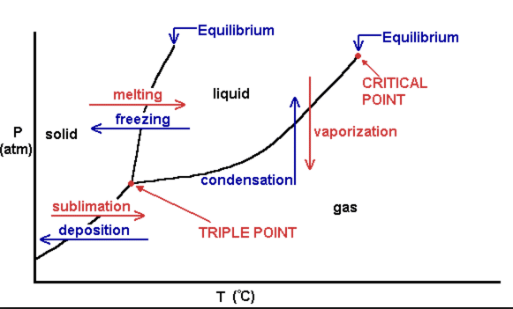
PHASE DIAGRAM
Triple Point - all three phases are at equilibrium
Solid lines are the equilibrium lines between phases. On these lines, both phases exist.

Slide 17
PHASE DIAGRAM
REMEMBER
Energy is conserved – it can be converted from one form to another, but it cannot be destroyed.
The energy stored in a substance because of its composition is CHEMICAL POTENTIAL ENERGY. Chemical potential energy plays an important role in chemical reactions.

Slide 18
PHASE DIAGRAM
In a chemical reaction, the potential energy can be released as heat.
Heat is the energy that flows from a warmer object to a colder object. Heat is measured using the SI unit Joule, J.

Slide 19
SOLUTIONS
SPS6. Obtain, evaluate, and communicate information to explain the properties of solutions.
Develop and use models to explain the properties (solute/solvent, conductivity, and concentration) of solutions.
Plan and carry out investigations to determine how temperature, surface area, and agitation affect the rate solutes dissolve in a specific solvent.
Analyze and interpret data from a solubility curve to determine the effect of temperature on solubility.

Slide 20
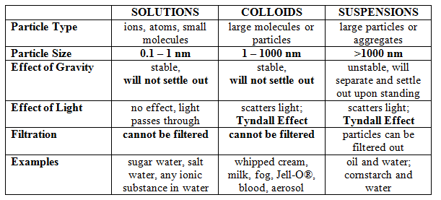
SOLUTIONS

Slide 21
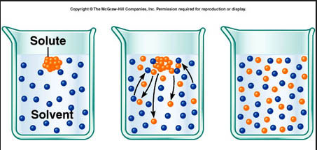
SOLUTIONS

Slide 22
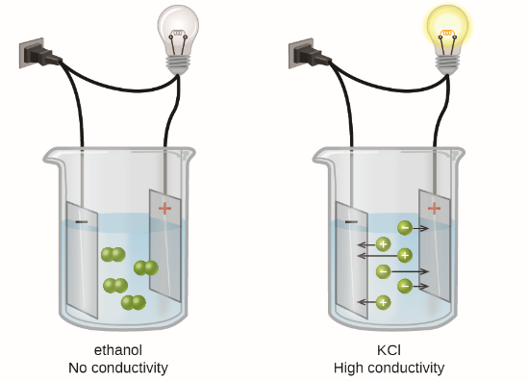
SOLUTIONS
ELECTROLYTE
NONELECTROLYTE

Slide 23

REVIEW
6. Be able to distinguish between a concentrated solution and a dilute solution.
CONCENTRATED: lots of solute in some solvent
DILUTE: little solute in some solvent
Most Concentrated
Most Dilute

Slide 24
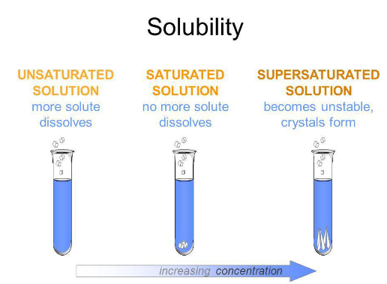
SOLUTIONS
Differentiate between saturated, unsaturated, and supersaturated.

Slide 25
SOLUTIONS
Unsaturated
There is more available space for solute to dissolve in the solvent.
Saturated
When there is enough solute in the solvent and you begin to see some crystals
Supersaturated
When there is an excess of solute in the solvent. The solution is unstable and the excess solute with crystallize out if given the chance.

Slide 26
SOLUTIONS
The factors affecting the rate of solubility.
Agitation – stirring or shaking puts the solute in contact with the solvent more often.
Temperature – raising the temperature makes the particles move faster which puts the solute in contact with the solvent more often.
Particle Size – smaller particles means more surface area which puts the solute in contact with the solvent more often.

Slide 27
SOLUTIONS
The factors that affect solubility.
Nature of the solvent and solute - “like dissolves like”.
Temperature - increase the temperature and solubility increases.
Pressure - increase the pressure and you increase solubility. (only gases)
How much is already dissolved?

Slide 28
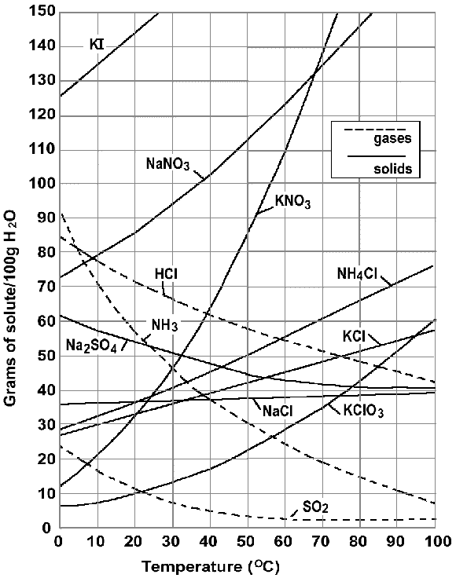
SOLUTIONS
Solubility curve graph.
How much is dissolved.
At what temperature it dissolved

Slide 29
SOLUTIONS
Saturated, unsaturated, and supersaturated.
Gases show a decrease in solubility when temperature rises.

Slide 30
ACIDS AND BASES
SPS6. Obtain, evaluate, and communicate information to explain the properties of solutions.
d. Obtain and communicate information to explain the relationship between the structure and properties (e.g., pH, and color change in the presence of an indicator) of acids and bases. (Clarification statement: Limited to only the structure of simple acids and bases (e.g., HCl and NaOH) that demonstrates the presence of an H+ or OH-.
e. Plan and carry out investigations to detect patterns in order to classify common household substances as acidic, basic, or neutral.

Slide 31
ACIDS AND BASES
Acid and Base Characteristics.
Acid and Base Properties (when dissolve in water):
ACIDS
Give off H⁺ ions
Taste sour
Change blue litmus to red
React with bases to neutralize their properties
React with active metals and carbonates to produce gases.
Conduct electricity.
BASES
Give off OH⁻ ions
Taste bitter
Feels slippery and smooth
Change red litmus to blue
React with acids to neutralize their properties.
Conduct electricity

Slide 32
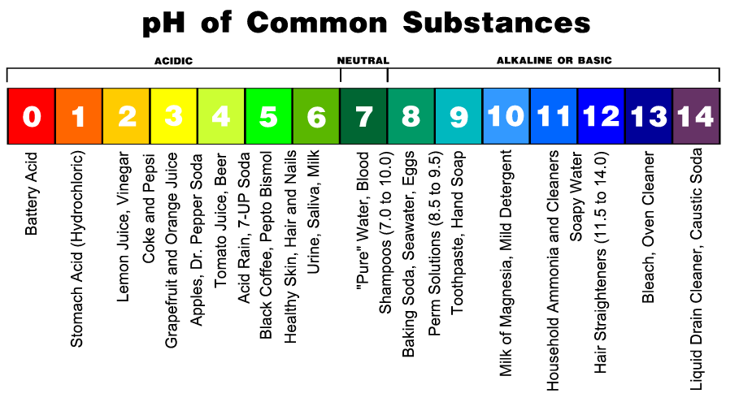
ACIDS AND BASES
pH = a measure of the concentration of hydronium ions in a solution using a scale ranging from 0 to 14 with 0 being the most acidic and 14 begin the most basic.

Slide 33
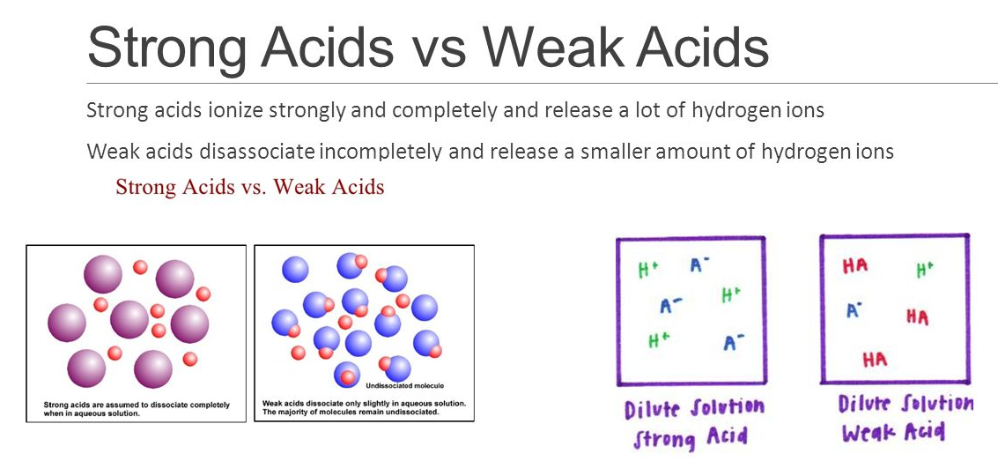
ACIDS AND BASES

Slide 34
ACIDS AND BASES
When you put an acid and base together, you get a SALT and WATER.
H₂SO₄ + 2NaOH → 2H₂O + Na₂SO₄
This is called a NEUTRALIZATION reaction.

Slide 35
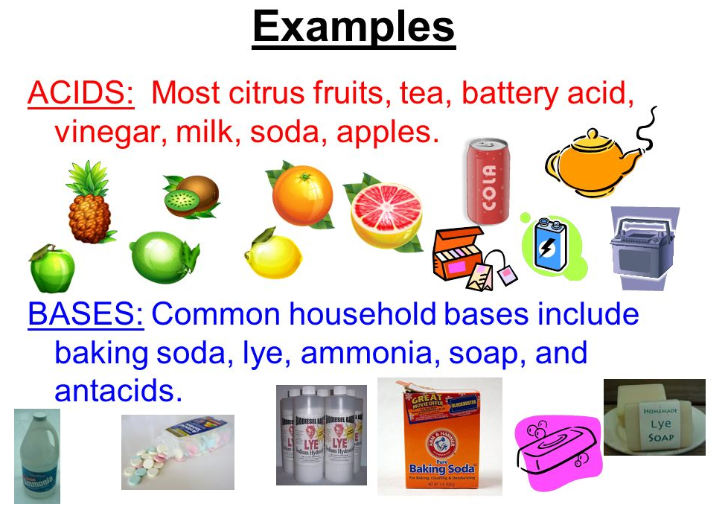
ACIDS AND BASES
Common household acids and bases.

