Slide 1
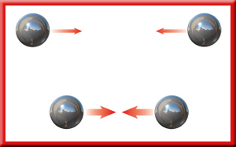
MOTION, FORCE, GRAVITY
EOC REVIEW

Slide 2
MOTION
SPS8. Obtain, evaluate, and communicate information to explain the relationships among force, mass, and motion.
A. Plan and carry out an investigation to analyze the motion of an object using mathematical and graphical models. (Clarification statement: Mathematical and graphical models could include distance, displacement, speed, velocity, time and acceleration.)

Slide 3
SPEED
How fast something moves is SPEED
Speed is the distance an object travels in a certain period of time.

Slide 4
VELOCITY
Hurricanes, pilots, and boat captains need this.
In order to completely describe the motion of an object, we need to include not only the speed of the object, but also the direction!

Slide 5


ACCELERATION
Changing Speed
  How fast the speed is changing.
Units: m/s²
  Velocity per second
  meters/second per second

Slide 6
FORCES
SPS8. Obtain, evaluate, and communicate information to explain the relationships among force, mass, and motion
b. Construct an explanation based on experimental evidence to support the claims presented in Newton’s three laws of motion (demonstrate relationships among force, mass, velocity, and acceleration).
c. Analyze and interpret data to identify the relationship between mass and gravitational force for falling objects.

Slide 7
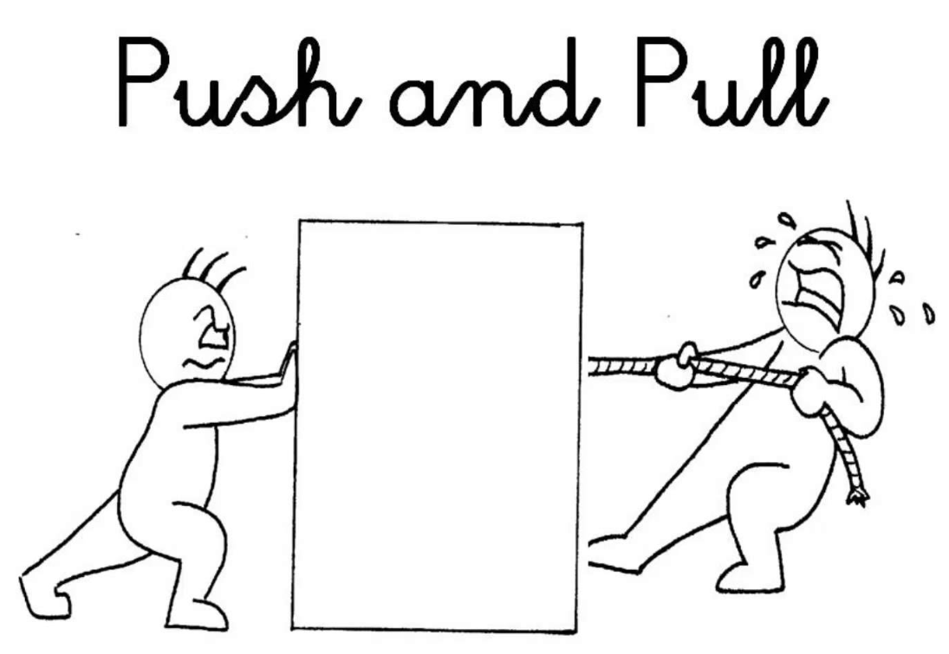
WHAT CAUSES THINGS TO MOVE?
FORCES!
What is a force?
  A push or a pull that one body exerts on another.

Slide 8
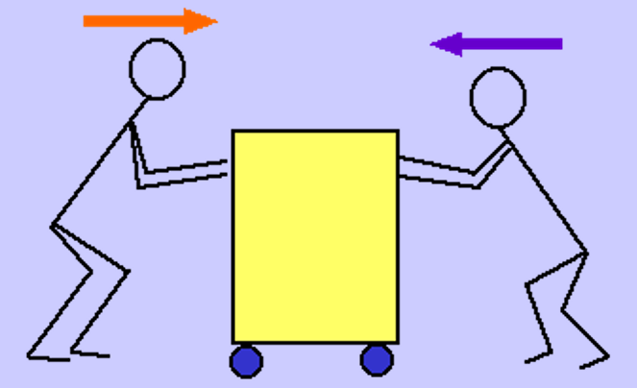
BALANCED FORCES
Balanced forces are
opposite and equal
act in opposite directions and cancel each other out
no motion occurs for the cart.

Slide 9
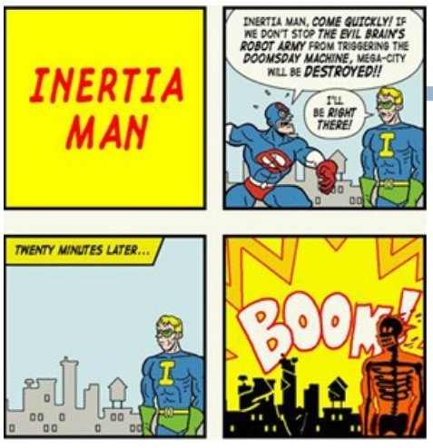
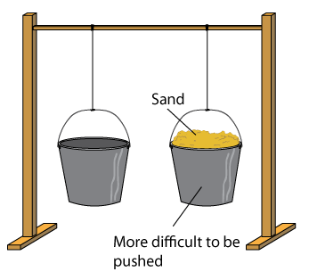
NEWTON’S FIRST LAW
LAW OF INERTIA
An object at rest stays at rest and an object in motion stays in motion until acted on by a net external force.

Slide 10
NEWTON’S SECOND LAW
The force on an object equals the mass of the object times the acceleration of the object.
In other words, a force causes a mass to accelerate.
EQUATION: Force = mass x acceleration
EQUATION: F = ma
UNITS: kilogram x meter/second² = Newton, N

Slide 11
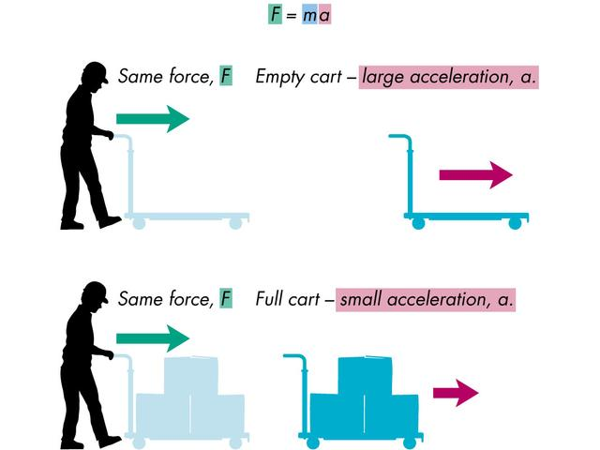
NEWTON’S SECOND LAW

Slide 12
FORCE PROBLEMS
What force is needed to give an object with a mass of 25.0 kg an acceleration of 15.0 m/s² ?
Formula
F = ma
Given:
m = 25.0 kg
a = 15.0 m/sec²
F = (25 kg)(15 m/sec²)
F = 375 kg•m/sec² = 375 N
Unknown:
F = ?

Slide 13
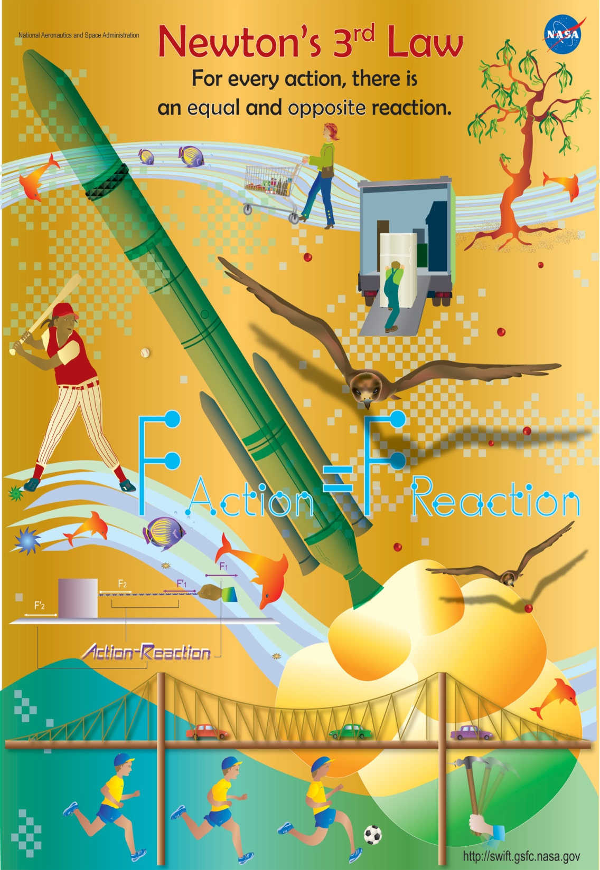
NEWTON’S THIRD LAW OF MOTION
LAW OF ACTION-REACTION
For every action force, there is an equal and opposite reaction force.
Every action has an equal and opposite reaction.

Slide 14
GRAVITY
Gravitational Force is an attractive force between all objects in the universe.
The amount of GRAVITATIONAL FORCE between objects depends upon their:
  Masses (greater mass means more gravity)
  Distance apart (greater distance means less gravity)

Slide 15
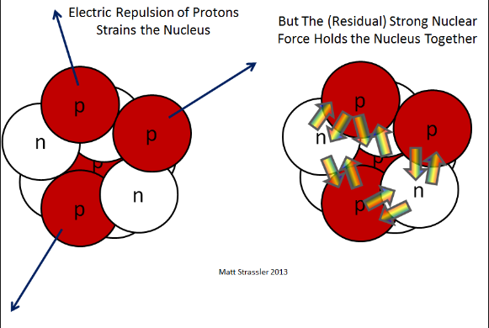
STRONG FORCE
Holds the protons and neurons together in the nucleus.
Remember that protons want to repel each other.

Slide 16
THREE TYPES OF FRICTION
Static Friction: The frictional force that prevents two surfaces from sliding past each other.
Sliding Friction: The force that opposes the motion of two surfaces sliding past each other.
Rolling Friction: The frictional force between a rolling object and the surface it rolls on.

Slide 17
WEIGHT AND MASS
Weight and mass are not the same.
Weight is a force and mass is a measure of the amount of matter an object contains.
Weight and mass are related. Weight increases as mass increases.
Force (weight) = mass x accel. due to gravity (9.8m/s²)
Unit: Newton, N

