Slide 1
WORK AND MACHINES
EOC REVIEW

Slide 2

WORK
For there to be work on an object, there must be a DISPLACEMENT and the force must cause that displacement.
Must move in the SAME direction of the force.

Slide 3
WORK
Work = Force x Distance
W = fd
The unit used to express work is Joule, J which is a Newton-meter.
Formula is on your reference sheet

Slide 4
Simple machines
Simple machines are useful because they can make a physical job easier by:
changing the amount of the force exerted to do work.
OR
changing the direction of the force exerted to do work.

Slide 5


MECHANICAL ADVANTAGE
Two ways to calculate this (on your reference sheet):
OR
MA = $\frac{effort distance}{resistance distance}= \frac{De}{Dr}$
MA = $\frac{resistance force}{effort force}= \frac{Fr}{Fe}$

Slide 6
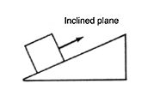
INCLINE PLANE
A sloping surface, like a ramp, that reduces the amount of force needed to lift something by increasing the distance over which the force is applied.
In other words, it reduces the amount of force needed.

Slide 7
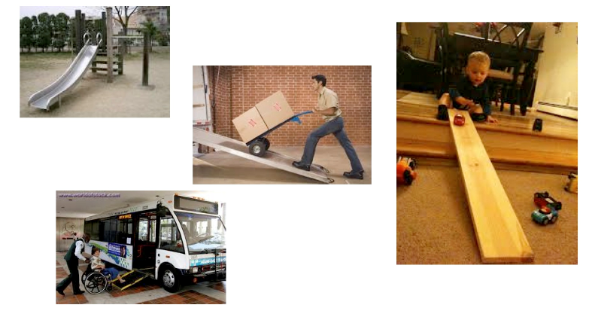
EXAMPLES

Slide 8
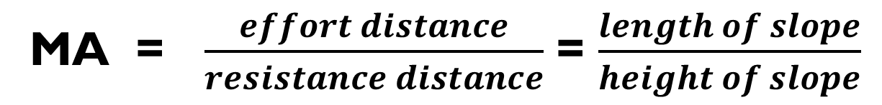
MECHANICAL ADVANTAGE
THE INCLINED PLANE
  Reduces the amount of force by:
  Increasing the distance over which the force is applied.
  As the ramp is made longer and less steep, less force is required.
MA = $\frac{effort distance}{resistance distance}$ = $\frac{length of slope}{height of slope}$

Slide 9
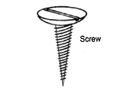
SCREW
An inclined plane wrapped in a spiral around a cylindrical post.
As you turn the screw, the threads pull the screw into the wood.
The inclined plane slides
through the wood.

Slide 10
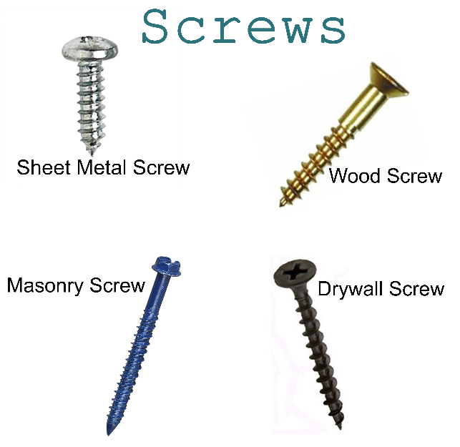
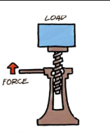
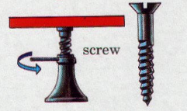
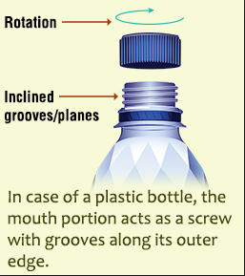
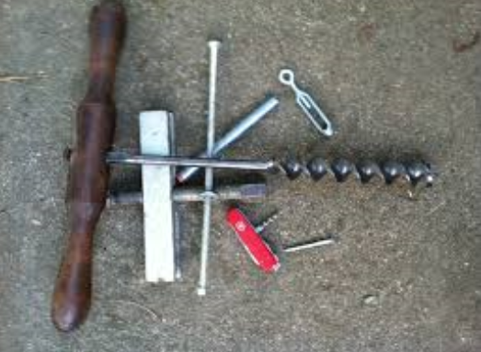
EXAMPLES

Slide 11
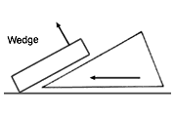
WEDGE
An inclined plane with one or two sloping sides.
Two inclined planes make a wedge.
Wedges change the direction of the force.

Slide 12
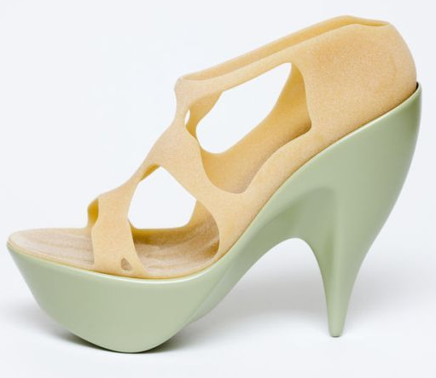
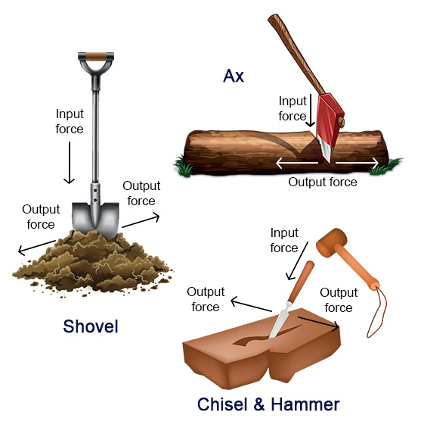
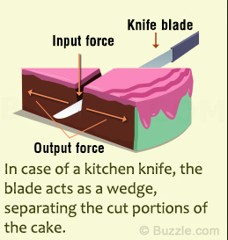
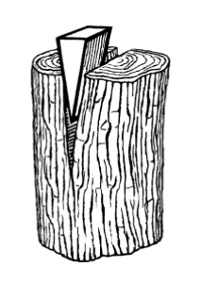
EXAMPLES

Slide 13
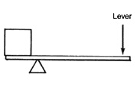
LEVERS
A bar that is free to pivot or turn around a fixed point.
Lever
Load
Fulcrum – fixed point

Slide 14
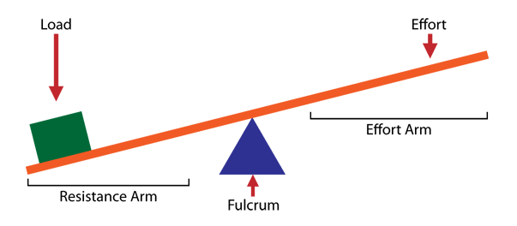
LEVERS

Slide 15
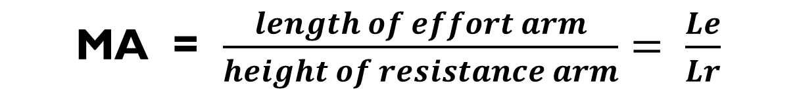
MECHANICAL ADVANTAGE
LEVER
  Makes work easier by:
  Multiplying your effort force and changing the direction of your force
MA = $\frac{length of effort arm}{height of resistance arm}= \frac{Le}{Lr}$

Slide 16
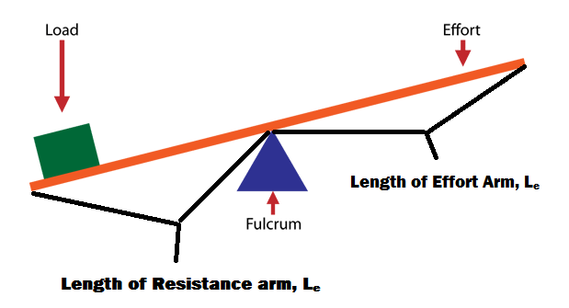
LEVERS

Slide 17
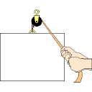
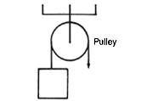
PULLEYS
A grooved wheel with a rope, chain, or cable running along the grove.
Wheel
Rope
The two sides of the pulley are the effort arm and the resistance arm.

Slide 18
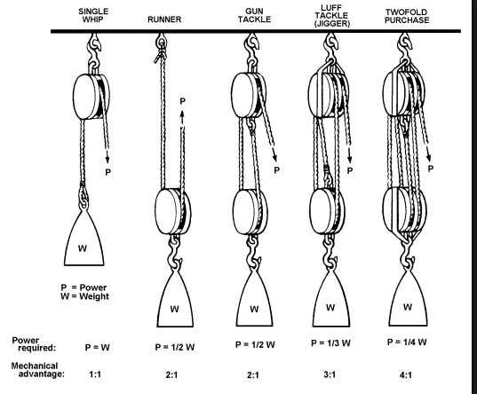
PULLEY
Cannot multiply the effort force, ONLY changes the direction of the effort force.
Count the number of ropes – that tells you the mechanical advantage.
Never count any rope that does not directly support the weight.

Slide 19
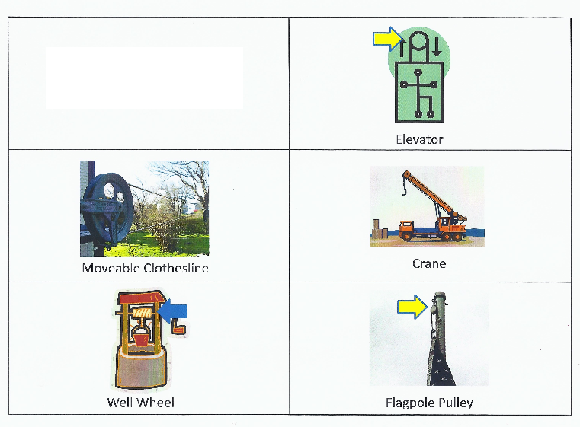
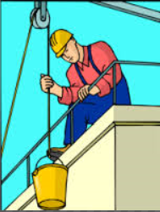
EXAMPLES

Slide 20
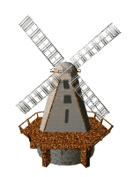

WHEEL AND AXLE
Usually the effort is exerted on the larger wheel. Then the smaller wheel (axle) exerts the resistance force.
A modified lever.
A machine consisting of two wheels of different sizes that rotate together.
Wheel
Axle

Slide 21
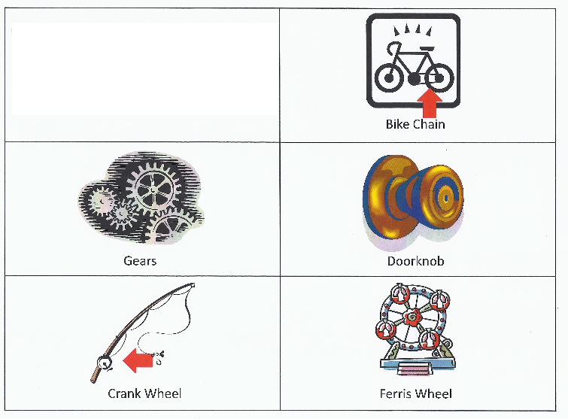
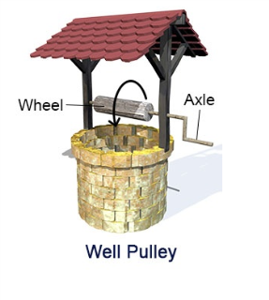
EXAMPLES

Slide 22

MECHANICAL ADVANTAGE
WHEEL AND AXLE
  The effort arm is the radius of the wheel
  The resistance arm is the radius of the axle
  The mechanical advantage of a wheel and axle can be increased by making the radius of the wheel larger.
MA = $\frac{radius of wheel}{radius of axle}= \frac{rw}{ra}$

Slide 23

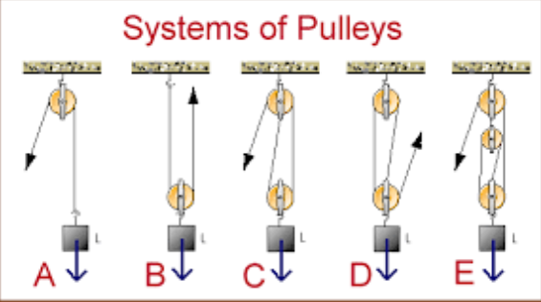
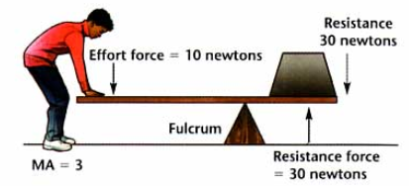
MECHANICAL ADVANTAGE

Slide 24
COMPOUND MACHINES
When two or more simple machines are used together.
The overall MA of the compound machine is related to the MA of all the machines involved.

Slide 25
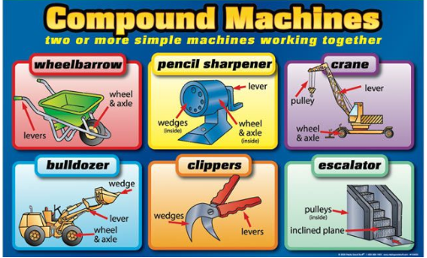
EXAMPLES

