Slide 1
WAVES, SOUND, AND LIGHT
SPS9. Obtain, evaluate, and communicate information to explain the properties of waves.
a. Analyze and interpret data to identify the relationships among wavelength, frequency, and energy in electromagnetic waves and amplitude and energy in mechanical waves.
b. Ask questions to compare and contrast the characteristics of electromagnetic and mechanical waves.
c. Develop models based on experimental evidence that illustrate the phenomena of reflection, refraction, interference, and diffraction.
d. Analyze and interpret data to explain how different media affect the speed of sound and light waves.
e. Develop and use models to explain the changes in sound waves associated with the Doppler Effect.

Slide 2
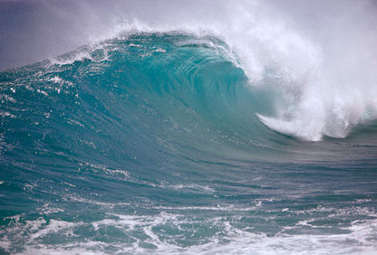
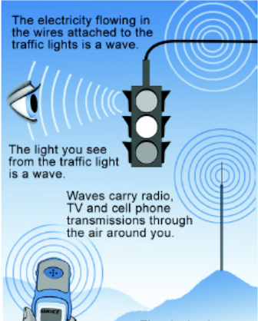
WAVES
A wave is a disturbance that transfers energy through matter or through space.
Some waves, like sound waves, must travel through matter, these waves are called mechanical waves.
Other waves, like light do not require a medium and can travel through space. These waves are called electromagnetic waves.

Slide 3
WAVES
2 Different Types of Waves
Mechanical | Electromagnetic
(requires a medium: solid, liquid, or gas) | (does not require a medium/ can travel in a vacuum)
Sound waves require air (gas) | Radio waves
Water waves require water (liquid) | Infrared Light
Earthquake (seismic waves) requires earth (solid) | Gamma rays
.

Slide 4
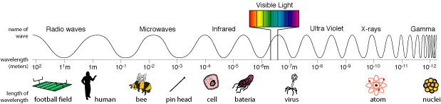
WAVES
THE ELECTROMAGNETIC SPECTRUM:
The electromagnetic spectrum is a set of electromagnetic waves in order of wavelength and frequency.
  a long wavelength has a low frequency
  a short wavelength has a high frequency.
What happens to frequency as you move from left to right? Wavelengths? Energy?
Which wave has the longest wavelength? Shortest?
Which wave has the highest frequency? Lowest?
Which wave has the most energy? Least?

Slide 5
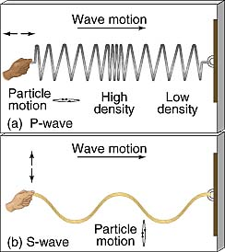
WAVES
Transverse Wave
  oscillations are perpendicular
  to the direction of motion .
  Example: light, water
Longitudinal wave
  oscillations are in the same
  direction of motion.
  (parallel to the motion)
  Example: sound

Slide 6


WAVES
Waves can be either longitudinal (compression) or transverse.
Longitudinal
Transverse

Slide 7
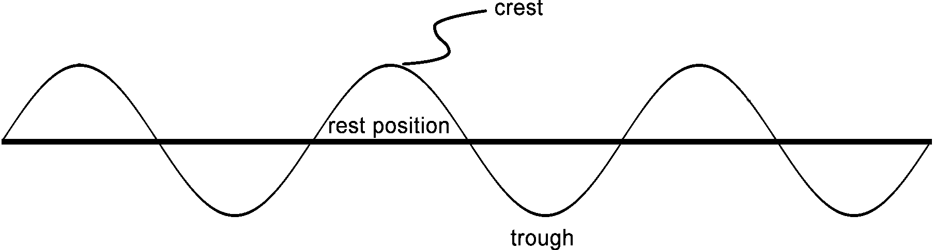
WAVES
TRANSVERSE WAVE
Crest: the highest point of a transverse wave.
Trough: the lowest point of a transverse wave
Rest Position: the position of the wave with no energy.

Slide 8
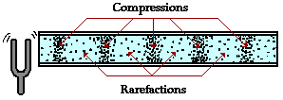
WAVE
COMPRESSIONAL/LONGITUDINAL WAVE
Rarefaction is a place where the material is the least dense (pressure is the lowest).
Compression is where the material is the most dense (atmospheric pressure is the highest).

Slide 9
WAVES
Frequency is how fast the wave is moving. If you stand in one spot and watch a wave go by, it is the number of crests that go by in a second.
Waves with long wavelengths have a low frequency. Waves with short wavelengths have a high frequency. The higher the frequency, the more energy a wave has.
The speed or velocity of a wave depends on the wavelength and the frequency. The formula for wave speed is:
Speed = wavelength x frequency

Slide 10
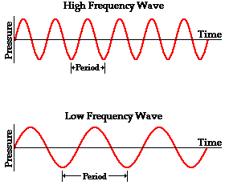
WAVES
Frequency vs. Wavelength
What happens to the wavelength as the frequency decreases?
Which wave has more energy? Why?
A.
B.

Slide 11
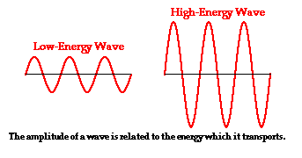
WAVES
Higher energy, higher amplitude; low energy, low amplitude

Slide 12
WAVE
WAVE INTERACTIONS
When a wave hits a piece of matter, the wave can be absorbed or it can be reflected.
  Reflection
  Refraction
  Diffraction
  Interference

Slide 13



WAVE
REFLECTION
REFRACTION
The bouncing back after a wave strikes an object that it cannot pass through.
The bending of waves due to a change in speed.
Examples include prisms, lenses like glasses and contacts, and a mirage.

Slide 14
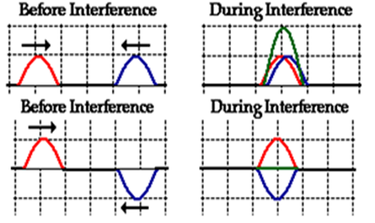
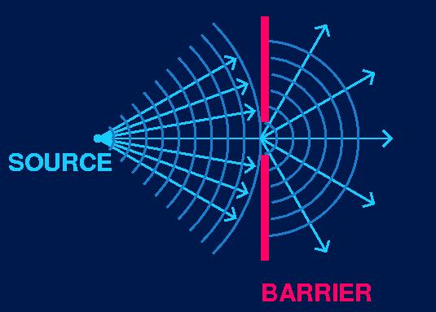
WAVE
INTERFERENCE
DIFFRACTION
Two or more waves may come in contact with each other and overlap to form a new wave. This is called INTERFERENCE.
As these waves overlap, they can either multiply and enhance each other, or cancel each other out.
The bending of waves around a barrier. When it encounters a barrier, the wave can go around it.
Examples include sound waves bending to come around a corner, or underneath a door

Slide 15
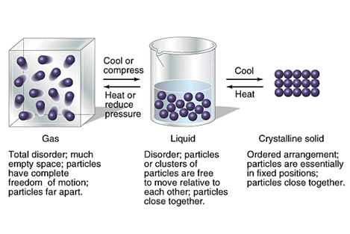
SOUND
Longitudinal/Compressional Wave
Requires matter to travel.
Wave Speed changes in different mediums
Sound travels fastest in solids; travels slowest in gases.
  Sound travels faster in solids because particles are closer together in solids than in gases, and therefore energy moves faster!
Solids travel faster in more elastic substances.
Gas
Liquid
Solid

Slide 16
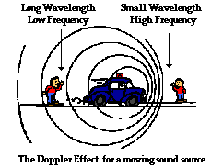
SOUND
DOPPLER EFFECT
Variation in the perceived pitch of a sound due to a moving sound source.
Waves are closer together in front of the source.
Waves spread out behind the source.

Slide 17
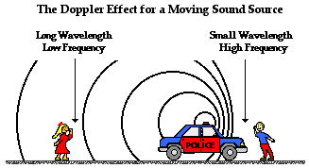
SOUND
Who hears a higher pitched sound? Why?

