Slide 1
ELECTRICITY AND MAGNETISM

Slide 2
ELECTRICITY AND MAGNETISM
SPS10. Obtain, evaluate, and communicate information to explain the properties of and relationships between electricity and magnetism.
a. Use mathematical and computational thinking to support a claim regarding relationships among voltage, current, and resistance.
b. Develop and use models to illustrate and explain the conventional flow (direct and alternating) of current and the flow of electrons in simple series and parallel circuits. (Clarification statement: Advantages and disadvantages of series and parallel circuits should be addressed.)
c. Plan and carry out investigations to determine the relationship between magnetism and the movement of electrical charge. (Clarification statement: Investigations could include electromagnets, simple motors, and generators.)

Slide 3
Static Electricity
Static - some of the outer electrons are held very loosely.
They can move from one atom to another.
An atom that loses electrons has more protons than electrons. It is positively charged- cation
An atom that gains electrons has more electrons than protons. It has a negative charge- anion.
A charged atom is called an "ion."

Slide 4
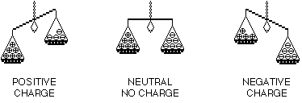
Static Electricity
Static electricity is the imbalance of positive and negative charges.

Slide 5
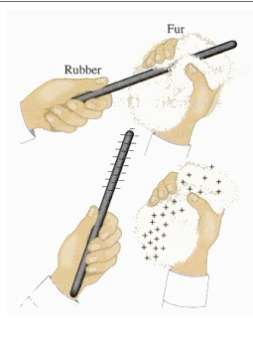
STATIC ELECTRICITY
Charging by Friction
    The charge is transferred because of rubbing two objects together.
    Example: shoes on a carpet

Slide 6
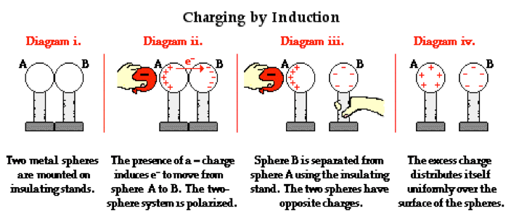
STATIC ELECTRICITY
Charging by Induction
  Involves the charging of one object by another object WITHOUT direct contact.
  Example: balloon and rice cereal/electroscope

Slide 7
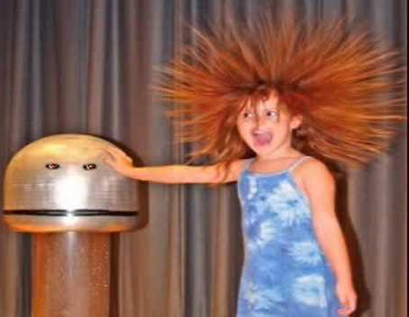
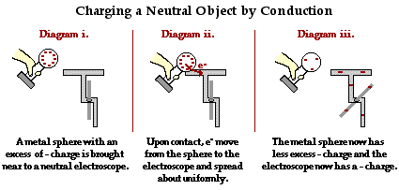
STATIC ELECTRICITY
Charging by Conduction
  Involves the DIRECT CONTACT of a charged object to a neutral object.
  Example: Van de Graaf generator

Slide 8
Electricity
To make somethin" turn on, we need:
  an appropriate source of electricity (battery/outlet),
  metal wires insulated with plastic,
  a switch
  and the “thing” (refrigerator, light, computer, radio controlled car, sewing machine......).
We connect them in a distinct sequence for the thing to work.

Slide 9
Source of Energy
In the case of DC (Direct Current – (battery) current flows in one direction only), it has a limited life than is unusable so we throw it away.
-In the case of AC (Alternating Current – (wall plug) current flows back and forth (changes direction)) the power company provides the electricity, it is far closer to limitless as an energy source.

Slide 10



Slide 11
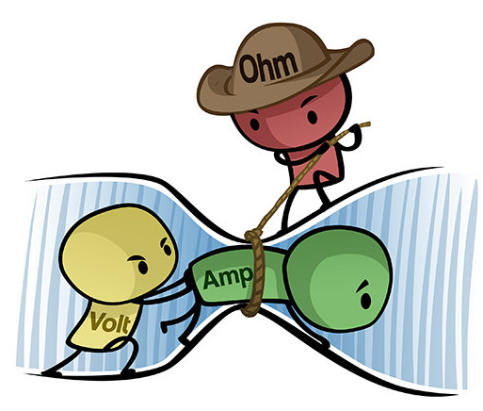
ELECTRIC CURRENT
There are three parts to an electric charge
Resistance
Current
Voltage

Slide 12
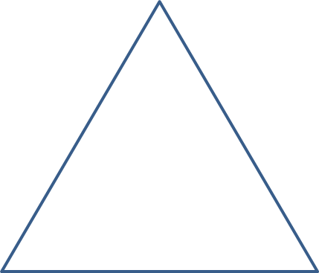
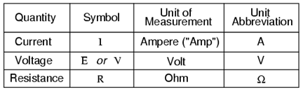
Electric Current
The flow of electrons is called a current, an electric current
Current flows from high to low energy.
The formula for calculating voltage is:
  V = R x I
V
R
I
Formula is on your reference sheet!

Slide 13
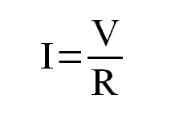
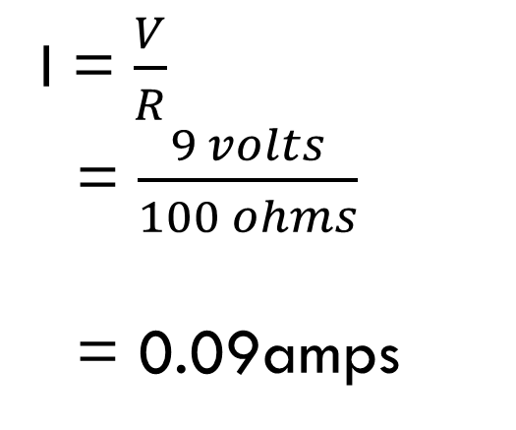
PRACTICE
What is the current produced with a 9-volt battery through a resistance of 100 ohms?
I = ?
R = 100 ohms
V = 9 volts
I = $\frac{V}{R}$
= $\frac{9 volts}{100 ohms}$
= 0.09amps

Slide 14
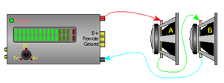
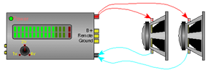
Circuits
Series Circuits
Parallel Circuits
The current must flow through one device to get to the next device. This means that the rate of current flow through all devices is the same.
1 loop
In a parallel circuit each device is directly connected to the power source. This means that each device receives the same voltage.
2+ loops

Slide 15
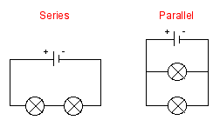
Circuits
Series
Parallel
Has a single loop for electrons to travel round
Components are connected one after another
Current has to travel through all components
Has two or more paths for electrons to flow down
Current is shared between the branches

Slide 16
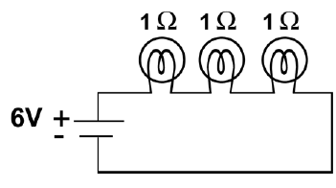
PRACTICE
6V
a. What is the total voltage across the bulbs?
b. What is the total resistance of the circuit?
c. What is the current in the circuit?
d. What is the voltage drop across each light bulb?
3Ω
2A
2V
e. What happens to the brightness of each bulb in a series circuit as additional bulbs are added?
Why?
Brightness
goes down
Energy goes down
because all the bulbs
are sharing the
same energy

Slide 17
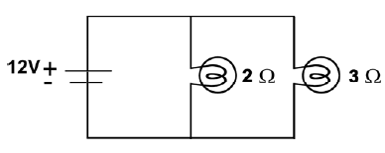
PRACTICE
12V
What is the voltage across each resistor?
What is the current in each branch?
c. What is the total current provided by the battery?
6 A and 4 A
10 A

Slide 18

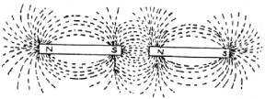
MAGNETISM
Magnetism is a universal force like gravity.
A magnet always has two poles - north and south.
Like poles repel each other and opposite poles attract.
LIKE POLES
OPPOSITE POLES

Slide 19
MAGNETISM
The moving electron acts as a mini electrical charge and therefore has a magnetic field associated with it.
Groups of atoms with magnetic poles aligned are called magnetic domains.
Materials with most of the domains lined up are considered magnetized.
The more domains that are aligned, the stronger the magnetic field in the material.

Slide 20
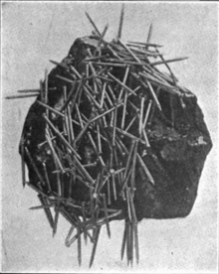
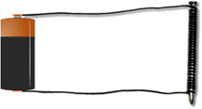
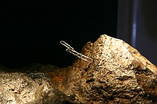
Temporary Magnet vs.
Permanent Magnet
Temporary Magnet
Permanent Magnet
Has magnetic properties for a short time.
Ex: electromagnet
A magnet that maintains its magnetic properties forever.
Ex: magnetite and lodestone

Slide 21
Electromagnetism
Electricity can produce a magnetic field and magnetism can produce an electric current.
An electromagnet is a temporary magnet.
As long as there is a current flowing, a magnetic field is present.
A simple electromagnet consists of a
  battery, copper wire, iron nail
The strength of the electromagnet depends on:
  the number of turns in the wire coil
  and the size of the iron core
  The amount of voltage.

Slide 22
ELECTROMAGNETIC INDUCTION
When a magnet is moved near a wire, an electric current can be created.
This process is called electromagnetic induction.
The direction of the induced current can be reversed by reversing the motion of the wire or reversing the field direction.
The strength of the current depends on the strength of the magnetic field and the speed of the wire's motion.
This is the basis for electric generators.

Slide 23

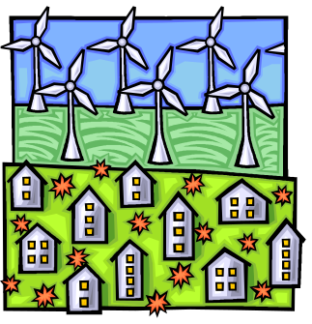
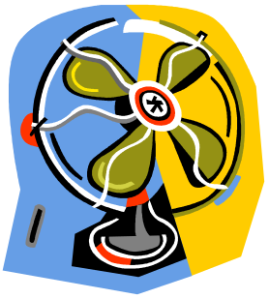

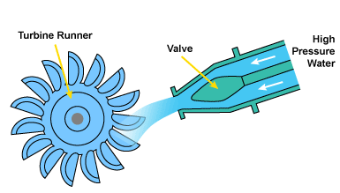
Electrical Machines
Motor
Generator
Converts electric energy to mechanical energy
Ex: battery, drill
Converts mechanical energy to electrical energy
Ex: windmill, turbine

