Slide 1
FINAL EXAM REVIEW
Climate and Human Interaction and the Environment

Slide 2
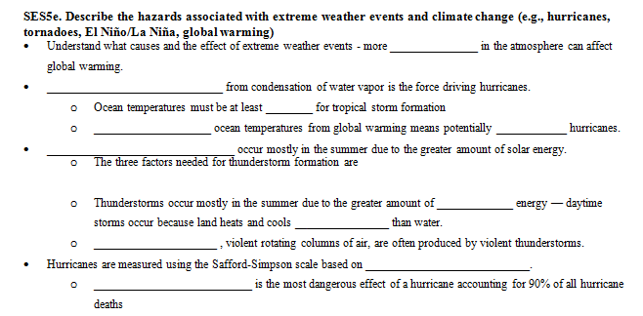
CHECK YOUR ANSWERS
energy
Latent heat
80°F
Warmer
more
Thunderstorms
deflected
Moisture, uplifting mechanism, instability
rotation
solar
faster
Tornadoes
wind speed
Storm surge

Slide 3
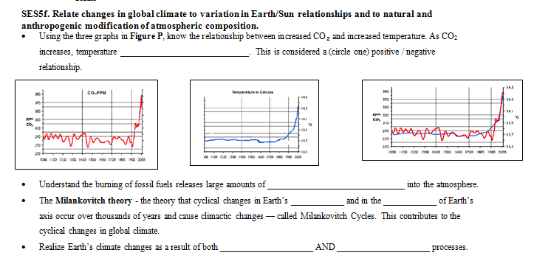
CHECK YOUR ANSWERS
increases
B
carbon dioxide
orbit
tilt
natural
human

Slide 4
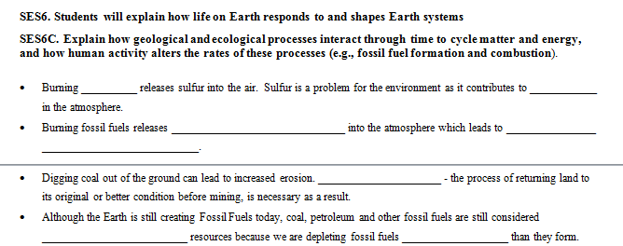
CHECK YOUR ANSWERS
coal
Acid rain
cool
carbon dioxide
global
dry
warming
reclamation
nonrenewable
faster

Slide 5
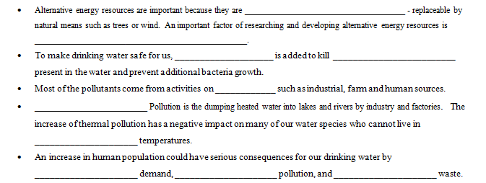
CHECK YOUR ANSWERS
renewable
cost effectiveness
chlorine
bacteria
land
Thermal
wetter
elevated
increasing
increasing
increasing

Slide 6
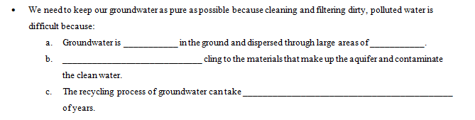
CHECK YOUR ANSWERS
deep
rock
Contaminants
hundreds or thousands

