Slide 1
FIRST DAY INSTRUCTIONS
PHYSICAL SCIENCE

Slide 2
Welcome to Physical Science!
Find a seat – sit where you want to for the semester – think about where the air conditioner is and where the screen is. Will you be able to see in that seat? Is the air blowing on you?
No seat in the front row should be empty.

Slide 3
STUDENT SCHEDULE
This schedule replaces all other schedules.

Slide 4
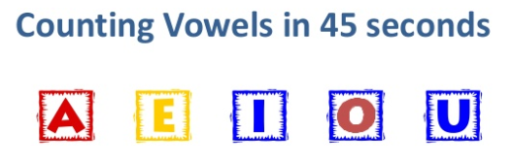
ENVELOPE
DO NOT open the envelope until I instruct you to do so.
You should have an envelope and two pieces of small white paper.
Take the card out of the envelope and:

Slide 5
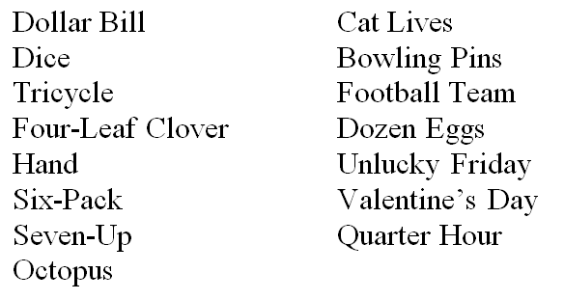
ENVELOPE

Slide 6
ENVELOPE
Put the card back into the envelope.
On the piece of white paper, write down as many words or phrases as you can remember.
You have two minutes.
DON’T CHEAT!

Slide 7
ENVELOPE
Look at the words again. What do they have in common? What are they arranged according to?

Slide 8
ENVELOPE

Slide 9
ENVELOPE
Put the card back into the envelope.
On the piece of white paper, write down as many words or phrases as you can remember.
You have two minutes.
DON’T CHEAT!

Slide 10
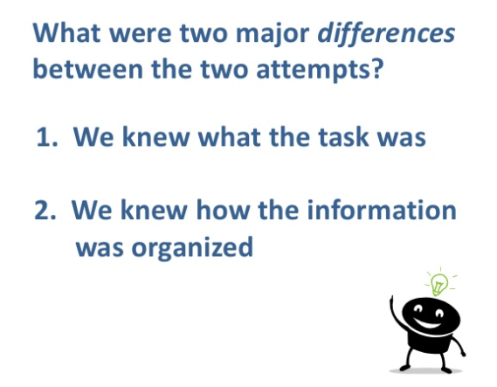
ENVELOPE

Slide 11
ENVELOPE
We will always try to make sure you know what the task it.
We will always try to help you know how it is organized.
LEARNING IS ACTIVE !
Passive learning is an oxymoron !

Slide 12
ENVELOPE
Put card back in envelope and pass to the front.
Pass your white papers up to the front.
The front desk should organize the two items in two piles for pick-up.

Slide 13
STATIONS
You are going to move from station to station. They can be done in any order.

Slide 14
STATION A
Pick up the syllabus. Read through it, sign it, and be sure to get your parents to sign by Friday.
We will go over it tomorrow in class.

Slide 15
STATION B
Find the seating chart for your period and fill in your name in the appropriate seat box IN PENCIL. Be sure to fill in name called and last name.

Slide 16
STATION C
Put your called name and last name on a popsicle stick - BOTH SIDES - in pencil and place the stick in the BRIM can.

Slide 17
STATION D
Pick up a lab safety contract. Read through the contract and print and sign your name. Take it home and get your parents to fill out their part.
We will over it on Wednesday.
Return it by Friday signed.

Slide 18
STATION E
Pick up the Student Information sheet. Please fill out the front and the back. Any information that you do NOT know should be filled in tonight at home and returned to me tomorrow.
Return it signed tomorrow.

Slide 19
STATION F
Get out your cell phone and sign up for REMIND for physical science. Then put your cell phone away.

Slide 20
TO DO
Can do these in any order.
Once all six have been done, pick up the handout from the front black desk. Always look there for something at the beginning of each class.
Then return to your seat.

Slide 21
Fortune Teller Fish
Get a Fortune Teller Fish. Follow the directions on the package. Think about why the fish moves.
Answer the questions on your handout.

Slide 22
HOMEWORK
Get syllabus and safety contract signed.
First Day Stations handout is due Wednesday.

