Slide 1
DO NOW
Pick up lab safety notes sheet.
Pick up student information sheet.

Slide 2
STUDENT INFORMATION SHEET
Fill this out.
Take it home and get any information you do not know.
Return it tomorrow.

Slide 3
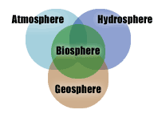
REVIEW
The lithosphere is part of which of Earth’s systems?
A: Atmosphere
B: Geosphere
C: Hydrosphere
D: Biosphere

Slide 4
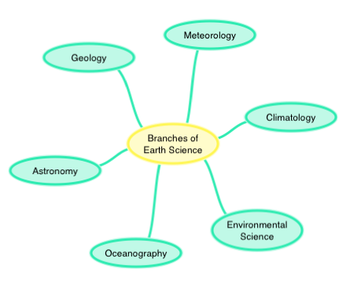
REVIEW
The study of the atmosphere and weather is called?
A: Astronomy
B: Geosphere
C: Meteorology
D: Biosphere

Slide 5
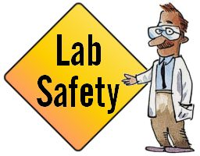
SAFETY
Safety in the Science Lab

Slide 6

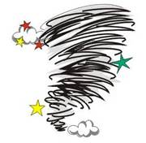

SAFETY DRILLS
Procedures…
Fire Drill – out the door to the right, go to parking lot past bus lane. Stand together. Look for my sign.
Tornado Drill – interior hall walls outside classroom.
Lock Down – lights, windows, on floor.
ALL DRILLS – QUIET.

Slide 7
SAFETY DRILLS
Fire in lab
  1. Fire extinguisher
  2. Fire blanket
Chemicals
  3. Eye wash (15 minutes)
  4. Emergency shower
Know location of each.

Slide 8
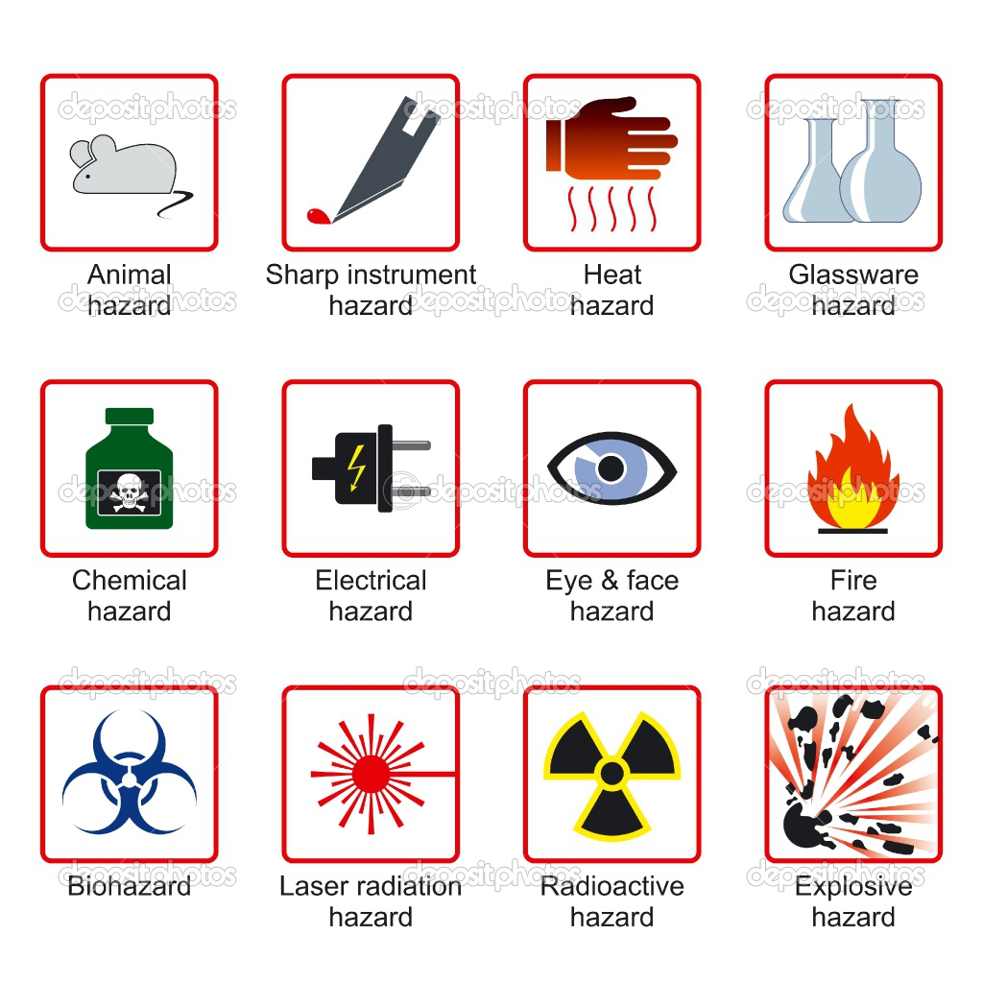
SCIENCE AND SAFETY
Things you can wear:
5. Goggles – wear them if directed!
6. Aprons - optional

Slide 9
SCIENCE AND SAFETY
7. Broken glass box – never in the trash
8. First Aid Kit – for cuts and injuries

Slide 10
SCIENCE AND SAFETY
NUMBER ONE RULE:
Tell your teacher if you spill something or have an accident!

Slide 11
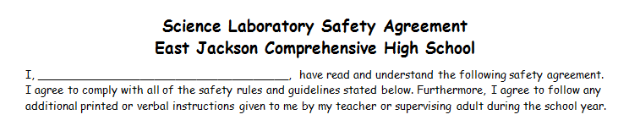
LAB SAFETY CONTRACT
Print your name on the line.

Slide 12

LAB SAFETY CONTRACTS
REQUIRED.
Parents and students both sign it.
It is required before lab work can be done.
There will ne an alternate assignment from the book for those who don’t return contracts.
Due back to us by Monday signed by you and your parent.

Slide 13
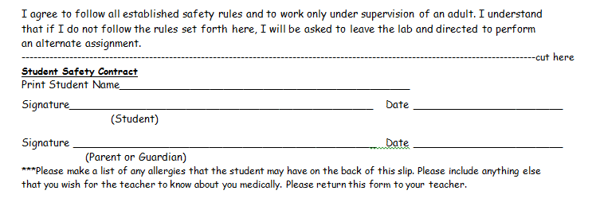
LAB SAFETY CONTRACT
We will cut off the bottom and return the top to you to put in your notebook.

Slide 14
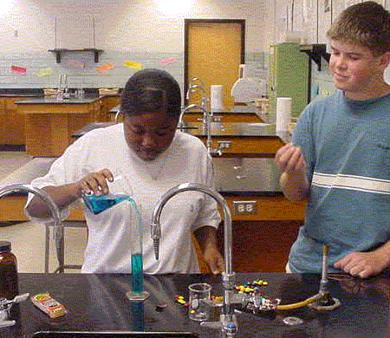
LAB SAFETY
Look at this photo:
1. What rule applies?
2. How you could PREVENT the problem from occurring?
Notes:
Two students are at lab desk. Bunsen burner is on at one side, not being used. The students do not have goggles on. There is food on the lab desk and one of the students is currently eating while pouring a chemical. The desk is relatively clean and the chemical are labeled.

Slide 15
Hair is back – good!
No goggles
– bad!
Food in lab – bad!
Top on bottle
- good!

Slide 16
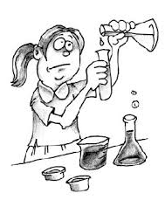
REVIEW
Which safety rule is this student violating?
A: Not measuring accurately
B: Not wearing an apron
C: Not sharing with lab partners
D: Not wearing goggles

Slide 17
PERFORMING A LAB
Plan ahead - read the lab twice.
Gather and organize equipment.
Follow the procedure step by step.
Record ALL observations and use the proper units of measurement.
Clean up, wash hands, put equipment back where it came from.
Answer the questions that go with the lab in complete sentences with no misspellings.

Slide 18
ACTIVITY: CHOSE ONE
Use all 12 Earth Systems Science vocabulary words to create ONE of the following:
Make an illustrated word wall poster (words, illustrations, definitions).
Design a poster on the major branches of Earth Science and the different interacting spheres. Include Illustrations (words, definitions, illustrations).
Create a brochure on the branches of Earth Science (branches, illustrations, definitions).
Create an illustrated concept map (all words in the concept map with definitions).
Create an Earth Systems Science collage that includes images and vocabulary (words, definitions, illustrations)..
DUE TUESDAY!

Slide 19
WORDS TO KNOW
Geology
Meteorology
Oceanography
Climatology
Environmental Science
Astronomy
Geosphere
Hydrosphere
Atmosphere
Biosphere
Lithosphere
Asthenosphere
You may use online resources, the textbook or this presentation on the class website

Slide 20
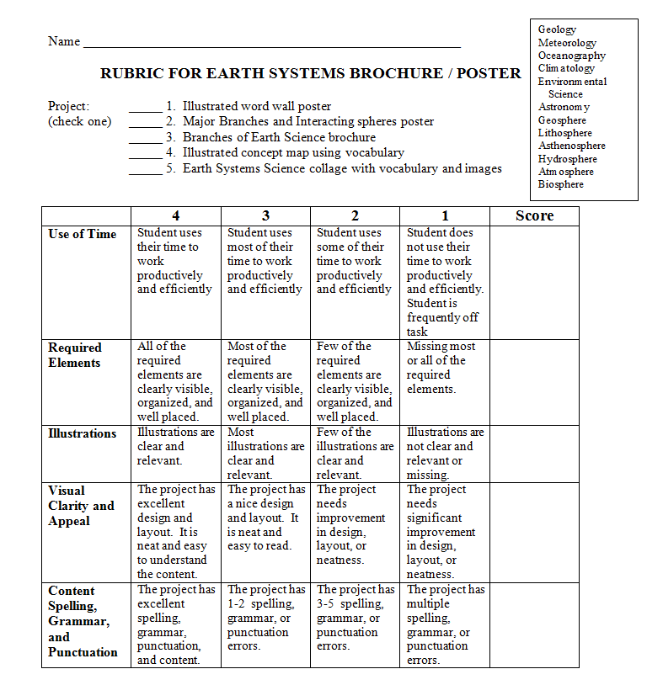

Slide 21
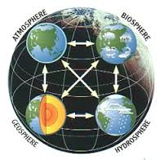
REMAINDER OF CLASS…
Work on your Earth Systems Project – poster or brochure.
Due Tuesday.
Safety Contract due by Friday.

