Slide 1
DO NOW
Pick up notes sheet.
Turn in your signed syllabus, student information sheet, and signed safety contract if you have not already.
If you did not turn in Finding Your Way yesterday, it should be turned in now.

Slide 2

LOOKING BACK….
What are the procedures for a(n):
Fire Drill?
Accident in the Lab?

Slide 3
Science as a Process
How does science work?

Slide 4
SCIENCE AS A PROCESS
Science is an organized way of investigating the natural world.
It is A WAY OF KNOWING about the world.
The SCIENTIFIC METHOD is a way to search for an answer in an orderly, systematic way.

Slide 5
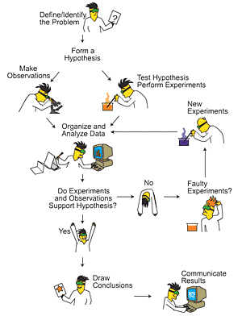
SCIENCE AS A PROCESS
State the Problem
Analyze the problem (gather information)
Form a hypothesis (educated guess)
Test the hypothesis (experiment)
Record and analyze the data
Form a conclusion

Slide 6

STATE THE PROBLEM
Be curious.
Ask questions about what you observe.

Slide 7
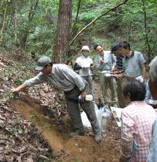
ANALYZE THE PROBLEM
Gather information.
Look for patterns.
Look at what other research has done.

Slide 8
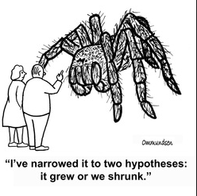
FORM A HYPOTHESIS
Form an educated guess about a solution to the problem.
A hypothesis is an educated guess. Make sure you have educated yourself about the problem.
Usually “If, Then” statements.
Cause and Effect statements.

Slide 9
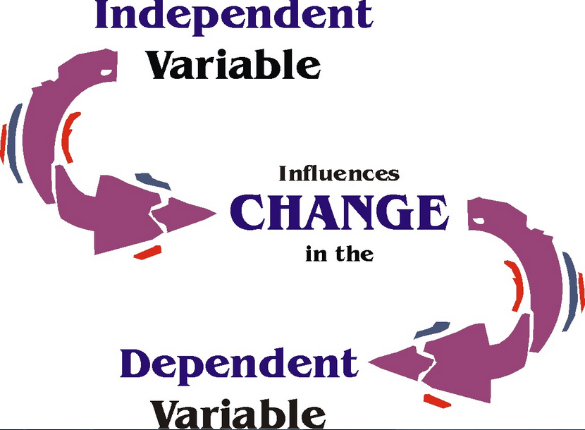
VARIABLES
Independent variable is the one factor you change in the experiment.
Dependent variable is the one factor that changes as a result of your independent variable.

Slide 10
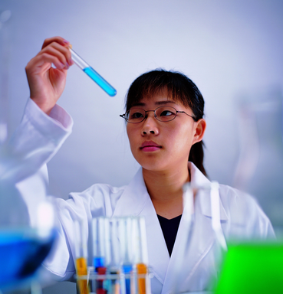
TEST THE HYPOTHESIS
Your experiment
The experiment should be tested multiple times (multiple trials).

Slide 11
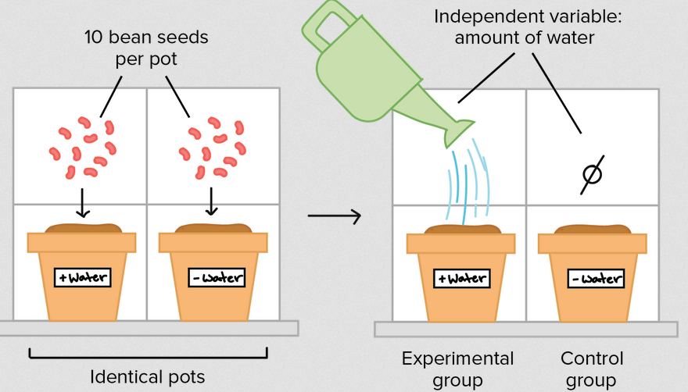
CONTROL
The parts of the experiment that you do not change.
Why is it necessary to have a control in an experiment?

Slide 12
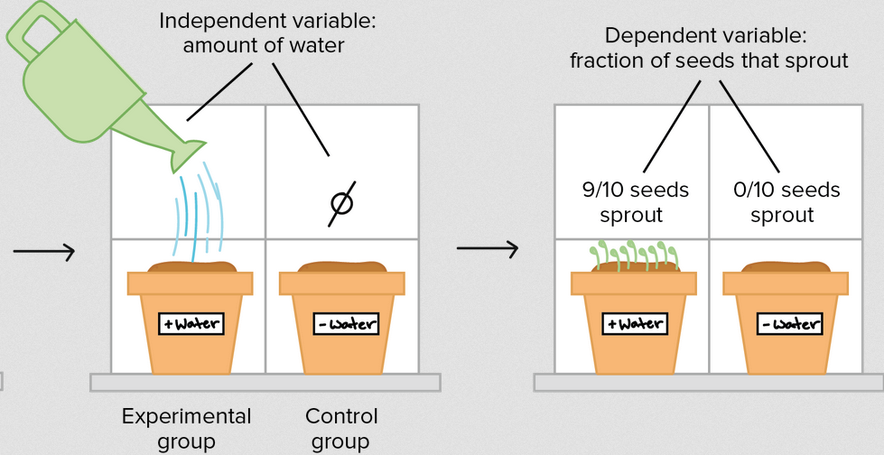
CONTROL VS EXPERIMENTAL
The Control Group is the group you make no changes to.
The Experimental Group is the group that has the independent variable changed.

Slide 13
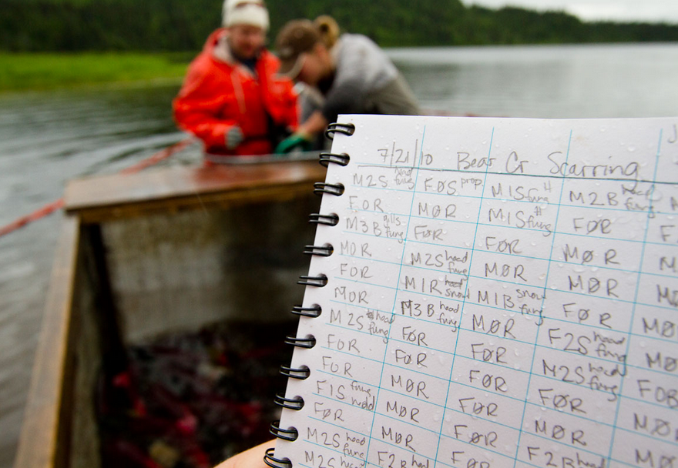
RECORD AND ANALYZE DATA
Write down your data and look for patterns.
Put in an organized data table.
Qualitative data: recorded by observation
Quantitative data: recorded with measuring devices.

Slide 14
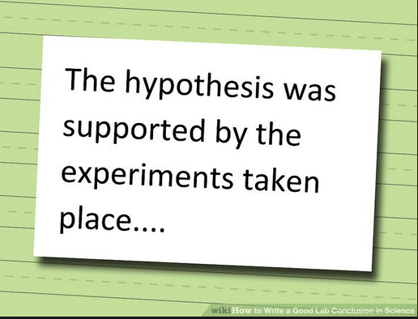
FORM A CONCLUSION
Discuss your hypothesis and support your findings with your data.
Was your hypothesis true?
Does your data prove or disprove your hypothesis?

Slide 15

FOR SOMETHING TO BECOME SCIENCE…
Data must be peer reviewed.
Conclusions must be critiqued.
Methods are repeatable.
Results becomes part of larger pool of evidence to explain phenomena.

Slide 16
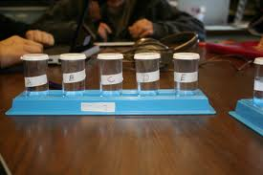
REVIEW
Tina is conducting an experiment to see how shrimp are affected by oil spills. She puts different amounts of oil in different containers of brine shrimp in sea water.
The independent variable is:
A: The amount of shrimp
B: The amount of oil
C: The amount of water
D: The size of the container

Slide 17
SCIENCE SCENARIOS
Scenario 1 Brands of Car Wax
Jack wanted to test which brand of car wax was most effective. He tested three brands of wax. They were Gold Class, Top Coat, and Ultra Shine. He cleaned the hood of his car and removed the old wax. He measured four equal sections on the hood of the car. Each of the waxes was used to cover a section and one section was left with no wax. An equal amount of wax, the same type of rag, and equal buffing were used on the wax sections. The no-wax section used the same rag and was buffed for the same amount of time. Five drops of water were placed on each square, and the diameter of each drop was measured in centimeters. Jack could have used a rating scale for amount of shine, from dull to very shiny.
Identify elements of the Scientific Process in the science scenario

Slide 18
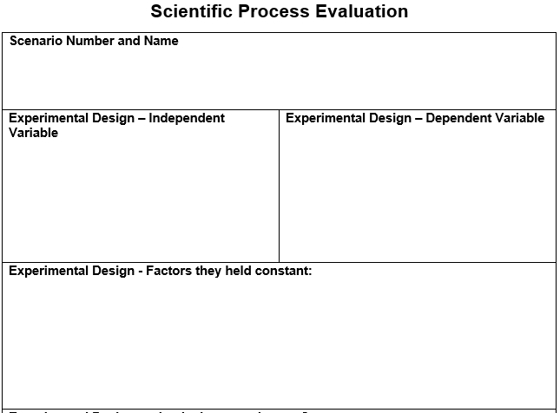
SCIENCE SCENARIO

Slide 19
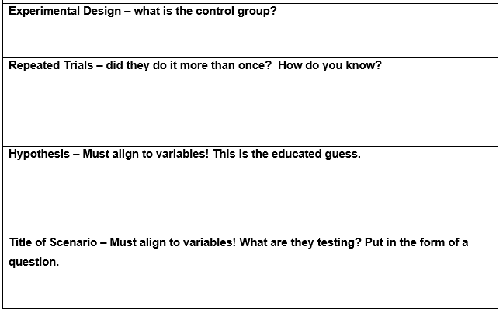
SCIENCE SCENARIO

Slide 20
SCIENCE SCENARIO
You and your talking partner will do the second scenario together.
Scenario 2 Compost and Bean Plants
After learning about recycling, members of John’s biology class investigated the effect of various recycled products on plant growth. John’s lab group compared the effect of different-aged grass compost on bean plants. Because composition is necessary for release of nutrients, the group hypothesized that older grass compost would produce taller bean plants. Three flats of bean plants (25 plants per flat) were grown for five days. The plants were then fertilized as follows: Flat A received 450g of 3-month-old compost, Flat B received 450g of 6-month-old compost, and Flat C received 0g of compost. The plants received the same amount of sunlight and water each day and were planted in the same type soil and containers. At the end of 30 days, the group recorded the height of the plants in centimeters.

Slide 21
TO DO
You and your talking partner will do the second scenario together.
Once your are finished, turn in your and your partner’s sheets.
Then you can work on your project which is due on TUESDAY.

