Slide 1
DO NOW
Get out notes packet.
Turn in syllabus and student information sheet (if you did not yesterday).
Turn in First Day Stations/Fortune Teller Fish handout.

Slide 2
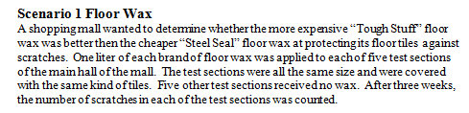
SCENARIO ONE – Floor Wax
Independent variable
Dependent variable
Control
Repeated Trials
Constants
Title
Hypothesis

Slide 3
PERFORMING A LAB
Plan ahead: read the lab twice.
Gather and organize all needed materials.
Follow the procedures step by step.
Record ALL observations (no matter how small) and use proper units of measurements.

Slide 4
PERFORMING A LAB
5. Clean all equipment and put it back where you found it.
6. Answer the questions that go with the lab; use complete sentences with no misspellings.

Slide 5
LAB RULES
NUMBER ONE RULE
Follow all directions and teacher instructions. Do not deviate!

Slide 6
LAB RULES
2. Perform only the activities that are authorized by the teacher.
3. Handle laboratory equipment only when instructed to do so.
4. Report all accidents to the teacher immediately.
5. Do not mix or taste chemicals for the fun of it.
6. Always clean up your workspace when you are finished.

Slide 7
CHOOSING LAB PARTNERS
Groups of two.
You will keep this partner for the semester.
We work at lab desks.
Need a permanent partner by next Tuesday.

Slide 8
HOW MANY PAPER CLIPS?
Work in groups of two or three. Complete the lab sheet as you work.
If you need more paperclips, ask.

Slide 9
STATING THE PROBLEM
Write in the form of a question.
How many paperclips will a full cup of water hold?

Slide 10
GATHERING INFORMATION
Write two complete sentences about information you might look up to help you with this problem.

Slide 11
PREDICTION/HYPOTHESIS
3. PREDICT the number of paper clips the full cup will hold and write it on your lab sheet IN INK.
4. Write a hypothesis:
A full cup of water will hold XXX paperclips.

Slide 12
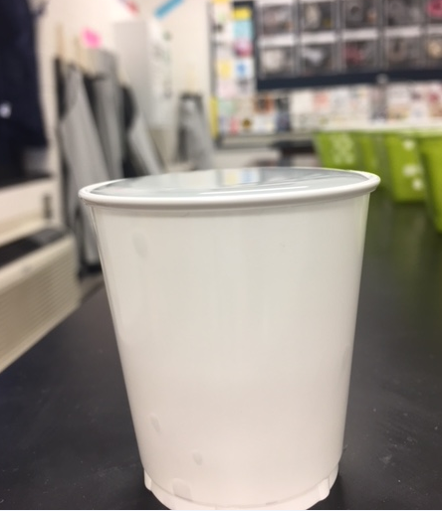
PERFORM THE EXPERIMENT
Materials: paper cup paper clips
Procedure:
Fill the paper cup with water to the very tip top.

Slide 13
PERFORM THE EXPERIMENT
Procedure:
b. Carefully place the paper clips, one at a time, into the water.
c. Describe what is happening:
Be sure to write something here about the water level.

Slide 14
RECORD DATA
List the number of paper clips placed in the cup of water before the water spilled over.

Slide 15
STATING A CONCLUSION
In a sentence, indicate if your hypothesis was true or not.
Give one reason why your hypothesis was or was not correct (in a complete sentence).

Slide 16
WHEN FINISHED
When finished, pour out the water, place the wet paper clips on a paper towel to dry and leave cup and paper clips at the lab desk.
Return to your seat.
Lab is due on Monday– be sure to do the two questions on the back.
Write your lab partner(s) names on the line provided.

Slide 17
PAPER CLIP LAB
With your lab partner(s), show me that you have completed #1, 2, 3 and #4 – estimate should be IN INK.
Once you have shown me, get started.
You have ten minutes to collect the data.
Be sure to fill in 4d – Describe what is happening.

Slide 18
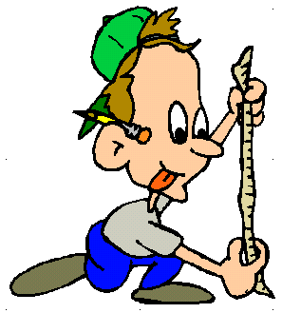
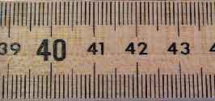
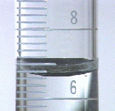
Measurements
The Metric system was developed in France during the Napoleonic reign of France in the 1790's.

Slide 19
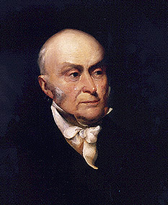
“Weights and measures may be ranked among the necessaries of life to every individual of human society… They are necessary to every occupation of human industry.... The knowledge of them, as in established use, is among the first elements of education...”
JOHN QUINCY ADAMS
- Report to the Congress, 1821

Slide 20
NO METRIC SYSTEM
Only a few small countries (Liberia and Myanmar), plus some Caribbean nations heavily influenced by the U.S., have not formally adopted the use of SI.
Among countries not claiming to be metric, the U.S. is the only significant holdout.

Slide 21
MEASUREMENT
In any measurement system…
    It must be agreed upon and
    It cannot change.
    Ex: The foot versus the cubit

Slide 22
SI SYSTEM
1960 - SI system - Le Systeme Internationale d’Unites (SI) – System International
Based on Metric System

Slide 23
STANDARDS
In a measurement system, there are exact quantities that people agree to use for a certain measurement.
Example: The meter
    The speed that light travels in a vacuum 1/299 792 458 meters in one second.
Why? ...This seems CRAZY!!!
The meter Clip

Slide 24
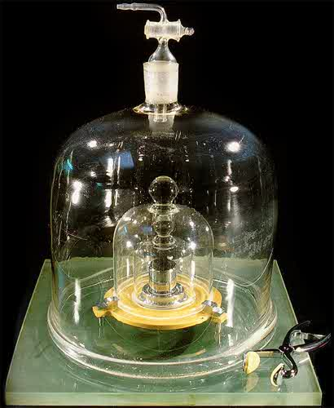
STANDARDS
KILOGRAM:
The official kilogram, made of platinum-iridium, remains in France at the International Bureau of Weights and Measures.

Slide 25
Le Systeme Internationale d’Unites (SI)
English call it International System of Units
Based on multiples of ten.
Each measurement has a base unit.

Slide 26
TO DO
Paper Clip lab is due Monday.

