Slide 1
DO NOW
Pick up notes.
Turn in #34 if you did not Friday.

Slide 2
SUPERMOON
Supermoon Trilogy

Slide 3
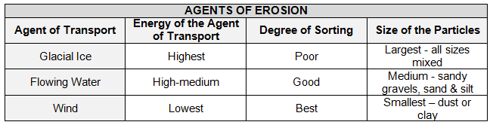
REVIEW #33
Determine the agent of erosion for each example.
The rock has large visible grains (sand-like) and feels gritty. _____________________
The rock has angular pieces, easily seen, with smaller pieces missed in. ____________
The rock has invisible grains (too small to see). ________________________________

Slide 4
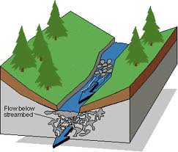
REVIEW
Gravity is the force that causes streams to pick up and move sediment.
What factors affect how sediment is transported and deposited?
Stream gradient
Stream velocity

Slide 5
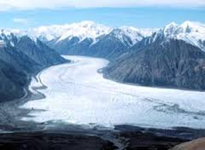
GLACIERS
SES3. Students will explore the actions of water, wind, ice, and gravity that create landforms and systems of landforms (landscapes).
d. Relate the past and present actions of ice, wind, and water to landform distribution and landscape evolution

Slide 6
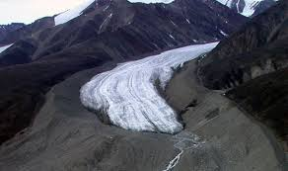
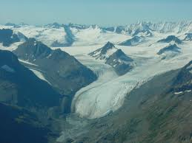
WHAT ARE GLACIERS?
Glaciers are a large mass of moving ice.
They are made up of fallen snow that, over many years, compresses into large, thickened, ice masses.
They flow like slow rivers (thanks gravity!) and shape the landscape.

Slide 7
WHAT ARE GLACIERS?
Cover 10% of land area on Earth (5.8 million square miles).
Store about 75% of the world's freshwater (2% of entire water supply).

Slide 8
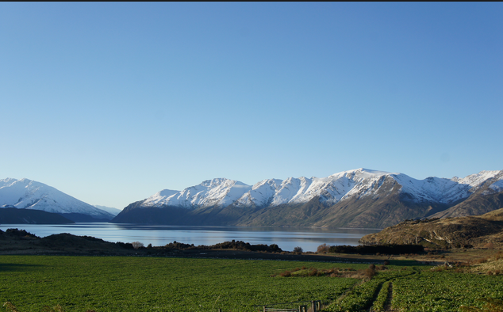
GLACIAL TERMS
Snowline – the elevation above which ice and snow remain year-round.

Slide 9
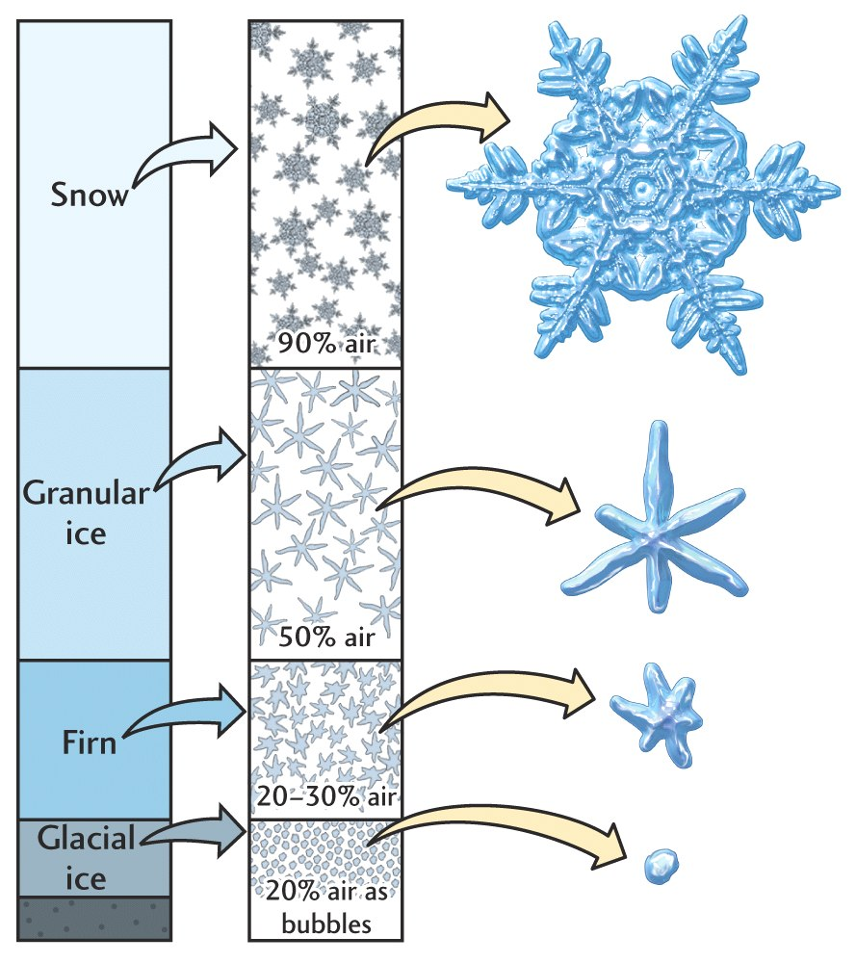
GLACIAL TERMS
Snowfields – a mass of permanent snow and ice that accumulates above the snowline.
  Firn: grainy ice that forms when snow melts and refreezes.

Slide 10
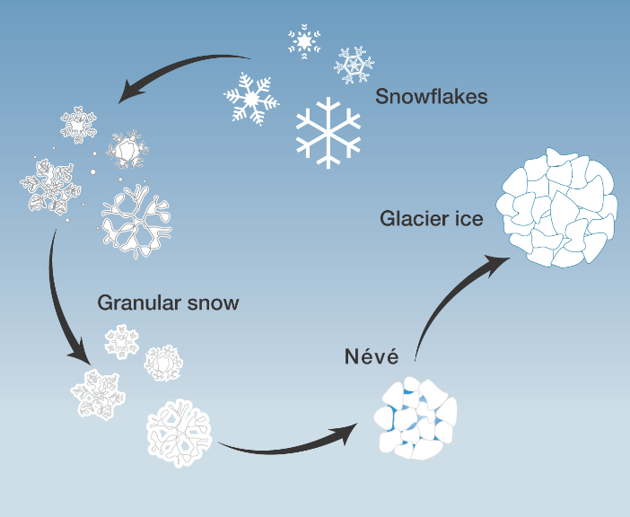
GLACIER FORMATION
Cycles of partial melting and refreezing change snow and ice into FIRN.
Deep layers of snow and firn create pressure on underlying layers.
Continued buildup of firn and snow form a glacier.

Slide 11
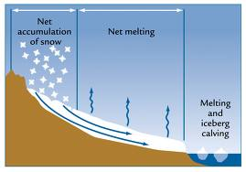
GLACIER FORMATION
It begins to move downslope and outward under its own weight.
Snow added greater than snow melted = glacier grows.
Snow added less than snow melted = glacier recedes.
Size depends on: snowfall added versus ice lost.

Slide 12
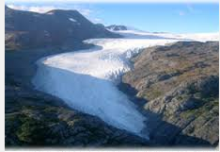
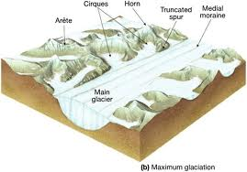
TYPES OF GLACIERS
Alpine
  Narrow, wedge-shaped mass.
  Forms in mountainous regions.
  Confined by topography.

Slide 13
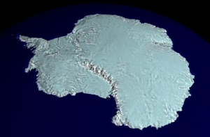
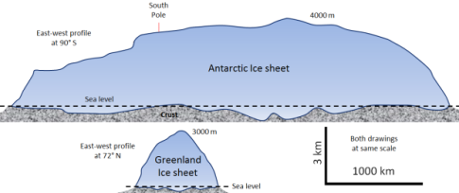
TYPES OF GLACIERS
Continental
  Massive sheets of ice.
  Also called “ice sheet”.
  Unconfined
  Exist only in Greenland and Antarctica.
  Move outward in all directions from center.

Slide 14
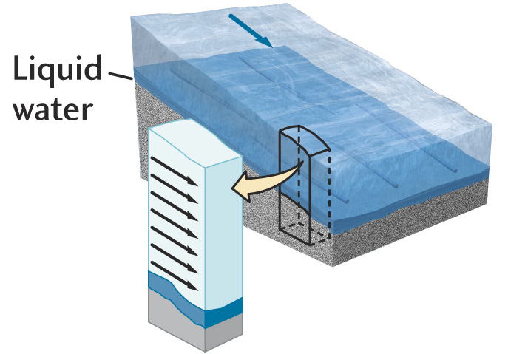
MOVEMENT OF GLACIERS
Movement of Entire Glacier
Weight of ice exerts pressure - lowers the melting point of ice.
Ice melts where glacier touches ground - thin layer of water acts as lubricant.

Slide 15
MOVEMENT OF GLACIERS
Movement of Entire Glacier
Entire glacier slides over thin layer of water and sediment between ice and ground.
Move over small barriers by melting and refreezing.

Slide 16
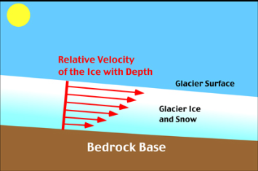
MOVEMENT BY INTERIOR PLASTIC FLOW
Movement of Interior of Glacier
Pressure deforms the ice.
Grains of ice slide over and past each other.
The rate of flow is determined by the slope, the thickness of ice, and the temperature of ice.
Edges of glaciers move slower than center because of the friction with underlying rock.

Slide 17
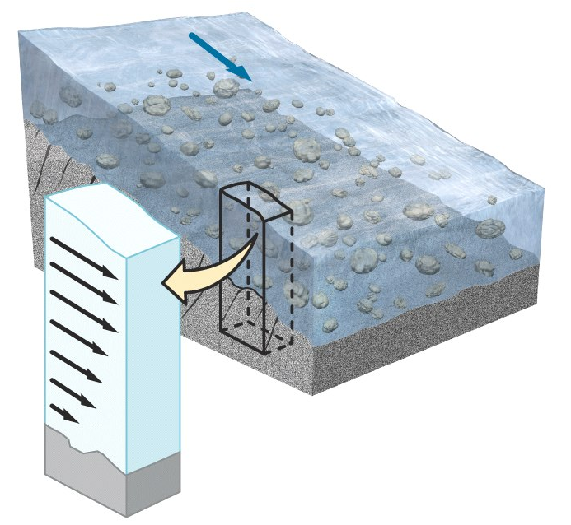
MOVEMENT BY INTERIOR PLASTIC FLOW
Movement of Interior of Glacier
Flows unevenly – interior flows faster than edges.
Surface of glaciers move quicker than the base.
Crevasses – large cracks form due to uneven flow - can be 50 meters deep.
Glacier Movement

Slide 18
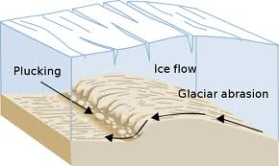
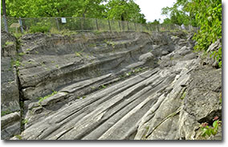
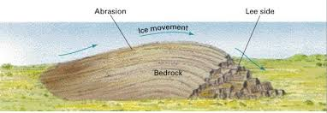
GLACIAL EROSION
HIGH transport energy.
Glaciers pick up and carry sediment.
Rocks carried by glaciers cause abrasion.

Slide 19
GLACIAL EROSION
Rocks gouge grooves in bedrock (glacial striations).
Long parallel grooves in direction of glaciers movement.

Slide 20
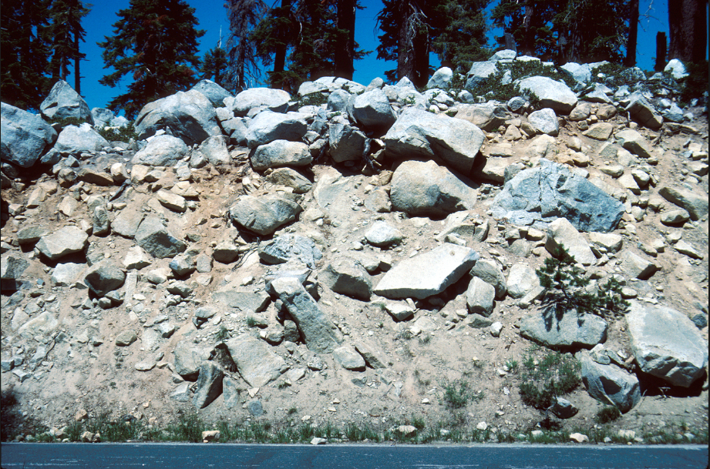
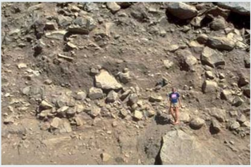
GLACIAL DEPOSITION
Glacial Drift: Sediment carried and deposited by glaciers.
Till: Carried and deposited by ice - unsorted, unorganized glacial drift.

Slide 21
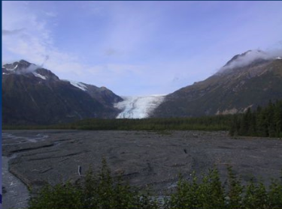
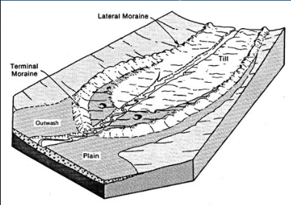
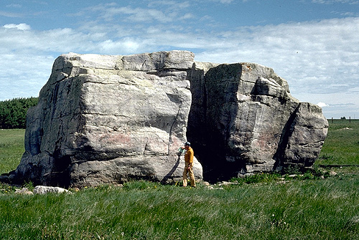
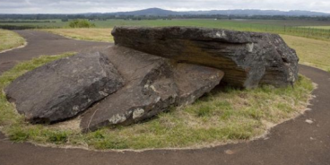
GLACIAL DEPOSITION
Outwash: Carried and deposited by melting water. Deposits that are organized into distinct layers as stream sediment.
Erratics: Large rocks - transported away from source.

Slide 22
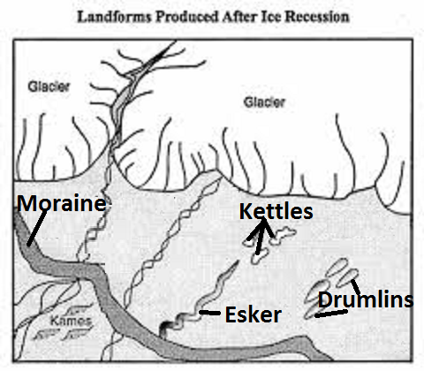
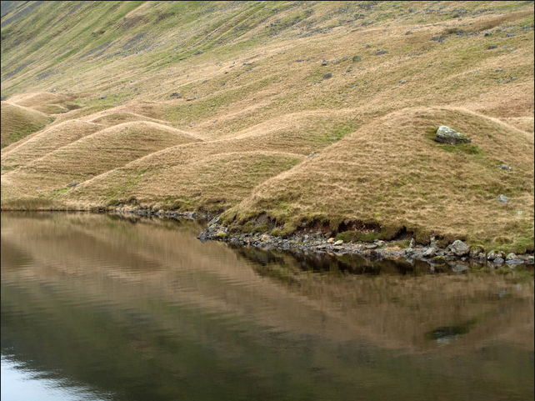
GLACIAL PLAINS LANDFORMS
Drumlins: sediment mounds
Moraines: ridge of deposits – like wall - can be at leading edge of glacier.

Slide 23
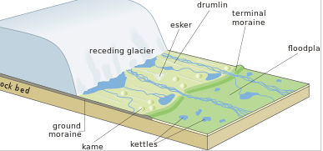
GLACIAL PLAINS LANDFORMS
Kettles: depressions – can form lakes.
Eskers: long, winding ridges of gravel and sand - like raised roadways.

Slide 24
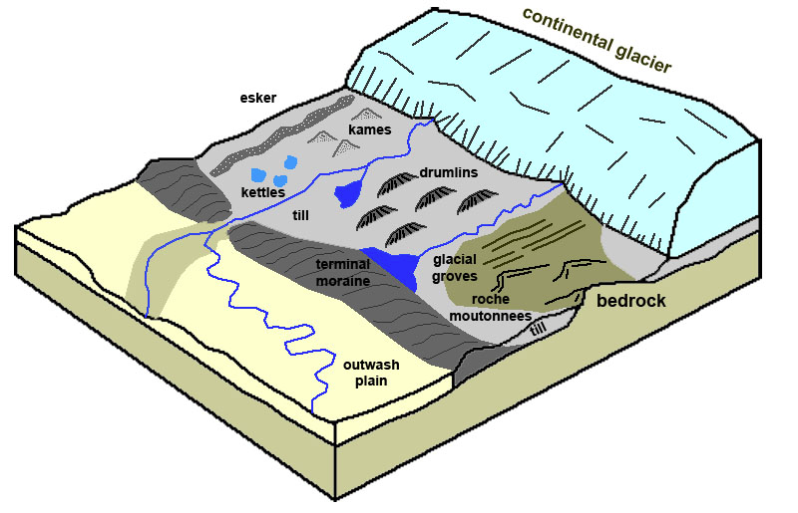
GLACIAL PLAINS LANDFORMS

Slide 25
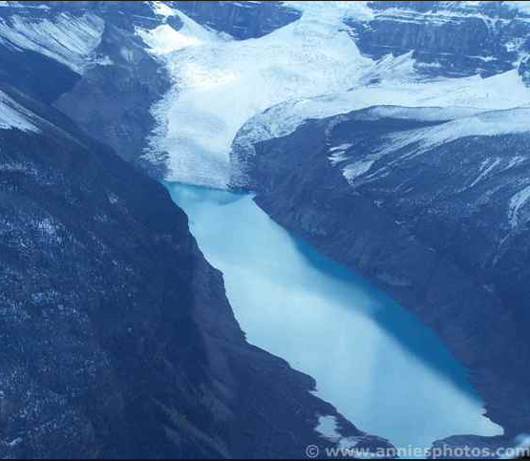
GLACIAL MOUNTAIN LANDFORMS
  Glacial Lakes - formed by erosion and deposition.

Slide 26
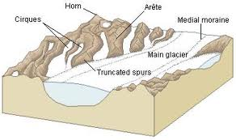
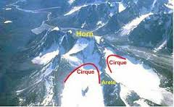
GLACIAL MOUNTAIN LANDFORMS
  Mountain Features:
Cirque (SHURK) – deep, bowl-shaped depression.
Arête (uhRAYT) – sharp, jagged ridges - form between cirques.
Horn – where several arêtes join to form sharp, pyramid-like peak.

Slide 27
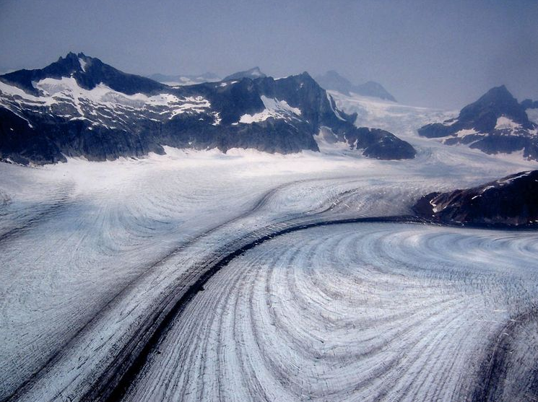
GLACIERS
Mendenhall Glacier

Slide 28
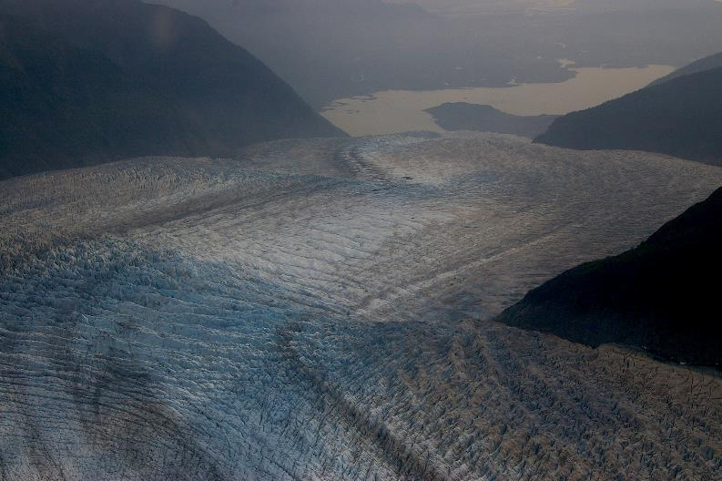
GLACIERS

Slide 29
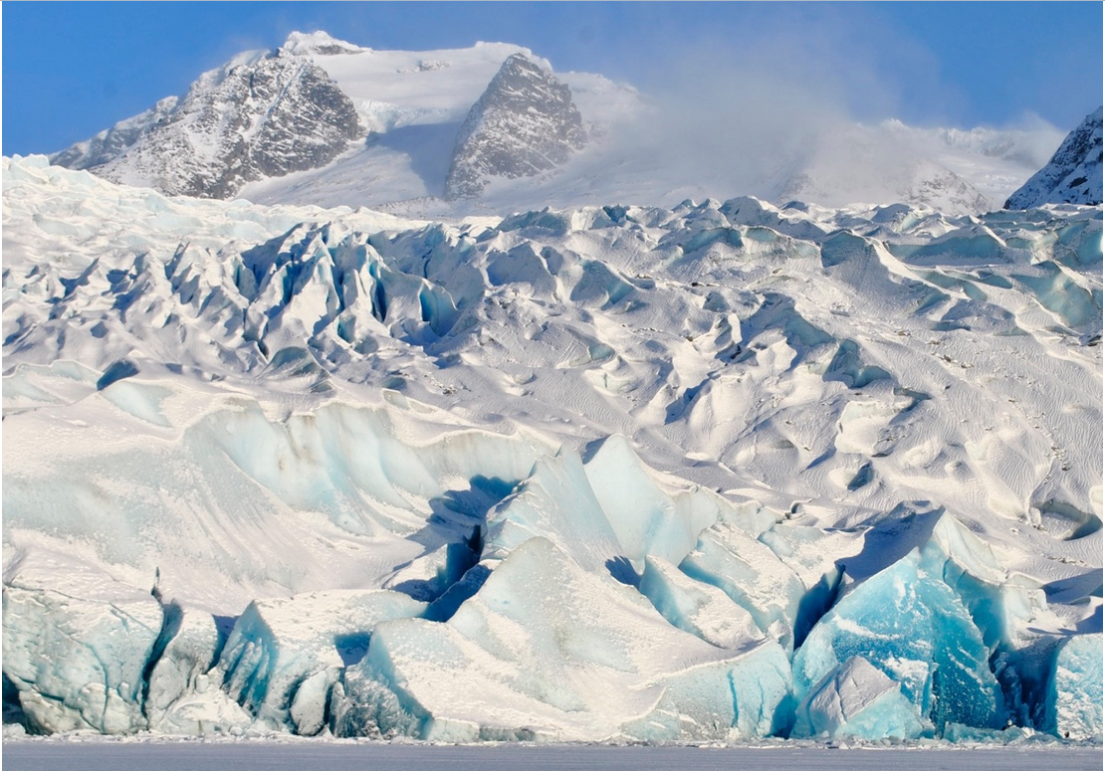
GLACIERS
This is Mendenhall glacier, a river of ice 13 miles long, near Juneau AK. The brighter the blue, the more recently chunks have caved off, exposing the solid-ice interior. Ice is blue for the same reason that water is blue: red light gets preferentially absorbed, while blue can penetrate and be scattered.
For scale, you may be able to see the tiny speck in the extreme lower-righthand corner of the photo. That’s a person!
The gray stripe at the bottom is Mendenhall Lake.

Slide 30
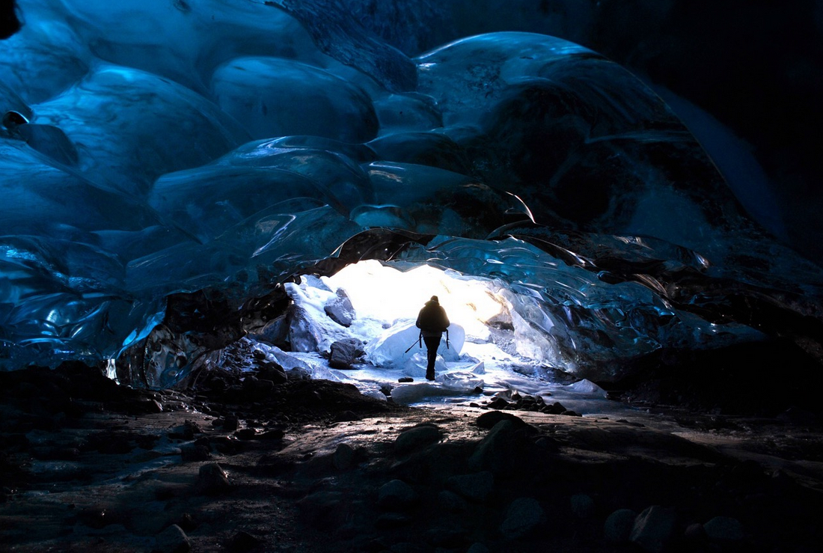
GLACIERS
This ice cave, at the base of the glacier, is a tunnel carved by subglacial meltwater drainage and airflow. (Note the bedrock floor.)
If those ceiling features look like bulbous masses, you’re not alone; I have trouble seeing them as anything else!
In fact they’re large hollows, shaped like the bowl of a spoon and separated from neighboring hollows by arete-like ridges.

Slide 31
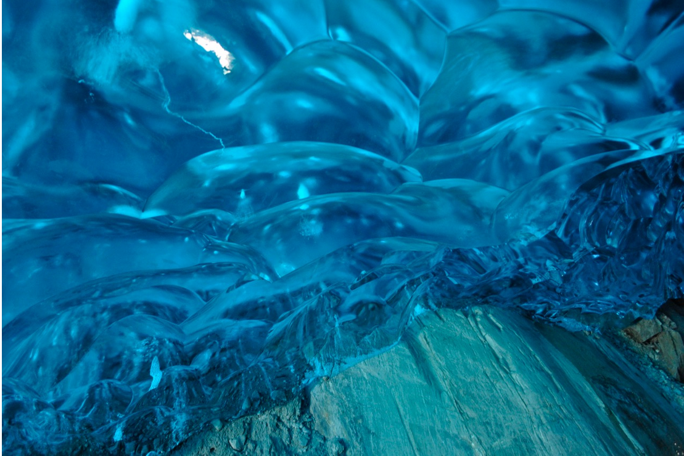
GLACIERS
Here’s a close-up of the ice-bedrock contact.
Note the glacial striations, a result of the glacier sliding.
Typically, about half a glacier’s movement is by internal deformation within the ice, and the other half by basal slip.

Slide 32
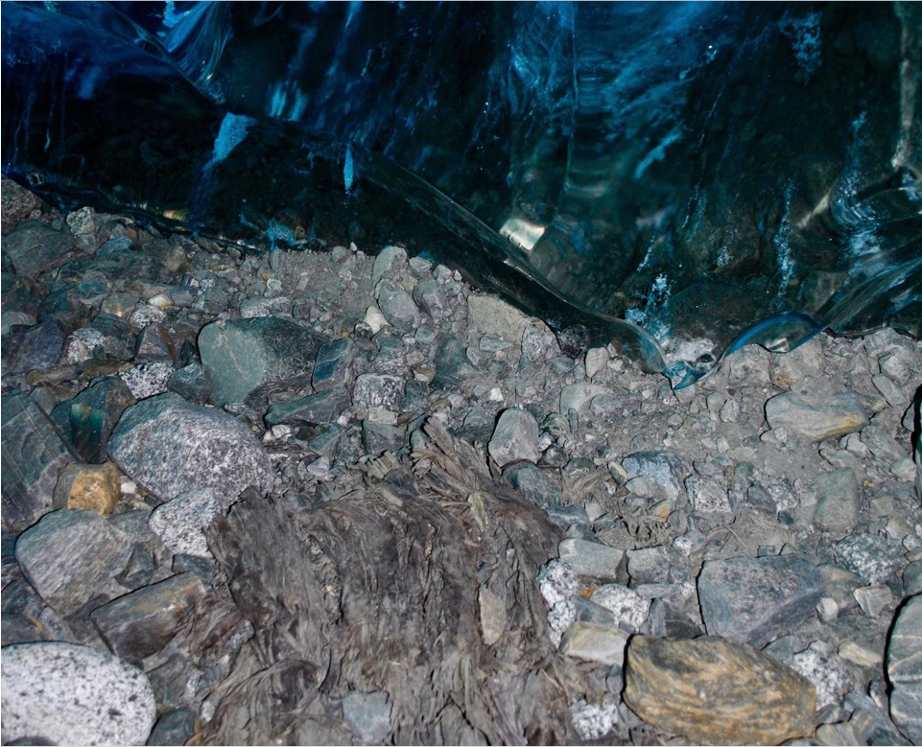
GLACIERS
The glacier is riding over its own debris. Note the truly lousy sorting.
In the late 1800s, anthropogenic warming reversed this 5000-year cooling trend and Mendenhall glacier began a rapid retreat… currently at nearly 200 feet per year!
Carbon-dating shows that the beat-up stump seen here was overridden by the advancing glacier about 2000 years ago. Many stumps like this one are now being exposed.

Slide 33
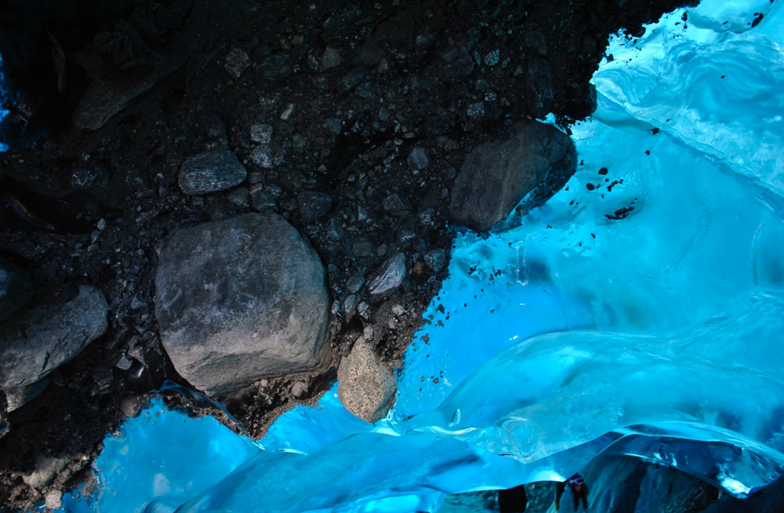
GLACIERS
Here’s some more englacial till. (“Englacial" means it’s currently part of the glacier’s active load.)
But now you’re looking up at the cave’s ceiling! This till is over your head! I’m guessing this dike-like feature is a medial moraine — seen from above, it would appear as a longitudinal stripe of debris decorating a glacier after two tributary glaciers have come together and merged their lateral moraines.
The large boulder is about two feet in diameter.

Slide 34
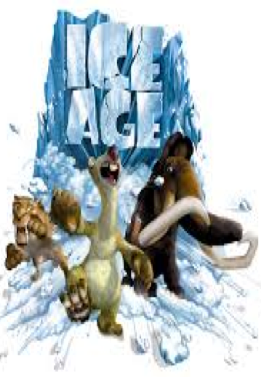
ICE AGES
Ice ages are long periods of climate cooling when continents are repeatedly covered with glaciers.
The most recent began four million years ago.
One third of Earth’s surface covered during last ice age.
Sea level was almost 140 meters lower.

Slide 35
ICE AGES
Possible Causes:
Milankovitch Theory: cyclical changes in Earth’s orbit and in the tilt of its axis causes climatic changes.
Volcanic dust that blocks sunlight.
Incoming solar radiation variations.
Continental Drift changes global patterns of air and ocean circulation.

Slide 36
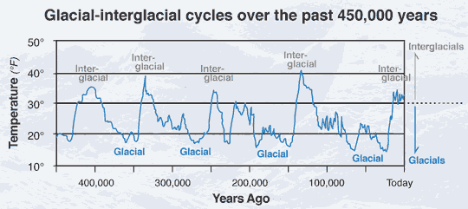
GLACIAL AND INTERGLACIAL PERIODS
Glacial periods:
  Glaciers advance, Cooler climate
Interglacial period:
  Glaciers retreat, Warmer climate

Slide 37
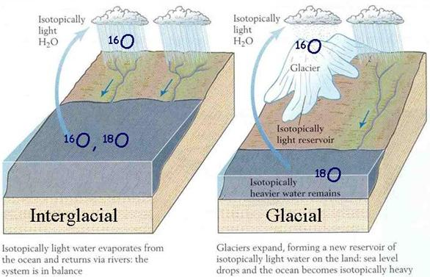
GLACIAL AND INTERGLACIAL PERIODS
Glaciers provide clues to changes in Earth’s climate!

Slide 38
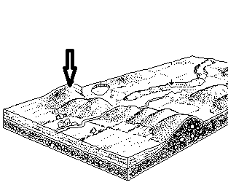
REVIEW
What glacial landform feature is indicated by the arrow?
Esker
Kettle
Moraine
Drumlin

Slide 39
TO DO
Review #35
Any missing work – get your labs done!
Your article summary #5 is due NEXT Monday!

Slide 40
DO NOW
Pick up video sheet.
Turn in Review #35.

Slide 41
VIDEO
EXTREME ICE follows the progress of photojournalist James Balog’s Extreme Ice Survey (EIS), the largest photographic study ever attempted of the cryosphere, the mantle of ice that covers large portions of the Earth.
Vocabulary tomorrow, review Wednesday, Test Thursday.

