Slide 1
DO NOW
Pick up review. You need a calculator.
Prepare for quiz over vocabulary words.
  QUIZLET: https://quizlet.com/_43em5n
Motion test is Monday.
Lab is due Tuesday.

Slide 2
TO DO ONCE YOUR QUIZ IS OVER
Work on lab due Tuesday or the test review.
DO NOT TALK until I tell you that all quizzes have been turned in.
We will then review for Monday’s test.

Slide 3
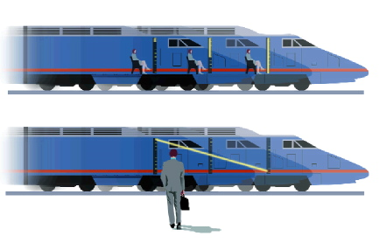
MOTION REVIEW
1. Know how to determine if motion is occurring (according to what measure?).
This is known as a FRAME OF REFERENCE.

Slide 4
MOTION REVIEW
2. Know what motion is and that it is measured by distance and time.
  occurs when something changes position
3. Know the vocabulary words.
Some words are really for the forces chapter.

Slide 5
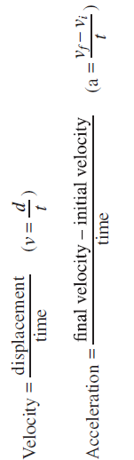
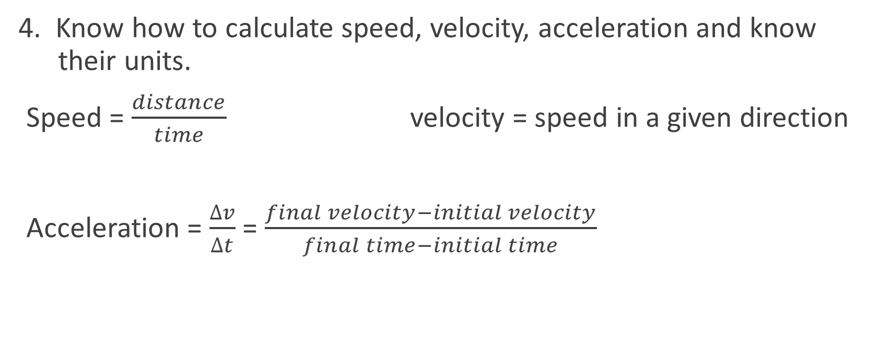
MOTION REVIEW
4. Know how to calculate speed, velocity, acceleration and know their units.
Speed = $\frac{distance}{time}$ velocity = speed in a given direction
Acceleration = $\frac{Δv}{Δt}$ = $\frac{final velocity−initial velocity}{final time−initial time}$

Slide 6
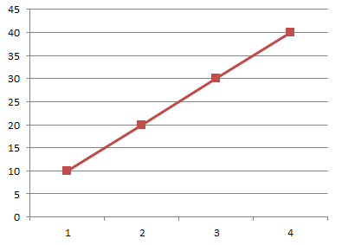
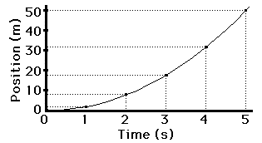
MOTION REVIEW
5. Be able to identify the distance-time graphs for the following:
Constant speed
b. Acceleration

Slide 7
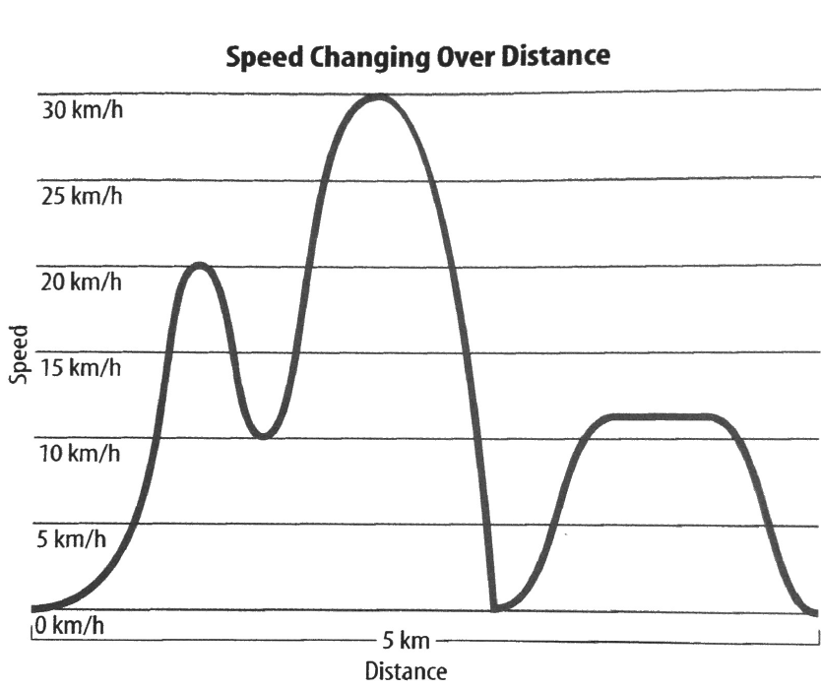
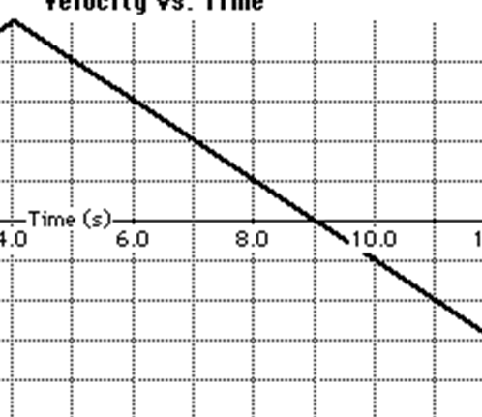
MOTION REVIEW
C. Average speed d. Deceleration

Slide 8
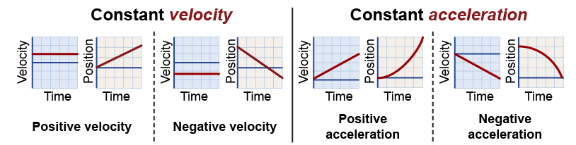
MOTION REVIEW

Slide 9
MOTION REVIEW
6. Be able to solve word problems involving speed, velocity, and acceleration. Be sure to include the following:
  Write what you know and where you are going.
  Write the formula.
  Plug in the data given and solve.
  Be sure your answer has the correct unit.
You will be awarded points on a word problem for the following:
  formula – 1 pt
  what you know and where you are going – 1 pt
  problem set up correctly with units - 2 pts
  correct answer with units - 2pts

Slide 10
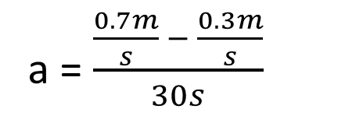
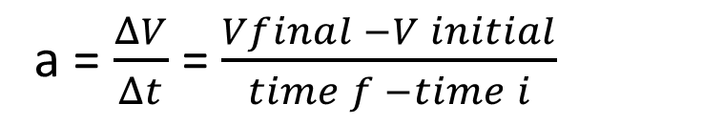
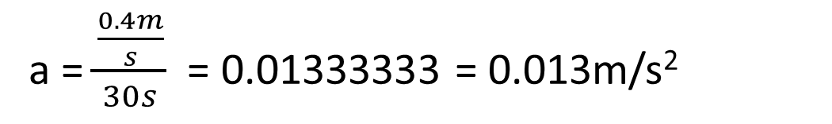
EXAMPLE
Calculate acceleration of a turtle going from 0.3 m/s to 0.7 m/s in 30 seconds.
Velocity_{i} = 0.3m/s
Velocity_{f} = 0.7m/s
Time = 30s
a = $\frac{ΔV}{Δt}$ = $\frac{Vfinal −V initial}{time f −time i}$
a = $\frac{\frac{0.7m}{s} − \frac{0.3m}{s}}{30s}$
a = $\frac{\frac{0.4m}{s}}{30s}$ = 0.01333333 = 0.013m/s²

Slide 11
MOTION REVIEW
Work on the test review. Remember if the packet is turned in complete and on time before the test, you will get test redo credit.
Lab is due Tuesday.
We will review for your midterm Tuesday and Wednesday.

Slide 12
DO NOW
Turn in your test review for test redo credit before the test if it is complete.
Prepare for your test. You need a calculator.
When you get finished with the test, you can work on your lab due tomorrow or the Midterm review packet.

Slide 13
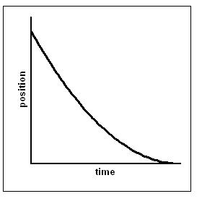
4th - EXTRA CREDIT
What kind of motion does the graph show?
If it takes Leaping Louie 5 minutes to jump 3 blocks, how long will it take for him to jump 15 blocks?
No electronic devices (even music) during the testing time – even if you finish early. Wait until ALL tests are completed.

Slide 14
5th - EXTRA CREDIT
What kind of motion does the graph show?
If it takes Leaping Louie 5 minutes to jump 3 blocks, how long will it take for him to jump 15 blocks?
No electronic devices (even music) during the testing time – even if you finish early. Wait until ALL tests are completed.

Slide 15
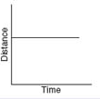
7th - EXTRA CREDIT
What kind of motion does the graph show?
If it takes Leaping Louie 3 minutes to jump 5 blocks, how long will it take for him to jump 15 blocks?
No electronic devices (even music) during the testing time – even if you finish early. Wait until ALL tests are completed.

