Slide 1
NEED TO ADD FOR 2018
Phase Changes
Heating Curve
Add Plasma

Slide 2
DO NOW
Search through your notebook for notes and test reviews on Scientific Method and Measurement, Atomic Theory, Periodic Table, Radioactivity, Bonding, Nomenclature, Chemical Reactions, Matter (Kinetic Theory), Solutions, Acids and Bases, and Motion.
Get out Midterm Review packet

Slide 3
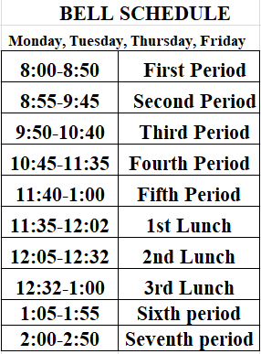
NEW BELL SCHEDULE
55
53
53
53
85
53
53

Slide 4
MIDTERM EXAM
50 multiple choice questions.
Bubble in answer sheet.
Cannot write on the test.
You can do scratch work on the test answer sheet.
You will need a calculator.

Slide 5
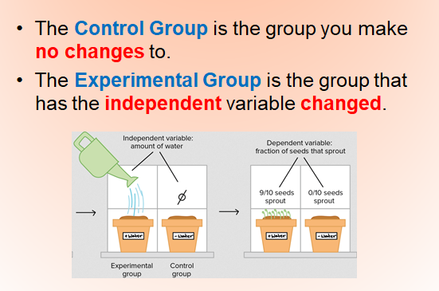
SCIENTIFIC METHOD

Slide 6
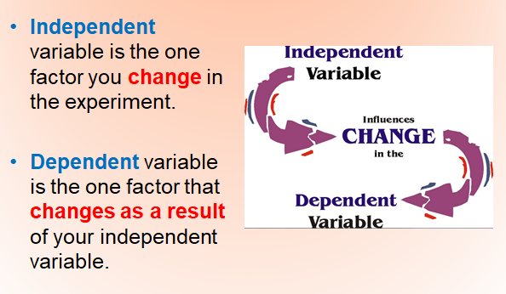
SCIENTIFIC METHOD

Slide 7
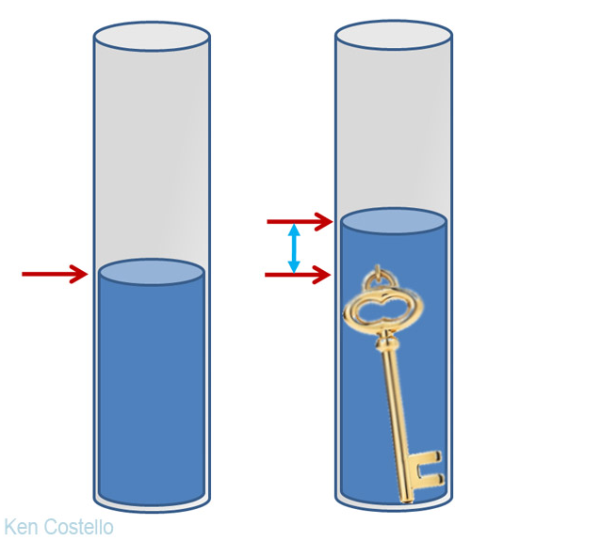
MEASUREMENT

Slide 8
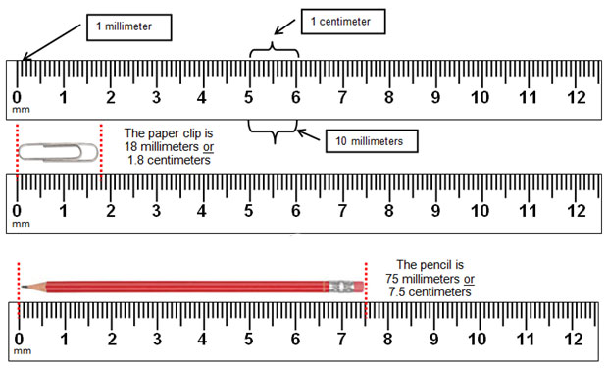
MEASUREMENT

Slide 9
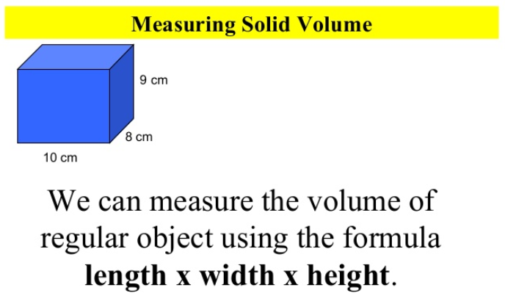
MEASUREMENT

Slide 10
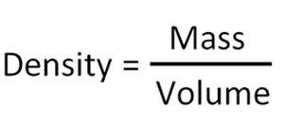
MEASUREMENT
Density is a measure of the amount of mass in a certain volume.
The heavier an object, the more dense it is.
This physical property is often used to identify and classify substances.
It is usually measured in g/cm³.
SAMPLE PROBLEM: What is the density of a billiard ball that has a volume of 100 cm³ and a mass of 250 g?

Slide 11
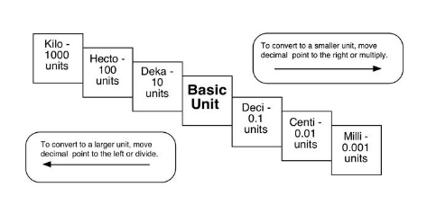
MEASUREMENT

Slide 12
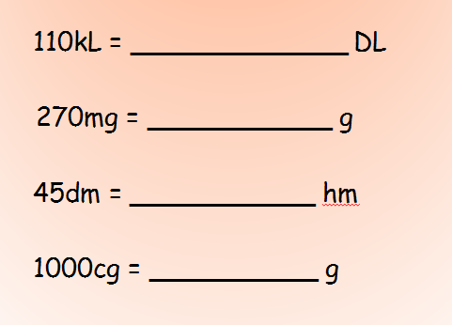
MEASUREMENT

Slide 13
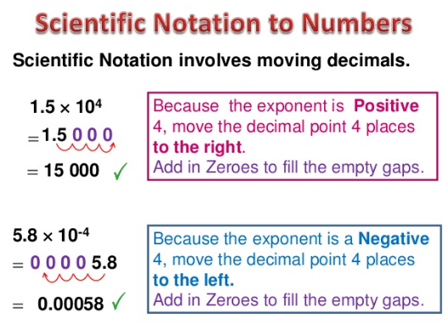
MEASUREMENT

Slide 14
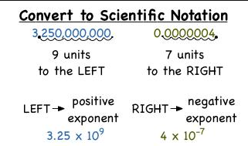
MEASUREMENT

Slide 15
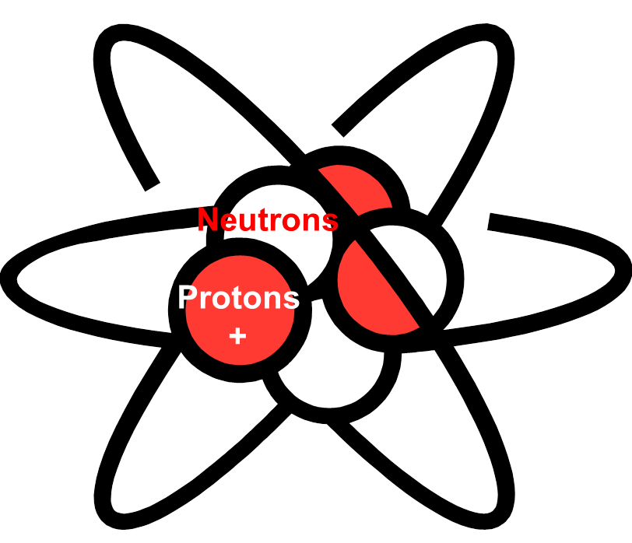
STRUCTURE OF THE ATOM
All matter is made up of atoms.
Subatomic Particle | Charge | Location | Size
Proton (p⁺) | 1+ | Nucleus | Equal to size of neutron
Neutron (n) | 0 | Nucleus | Equal to size of proton
Electron (e⁻) | 1- | Outside nucleus | Smallest subatomic particle

Slide 16

STRUCTURE OF THE ATOM
Protons (+) equals Electrons (-)
Electrons (- charge) and protons (+ charge) to make the atom electrically neutral.
Protons(+)
Electrons (-)

Slide 17
STRUCTURE OF THE ATOM
The atomic number of an element is what distinguishes it from all other elements.
The atomic number is the number of protons there are in the nucleus.
Hydrogen's atomic number is 1.
Helium's atomic number is 2.
Atomic Number
1
H
Hydrogen
1.0079
Atomic Number
2
He
Helium
4.0026

Slide 18
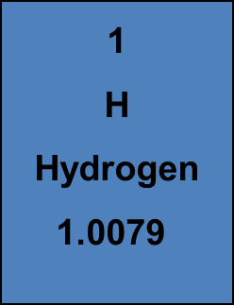
STRUCTURE OF THE ATOM
The atomic mass is the larger number on the periodic table.
It is the average of the masses of the isotopes of that element.
2
He
Helium
4.0026
Atomic Mass
Atomic Mass

Slide 19
STRUCTURE OF THE ATOM
The mass number is the number of neutrons added to the number of protons.
In other words, the total number of particles in the nucleus.
2
He
Helium
4.0026
Take atomic mass and round to a whole number
1 4

Slide 20
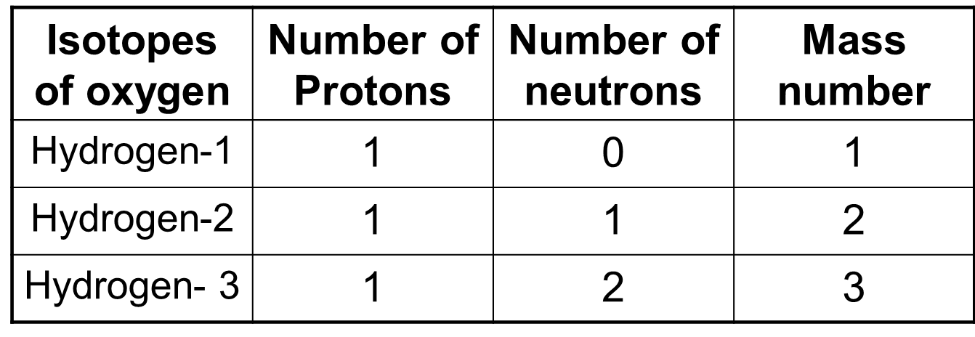
STRUCTURE OF THE ATOM
Isotopes are atoms of the same element that have different numbers of neutrons and different mass numbers.
To distinguish one isotope from another, the isotopes are referred by their mass numbers.
hydrogen

Slide 21
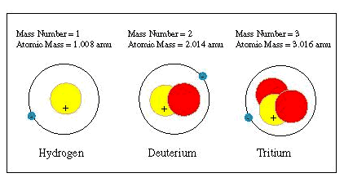
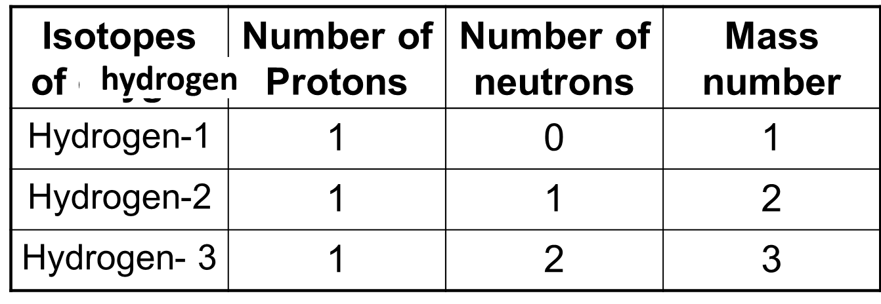
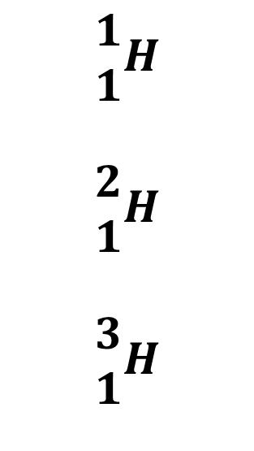
$$\begin{matrix}1 \\ 1\end{matrix}H$$
$$\begin{matrix}2 \\ 1\end{matrix}H$$
$$\begin{matrix}3 \\ 1\end{matrix}H$$

Slide 22
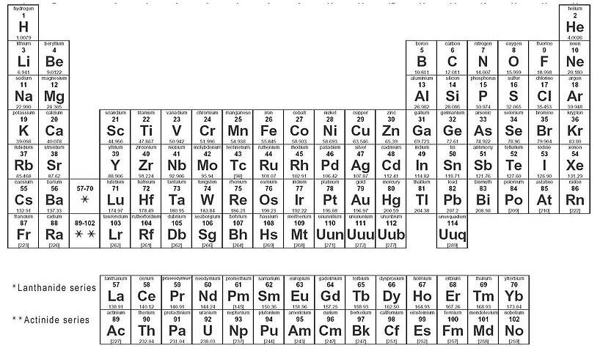
PERIODIC TABLE
The Periodic Table is organized into
  Rows (periods)
  Columns (groups)

Slide 23
PERIODIC TABLE
Horizontally into Periods- Total of 7
Each row in the table of elements is a period.
  Elements in period 1 have one energy level.
  Elements in period 2 have two energy levels.
  Elements in period 3 have three energy levels.
  Elements in period 4 have four energy levels.
  Elements in period 5 have five energy levels.
  Elements in period 6 have six energy levels.
  Elements in period 7 have seven energy levels.

Slide 24
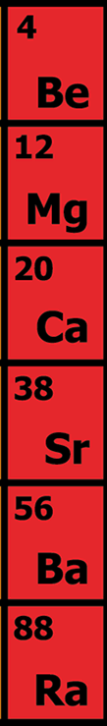
PERIODIC TABLE
There are 18 GROUPS
Vertically into Groups
Groups
Each column in the periodic table is called a group.
  The elements in a group have the same number of valence electrons.
  Therefore members of a group in the periodic table have similar chemical properties.

Slide 25
PERIODIC TABLE
Vertically into Groups
Elements in group 1 have one valence electron.
Elements in group 2 have two valence electrons.
Elements in group 13 have three valence electrons.
Elements in group 14 have four valence electrons.
Elements in group 15 have five valence electrons.
Elements in group 16 have six valence electrons.
Elements in group 17 have seven valence electrons.
Elements in group 18 have eight valence electrons; except Helium (2).

Slide 26
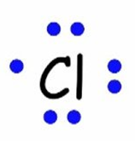
ELECTRON DOT DIAGRAMS
Each ‘side’ of the symbol represents an orbital. Draw the dots on the appropriate sides to represent the electrons in that orbital. Start at top and work your way around.
Dots correspond to the number of valence electrons.

Slide 27
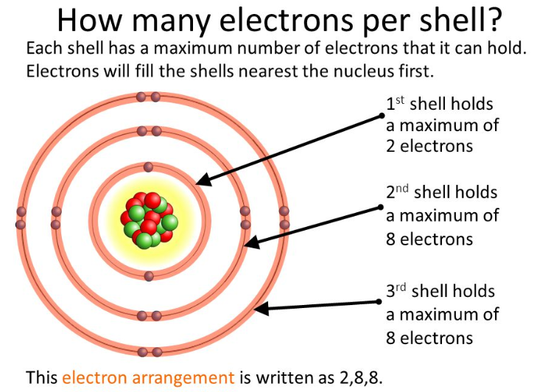
PERIODIC TABLE
Each horizontal row is also the electron shell.

Slide 28
PERIODIC TABLE
Atoms for ions based on their group:
Elements in group 1 form a 1+ ion
Elements in group 2 form a 2+ ion
Elements in group 13 form 3+ ion
Elements in group 14 form a 4+ or 4- ion
Elements in group 15 form a 3- ion
Elements in group 16 form a 2- ion
Elements in group 17 form a 1- ion
Elements in group 18 form NO ions.

Slide 29
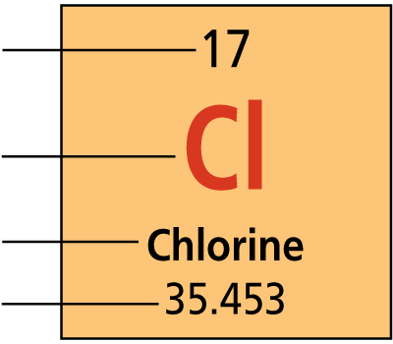
PERIODIC TABLE
There are four pieces of information for each element.
1. Atomic number
2. Element symbol
3. Element name
4. Atomic mass

Slide 30
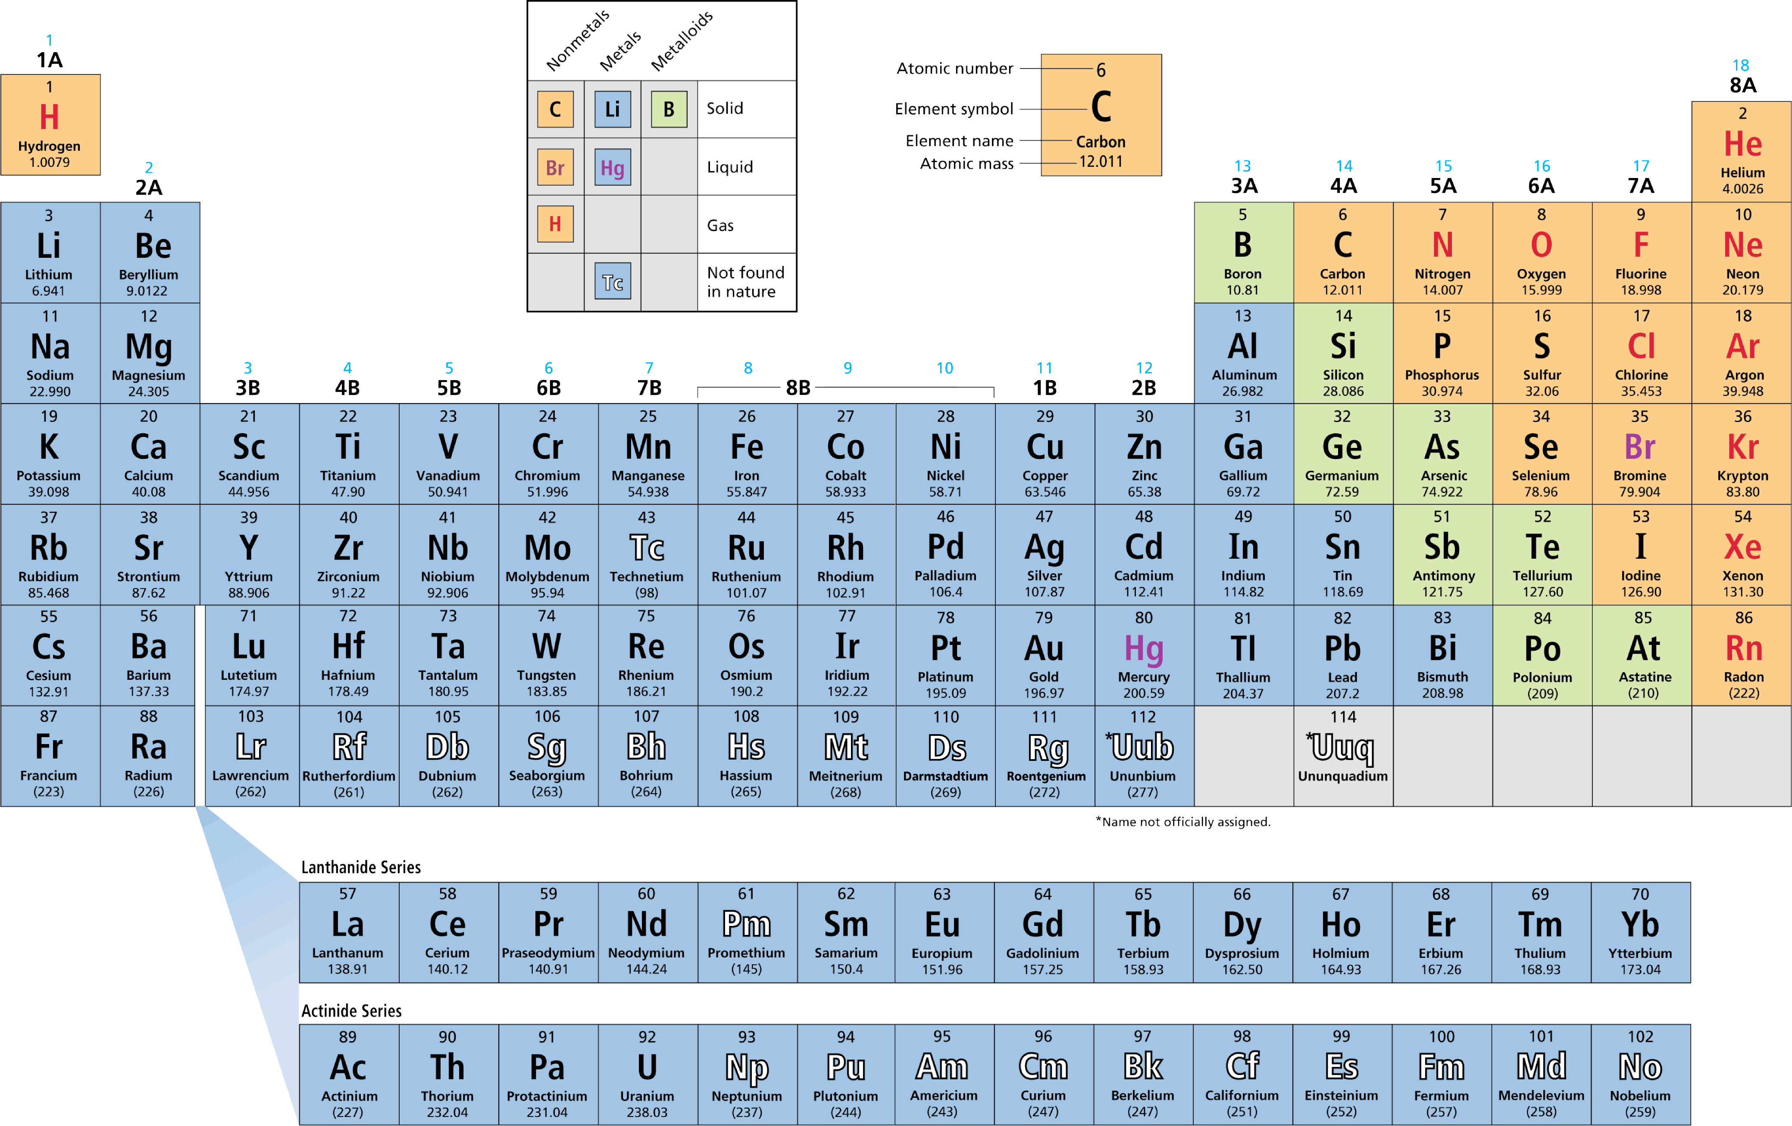
PERIODIC TABLE

Slide 31
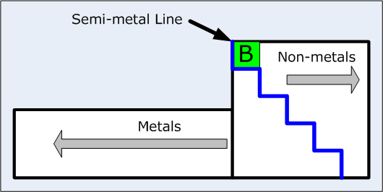
Elements to the left of the blue stair case line are metals.
Elements to the right of the staircase line are nonmetals
Elements along the staircase line are metalloids/semi-conductors.

Slide 32
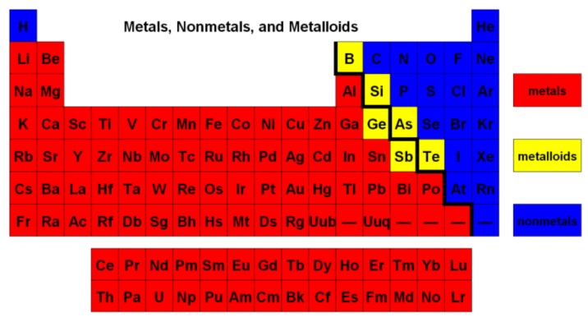
PERIODIC TABLE
METALS
The majority of the elements on the periodic table are classified as metals.

Slide 33
PERIODIC TABLE
METALS
Metals are elements that are good conductors of electric current and heat.
  Except for mercury (liquid), metals are solids at room temperature.
  Most metals are malleable.
  Many metals are ductile; that is, they can be drawn into thin wires.

Slide 34
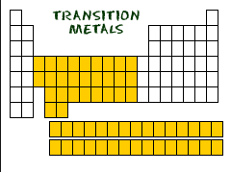
PERIODIC TABLE
The metals in groups 3 through 12 are called transition metals. Transition metals are elements that form a bridge between the elements on the left and right sides of the table.
  Transition elements, such as copper and silver, were among the first elements discovered.
  One property of many transition metals is their ability to form compounds with distinctive colors.

Slide 35
PERIODIC TABLE
Nonmetals
Nonmetals generally have properties opposite to those of metals.

Slide 36
PERIODIC TABLE
Nonmetals
  Nonmetals are elements that are poor conductors of heat and electric current.
  Nonmetals have low boiling points–many nonmetals are gases at room temperature.
  Nonmetals that are solids at room temperature tend to be brittle. If they are hit with a hammer, they shatter or crumble.

Slide 37
PERIODIC TABLE
Metalloids
Metalloid elements are located on the periodic table between metals and nonmetals.

Slide 38
PERIODIC TABLE
Metalloids
  Metalloids are elements with properties that fall between those of metals and nonmetals.
  For example, a metalloid’s ability to conduct electric current varies with temperature. Silicon (Si) and germanium (Ge) are good insulators at low temperatures and good conductors at high temperatures.

Slide 39
PERIODIC TABLE
Some groups have specific names
  Group 1- alkali metals (most reactive metals)
  Group 2- alkaline earth metals
  Groups 3-12- transition metals
  Group 17- halogens (most reactive nonmetals)
  Group 18- noble gases (unreactive)
Group 1 and Group 17 are the most reactive elements.
Group 18, the noble gases, are unreactive.

Slide 40
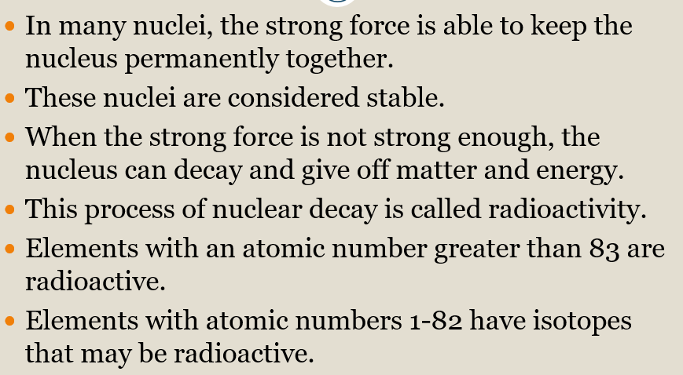
RADIOACTIVITY
Radioactivity is the spontaneous emission of radiation from an element because the strong force cannot hold the nucleus together.

Slide 41
RADIOACTIVITY
 | ALPHA | BETA | GAMMA
Type | Particle | Particle | energy
Charge | Positive | Negative | Neutral
Composition | Two protons and two neutrons | One electron | Pure energy
Mass | 4 amu | 1/1840 amu | none
Symbol | α | β | γ
Stopped by | Paper | Thin metal | Thick lead or concrete
Size | Largest | Smaller | Smallest
New element? | Atomic # drops by two | Atomic # goes up by one | No change

Slide 42
RADIOACTIVITY
Unstable nuclei lose energy by emitting matter and energy in a spontaneous (does not require energy) process called radioactive decay.
The atom undergoes radioactive decay until it becomes stable.
Radioactive decay rates are measured in half-lives.
A HALF-LIFE is the time it takes for one half of the radioactive sample to decay.

Slide 43
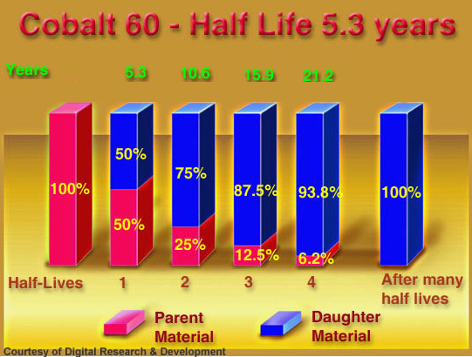
RADIOACTIVITY
Different isotopes have different half-lives.

Slide 44
RADIOACTIVITY
The half-life of Zn-71 is 2.4 minutes. If one had 100.0 g at the beginning, how many grams would be left after 7.2 minutes has elapsed?

Slide 45
RADIOACTIVITY
After 24.0 days, 2.0mg of an original sample of 128.0mg sample remains. What is the half-life of the sample?

Slide 46
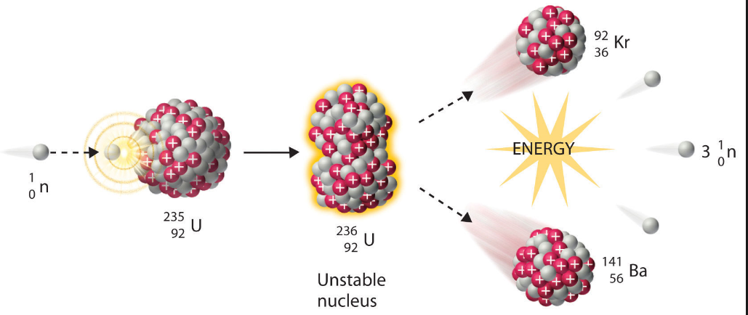
RADIOACTIVITY
NUCLEAR FISSION
Large nucleus splits into two smaller one, releasing energy
A CHAIN REACTION can occur is there are enough nuclei present to be split and the reaction keeps going.

Slide 47
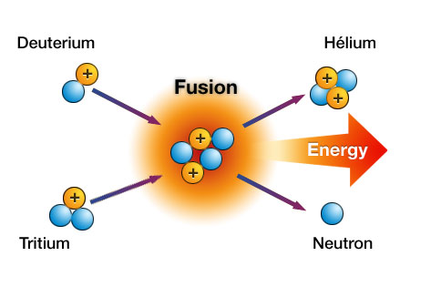
RADIOACTIVITY
NUCLEAR FUSION
Two small nuclei fuse creating one larger nucleus, releasing energy.
In the sun, several hydrogen fuse to form one helium.

Slide 48
RADIOACTIVITY
Fusion fuses atomic nuclei together.
Fission splits nuclei apart.
 | FISSION | FUSION
Involves | One nucleus becoming two | Two nuclei becoming one
Energy released | Less | 3-4 times more
Where does it occur | Nuclear power generators, bombs | Sun

Slide 49
RADIOACTIVITY
Advantages and disadvantages of using nuclear energy to produce electricity.
ADVANTAGES | DISADVANTAGES
No fossil fuels | Mining can damage environment
No air pollutants | Produces heat pollution in the water used to cool
Cheap to produce electricity | Expensive to build plants
More energy available | Accidental radiation leaks
 | No place for the waste to go to finish decaying

Slide 50
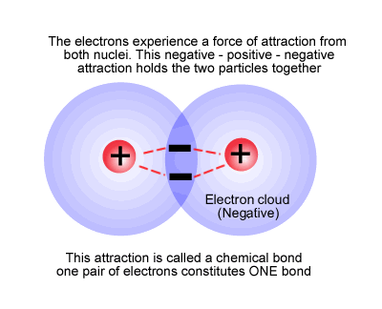
CHEMICAL BONDING
A Chemical Bond is the force that holds atoms together in a compound.
They are formed because it makes the atom more stable.

Slide 51
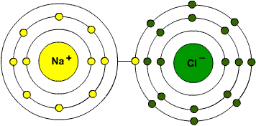
IONIC BONDS
involves a TRANSFER of electrons from one atom to another.
happens between positive ions and negative ions.

Slide 52
IONIC BONDS
high melting and boiling points
tend to be soluble in water
Solids are poor conductors of heat and electricity.
When dissolved in a liquid or melted, they become good conductors.
Generally forms between elements on opposite sides of the periodic table.

Slide 53
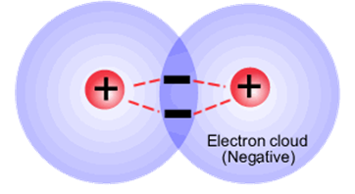
COVALENT BONDS
Atoms with similar electron affinities tend to SHARE electrons.
Neither atom wants to lose electrons; both want to gain them.

Slide 54
COVALENT BONDS
Usually forms between nonmetals.
low melting points compared to ionic
many exist as gases or vaporize easily at room temperature
relatively soft, brittle
Poor conductors of electricity.

Slide 55
NOMENCLATURE
A chemical formula tells:
what type of atoms are present.
the number of each type of atom present.
ratio of one atom to another.
Can tell you if the compound is ionic or covalent (molecular)
H₂O Cl₂ Al₂O₃

Slide 56
NOMENCLATURE
IONIC
contains cations and anions.
Includes metals and nonmetals.
Metals go first in name and formula.
Naming compounds
  Write the name of the cation (metal)
  Write the name of the anion and change the ending to “ide”.

Slide 57
NOMENCLATURE
IONIC
Writing Formulas
  Write the charge for the element over the name. You determine the charge by looking at your periodic table or the list of ions in your notes.
  Write the symbol for the cation, followed by the symbol for the anion.
  Crisscross the numbers only (not the signs), writing the oxidation number as a subscript for the other. Do not write the number 1. Balance the charges by placing the subscripts. Net charges must be zero.
  Make sure the formula is in its simplest form. Mg₂O₂ is reduced to MgO, but MgCl₂ cannot be reduced.

Slide 58
NOMENCLATURE
IONIC
Some cations (positive ions) can have more than one charge.
Most are transition elements. Lead and tin are exceptions.
It is important to distinguish which ion is in the compound. – using a Roman numeral in the NAME ONLY. Ex. Copper(II) sulfide

Slide 59
NOMENCLATURE
COVALENT
Called molecular
usually binary;
called a molecule
usually contain two nonmetals; or a metalloid and a nonmetal

Slide 60
NOMENCLATURE
COVALENT/MOLECULAR:
Use prefixes to identify the number of atoms present.
If only one of the first atom (nonmetal), then NO prefix is used.
Last element ends in “ide”.
* Can combine in different ratios so MUST use prefixes.

Slide 61
NOMENCLATURE
COVALENT NAMING
Prefixes:
1 - mono 6 - hexa
2 - di 7 - hepta
3 - tri 8 - octa
4 – tetra 9 - nona
5 - penta 10 - deca

Slide 62
NOMENCLATURE
COVALENT
Write the symbol of the first element adding a subscript of the number of atoms present. If only one of the first atom (nonmetal), then NO number is used.
2. Write the symbol of the second element adding a subscript of the number of atoms present.

Slide 63
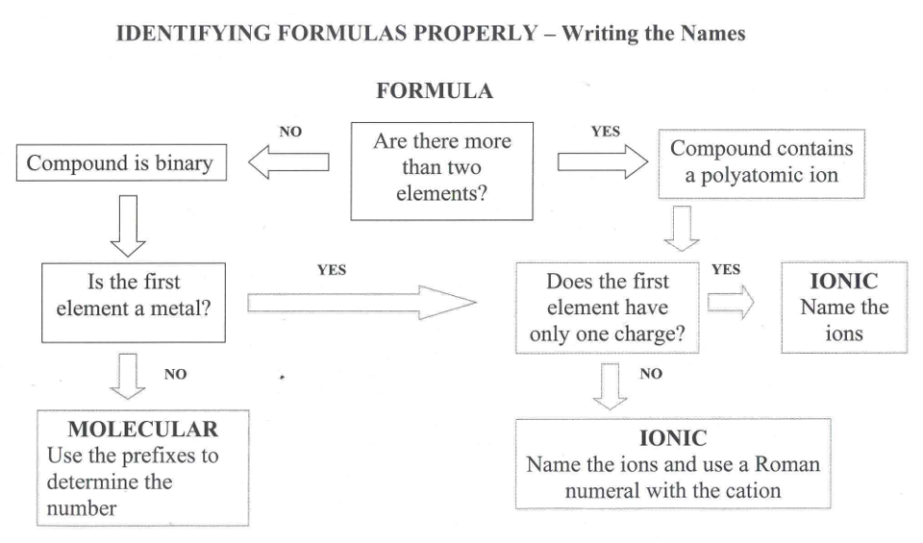
MgSO₄ P₂O₅ Na₂O

Slide 64
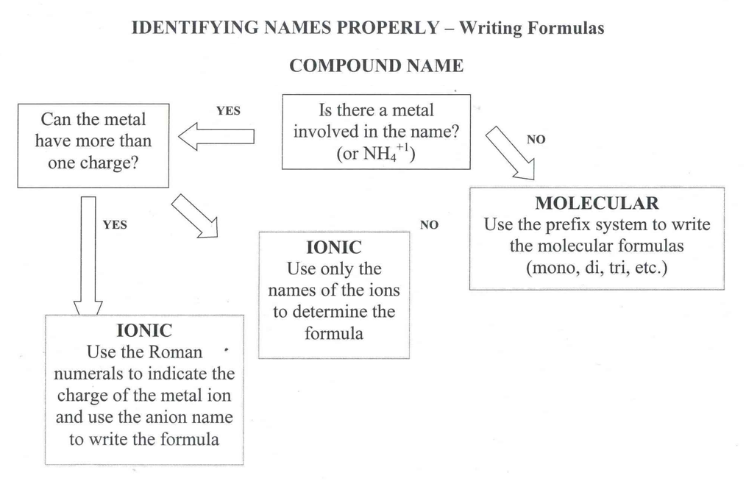
Calcium chloride Dinitrogen pentoxide Copper(II) nitrate

Slide 65
CHEMICAL REACTIONS
Conservation of Mass
Atoms (matter) cannot be created or destroyed. The number of reactant atoms must equal the number of product atoms.
H₂ + I₂ → 2HI
H = 2 H = 2
I = 2 I = 2

Slide 66
CHEMICAL REACTIONS
There are always two kinds of substances:
1. Reactant - substance that enters into a chemical reaction; substance that reacts.
2. Product - substance produced by a chemical reaction; the substance that is made or produced.
Reactants → Products

Slide 67
CHEMICAL REACTIONS
1. Count the number of atoms of each element on both sides of the arrow.
Balance the equation using coefficients. A coefficient is a whole number placed in front of a chemical formula to indicate the number of molecules present. Look for the least common multiple (LCM). Balance metals, then nonmetals, then hydrogen, then oxygen.
3. Check your work by recounting the number of atoms on each side of the arrow.
4. Continue adding coefficients and counting atoms until the equation is balanced.

Slide 68
CHEMICAL REACTIONS
______Li + ______H₂O → ______LiOH + ______H₂
Li – Li -
H – H -
O - O –
H –
______H₂O → ______H₂ + ______O₂
H – H -
O - O -

Slide 69
CHEMICAL REACTIONS
SYNTHESIS Reaction
Two or more substances combine to form a different substance.
What to look for: one product
EX. 2 Mg _{(s)} + O_{2 (g)} → 2 MgO _{(s)}

Slide 70
CHEMICAL REACTIONS
DECOMPOSITION Reaction
one substance breaks down into two or more substances.
What to look for: one reactant
H₂SO₄
Ex. C₁₂H₂₂O_{11(s)} → 11 H₂O_{(g)} + 12 C_{(s)}
sucrose → water and carbon

Slide 71
CHEMICAL REACTIONS
SINGLE REPLACEMENT Rxn
Also called single displacement reaction
one element replaces another element in a compound.
What to look for: uncombined elements on
both sides of the arrow
Cu _{(s)} + AgNO_{3 (aq)} → Cu(NO₃) _{2 (aq)} + Ag _{(s)}

Slide 72
CHEMICAL REACTIONS
DOUBLE REPLACEMENT Rxn
Also called double displacement reaction
Produces a precipitate, water, or a gas when to ionic compounds in a solution are combined.
What to look for: two compounds on each side
Ex. HCl _{(aq)} + NaOH _{(aq)} → NaCl _{(aq)} + H₂O _{(l)}

Slide 73
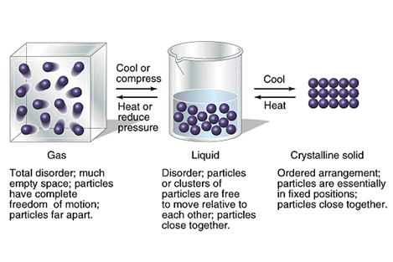
STATES OF MATTER

Slide 74
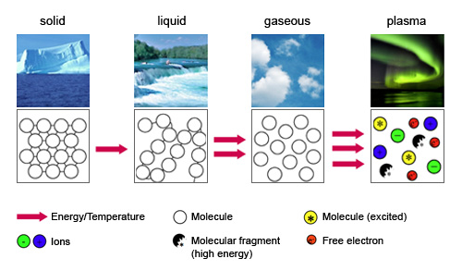
STATES OF MATTER

Slide 75
MATTER
Common States of Matter | Volume | Shape | Molecular Attraction | How the molecules move
Solids | yes | yes | strong | Vibrate around a fixed spot
Liquids | yes | no | medium | Can flow past each other
Gases | no | no | weak | Behave independently
Plasma | No | No | Weak | Electrons are stopped off atoms

Slide 76
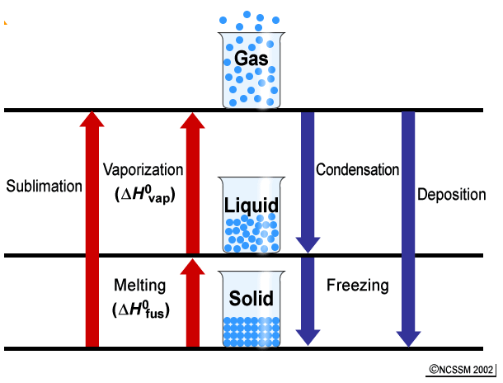
PHASE CHANGES

Slide 77
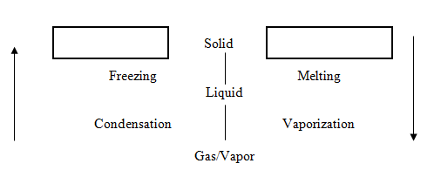
PHASE CHANGES
Endothermic
Exothermic

Slide 78
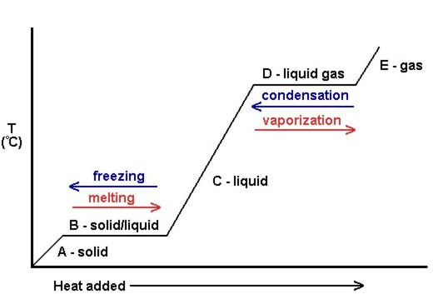
HEATING CURVE

Slide 79
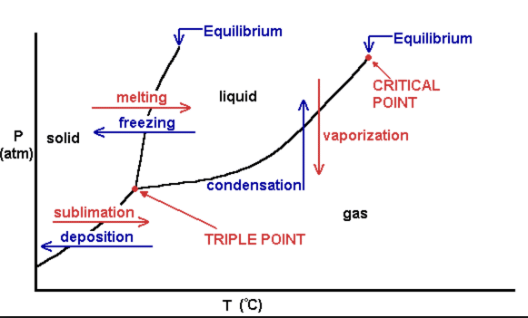
PHASE DIAGRAM
Triple Point - all three phases are at equilibrium
Solid lines are the equilibrium lines between phases. On these lines, both phases exist.

Slide 80
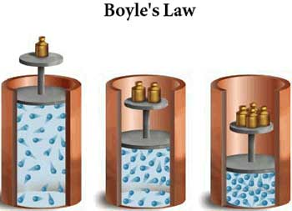
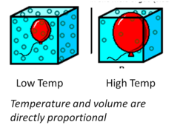
GASES
Factors that affect Gas Pressure
TEMPERATUE
  Increase in temperature increases volume.
  DIRECTLY Proportional
VOLUME
  Decrease in volume increases pressure
  INDIRECTLY/INVERSELY Proportional

Slide 81
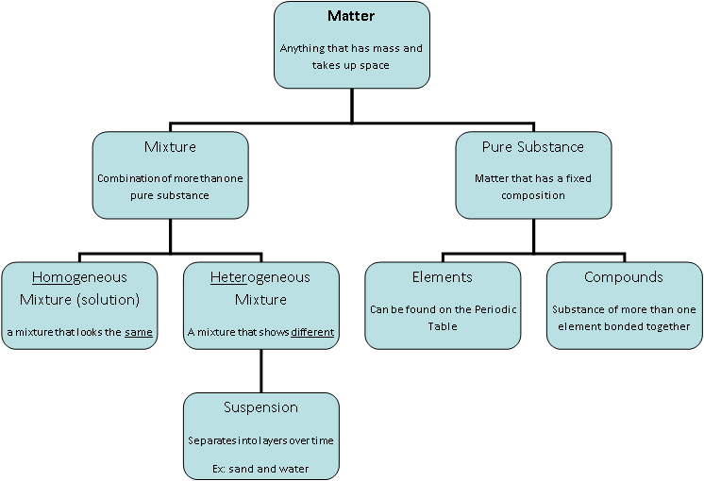
MATTER
MIXTURE
PURE SUBSTANCE
HOMOGENEOUS MIXTURE (SOLN)
HETEROOGENEOUS MIXTURE
ELEMENT
COMPOUNDS
SUSPENSION

Slide 82
PHYSICAL PROPERTIES AND CHANGES
Physical Property Characteristic that can be observed or measured using the 5 senses. | Physical Change Change in the form of matter but not in identity.
Density Shape Color Odor Texture Viscosity Conductivity Malleability Hardness Melting and Boiling Points | Phase changes (melting, freezing) Beating an egg Stirring milk Bending wire Folding a paper Crushing sugar Dissolving Slicing a tomato Boiling water

Slide 83
CHEMICAL PROPERTIES AND CHANGES
Chemical Property Way a substance reacts with another substance to produce a new substance | Chemical Change Occurs when a substance reacts and forms one or more new substances
Reactivity Flammability Combustion Fermentation Oxidation Corrosion | Baking a cake Mixing baking soda and vinegar Burning a candle Iron rusting Making wine Milk souring Banana ripening/rotting Digestion Breathing Evidence of chemical change: Formation of a new substance (solid, gas) Change in color or odor Change in energy Explosion or flammability

Slide 84
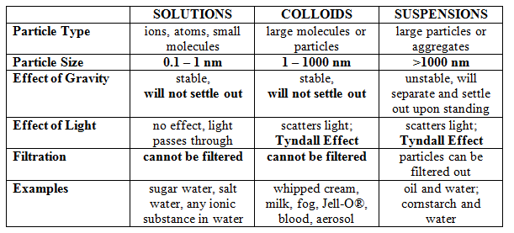
SOLUTIONS

Slide 85
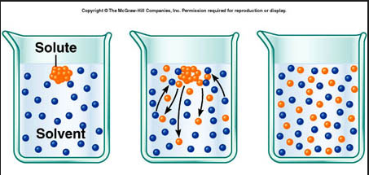
SOLUTIONS

Slide 86
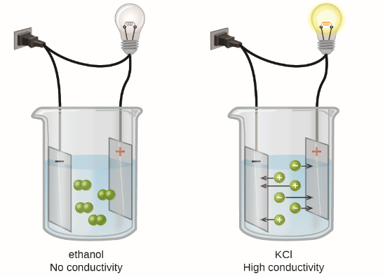
SOLUTIONS
ELECTROLYTE
NONELECTROLYTE

Slide 87

SOLUTIONS
6. Be able to distinguish between a concentrated solution and a dilute solution.
CONCENTRATED: lots of solute in some solvent
DILUTE: little solute in some solvent
Most Concentrated
Most Dilute

Slide 88
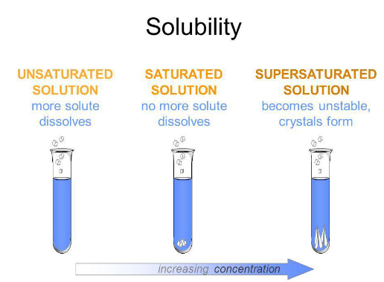
SOLUTIONS
Differentiate between saturated, unsaturated, and supersaturated.
Unsaturated - There is more available space for solute to dissolve in the solvent.
Saturated - When there is enough solute in the solvent and you begin to see some crystals
Supersaturated - When there is an excess of solute in the solvent. The solution is unstable and the excess solute with crystallize out if given the chance.

Slide 89
SOLUTIONS
The factors affecting the rate of solubility.
Agitation – stirring or shaking puts the solute in contact with the solvent more often.
Temperature – raising the temperature makes the particles move faster which puts the solute in contact with the solvent more often.
Particle Size – smaller particles means more surface area which puts the solute in contact with the solvent more often.

Slide 90
SOLUTIONS
The factors that affect solubility.
Nature of the solvent and solute - “like dissolves like”.
Temperature - increase the temperature and solubility increases.
Pressure - increase the pressure and you increase solubility. (only gases)
How much is already dissolved?

Slide 91
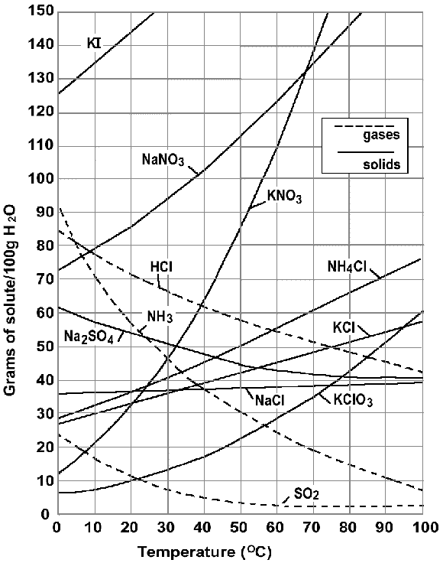
SOLUTIONS
Solubility curve graph.
How much is dissolved.
At what temperature it dissolved

Slide 92
SOLUTIONS
Saturated, unsaturated, and supersaturated.
Gases show a decrease in solubility when temperature rises.

Slide 93
ACIDS AND BASES
Acid and Base Characteristics.
Acid and Base Properties (when dissolve in water):
ACIDS
Give off H⁺ ions
Taste sour
Change blue litmus to red
React with bases to neutralize their properties
React with active metals and carbonates to produce gases.
Conduct electricity.
BASES
Give off OH⁻ ions
Taste bitter
Feels slippery and smooth
Change red litmus to blue
React with acids to neutralize their properties.
Conduct electricity

Slide 94
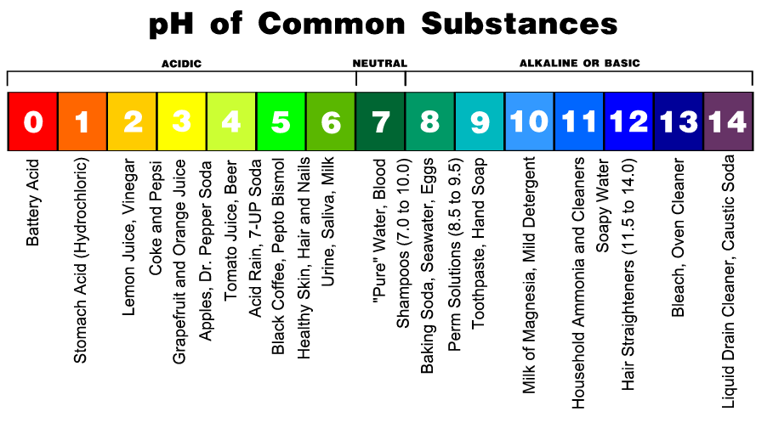
ACIDS AND BASES
pH = a measure of the concentration of hydronium ions in a solution using a scale ranging from 0 to 14 with 0 being the most acidic and 14 begin the most basic.

Slide 95

ACIDS AND BASES

Slide 96
ACIDS AND BASES
When you put an acid and base together, you get a SALT and WATER.
H₂SO₄ + 2NaOH → 2H₂O + Na₂SO₄
This is called a NEUTRALIZATION reaction.

Slide 97

ACIDS AND BASES
Common household acids and bases.

Slide 98
MOTION
How fast something moves is SPEED.
SPEED is the distance an object travels in a certain period of time.
In order to completely describe the motion of an object, we need to include not only the speed of the object, but also the direction.
VELOCITY is speed in a particular direction.

Slide 99



MOTION

Slide 100




MOTION

Slide 101
MIDTERM EXAM
50 multiple choice questions.
Bubble in answer sheet.
Cannot write on the test.
You can do scratch work on the test answer sheet.
You will need a calculator.
I will take up your midterm review packet on your exam day.

