Slide 1
DO NOW
Get out notes and EOC sheet.
Pick up review.
Reflection and Refraction lab is due Thursday.
Computer Practice is due Friday.

Slide 2
PHYSICAL SCIENCE PS39
What are the four parts of a lever system?
How is mechanical advantage increased in a lever system?

Slide 3
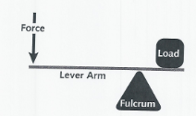
PHYSICAL SCIENCE PS39
force, lever arm, fulcrum, load
MA is gained by moving the fulcrum closer to the load

Slide 4

TEST REVIEW

Slide 5
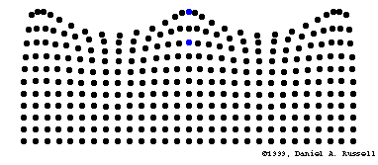
REVIEW
1. Know the 15 vocabulary words.
2. Recognize that waves carry energy but not matter.
3. Define mechanical waves.
waves need a medium in order to travel.
    Examples: Sound, water

Slide 6
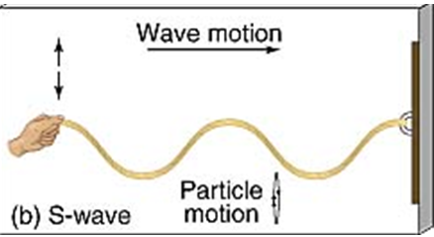
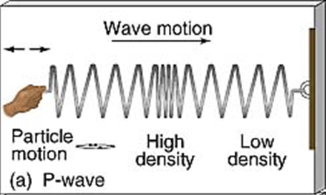
REVIEW
4. Define and recognize transverse and compressional (longitudinal) waves.

Slide 7
REVIEW
5. Compare and contrast transverse and compressional (longitudinal) waves.
Transverse Waves | Both Types | Compressional Waves
The wave energy causes matter in the medium to move at right angles to the direction the wave travels. | Both are mechanical waves. Both move energy, not matter forward | Medium moved forward and backwards along the direction the wave travels.

Slide 8
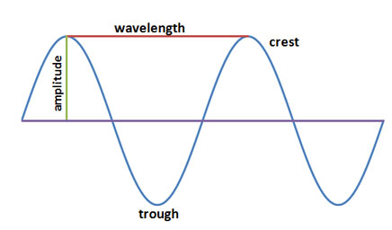
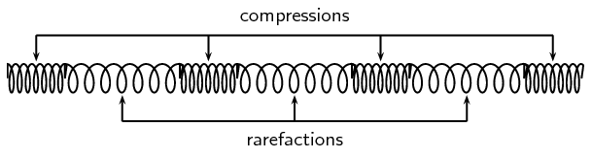
REVIEW
6. Know the parts of a transverse and a compressional (longitudinal) wave.

Slide 9
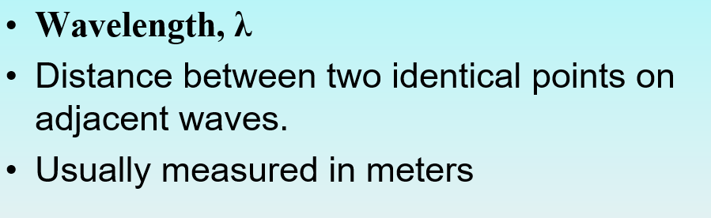
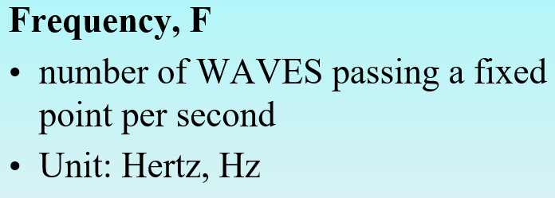
REVIEW
Define wavelength and frequency and know the units for each.

Slide 10
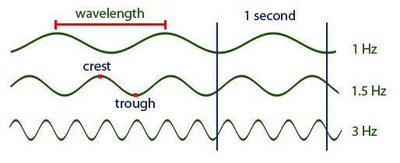
REVIEW
8. Describe the relationship between wavelength and frequency.
Wavelength and frequency are inversely proportional.

Slide 11
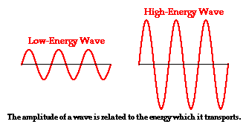
REVIEW
9. Explain how a wave’s amplitude is related to the wave’s energy.
The higher the amplitude,
the more energy a wave has.

Slide 12
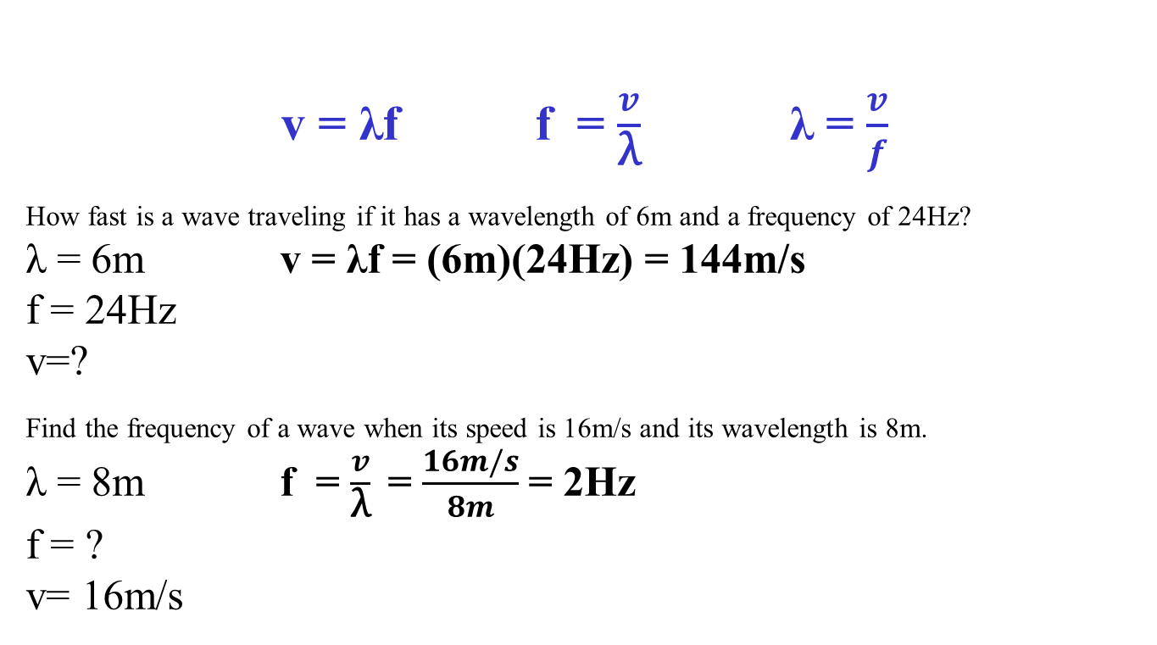
REVIEW
10. Calculate a wave’s speed, frequency, and/or wavelength
v = λf f = $\frac{v}{\text{λ}}$ λ = $\frac{v}{f}$
How fast is a wave traveling if it has a wavelength of 6m and a frequency of 24Hz?
λ = 6m v = λf = (6m)(24Hz) = 144m/s
f = 24Hz
v=?
Find the frequency of a wave when its speed is 16m/s and its wavelength is 8m.
λ = 8m f = $\frac{v}{\text{λ}}$ = $\frac{16m/s}{8m}$= 2Hz
f = ?
v= 16m/s

Slide 13
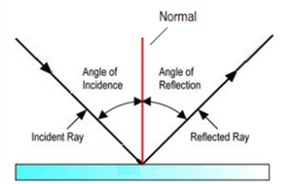
REVIEW
11. Identify the Law of Reflection and know the parts of the diagram explaining it.
The Law of Reflection states that the angle of incidence is equal to
the angle of reflection on a flat reflecting surface.

Slide 14
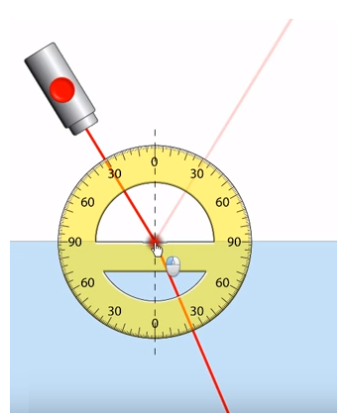
REVIEW
12. Recognize what makes waves bend.
The bending of the path of a wave as it passes from one material into another material.
The refraction occurs at the boundary and is caused by a change in the speed of the light wave upon crossing the boundary.

Slide 15
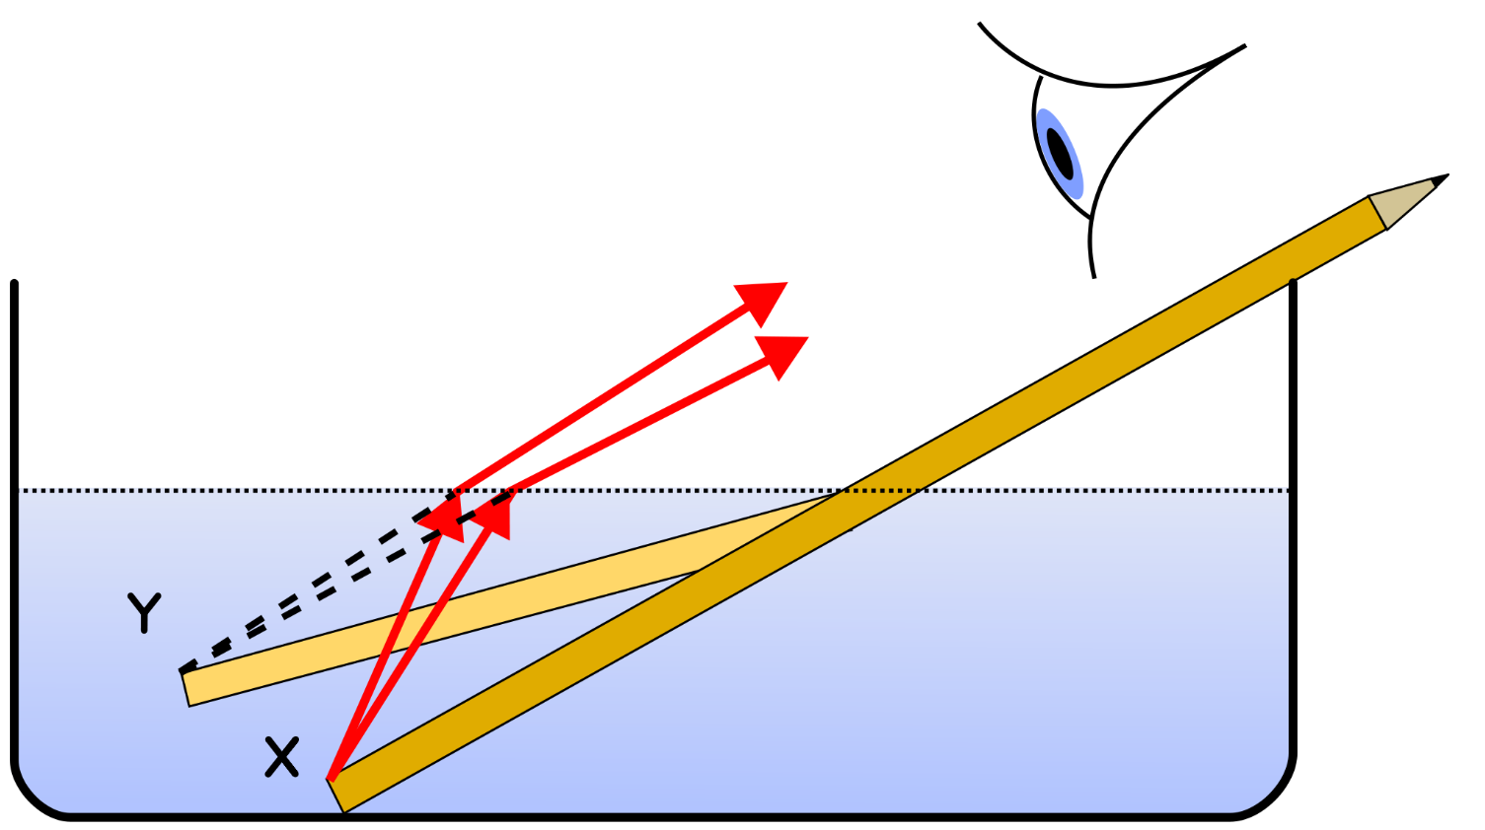
REVIEW
13. Define refraction and be able to give examples.
Examples:
“Bent” pencil
Mirage
Sparkle of a diamond
rainbow

Slide 16
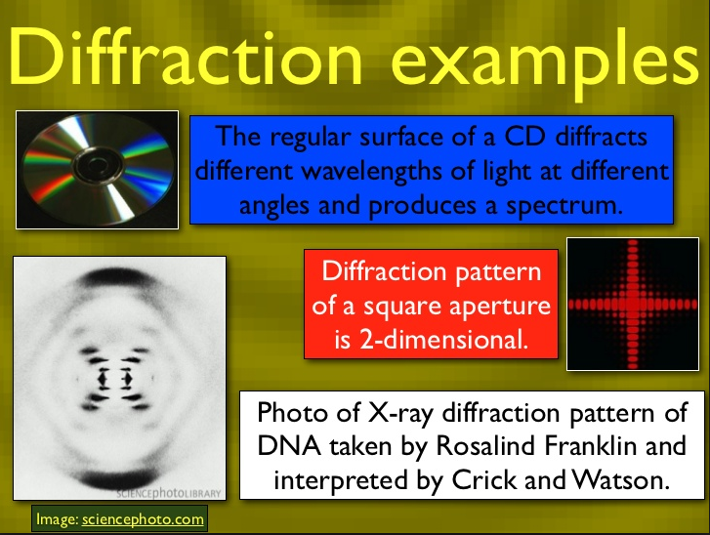
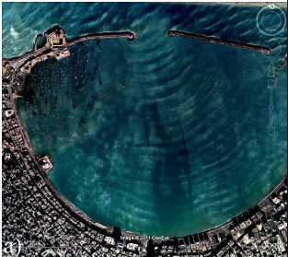
REVIEW
13. Define diffraction and be able to give examples.
- Diffraction is the bending of a wave around a barrier.

Slide 17
REVIEW
14. Explain how waves combine, be able to give examples, and draw the waves before and after.
INTERFERENCE: Sometimes two or more waves may come in contact with each other and overlap to form a new wave.
CONSTRUCTIVE INTERFERENCE occurs when two or more waves hit the same point and combine to produce a larger single wave.
DESTRUCTIVE INTERFERENCE occurs when two or more waves hit the same point and combine to produce a smaller single wave.

Slide 18
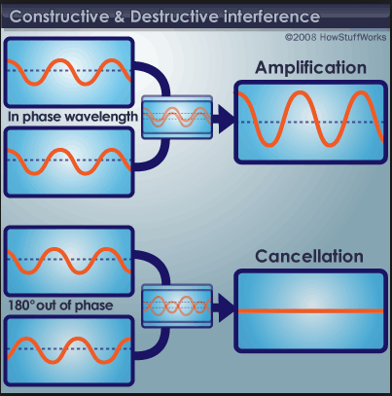
REVIEW
Constructive Interference
Destructive Interference

Slide 19
TEST FORMAT
18 Multiple Choice
7 True and False
2 Speed, frequency, and wavelength calculations
Short answer questions
Drawings (transverse wave, reflection, refraction, interference)
The first two are on a bubble-in sheet

Slide 20
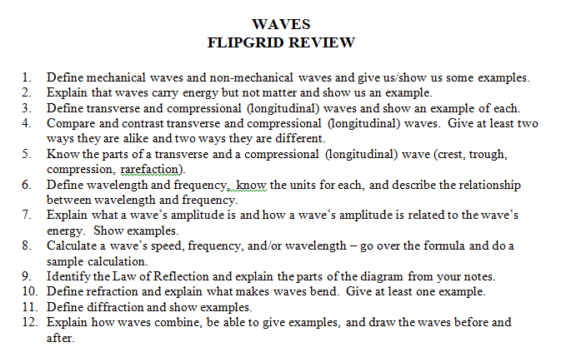
FLIP GRID - WAVES

Slide 21
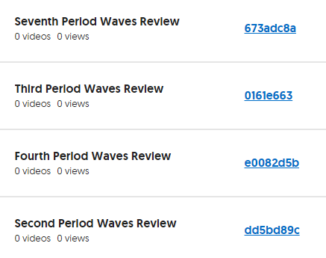
FLIP GRID - WAVES

Slide 22
TO DO
Do your Flipgrid video with your current lab partner – due by Friday.
Work on test review – due tomorrow for test redo credit.
Work on the Reflections/Refraction lab – due by Thursday.
Work on Computer Simulations – due by Friday.

