Slide 1
Energy and Energy Transformations
SPS7. Obtain, evaluate, and communicate information to explain transformations and flow of energy within a system.
a. Construct explanations for energy transformations within a system. (Types of energy to be addressed include chemical, mechanical, electromagnetic, light, sound, thermal, electrical, and nuclear.)
b. Plan and carry out investigations to describe how molecular motion relates to thermal energy changes in terms of conduction, convection, and radiation.
c. Analyze and interpret specific heat data to justify the selection of a material for a practical application (e.g., insulators and cooking vessels).

Slide 2
ENERGY
LAW OF CONSERVATION OF ENERGY
Energy cannot be created or destroyed…only changed from one form to another.
The total energy of an isolated system remains constant (isolated systems have no external forces and no mass changes).

Slide 3
ENERGY
Energy is the capacity (ability) to do work.
Kinetic Energy: Associated with an object in motion.
Potential Energy: Present in an object that has the potential to move because of its position.
Classify the following as a type of potential energy or kinetic energy (use K or P)
A bicyclist pedaling up a hill _____
An archer with his bow drawn _____
A volleyball player spiking a ball _____
A baseball thrown to second base _____
The chemical bonds in sugar _____
The wind blowing through your hair _____

Slide 4
ENERGY
Types of Energy
Potential energy | Stored energy due to position
Kinetic energy | Energy of motion
Chemical Energy | A form of potential energy and it is possessed by things such as food, fuels and batteries
Thermal Energy | Heat – energy of moving molecules or electromagnetic radiation.
Mechanical Energy | Energy contained by moving objects due to their motion
Electromagnetic Energy | The energy source required to transmit information (in the form of waves). Some types of electromagnetic energy include: radio waves, microwaves, infrared waves, visible light, ultraviolet light, x-rays, and gamma rays. All electromagnetic forms of energy travel at the speed of light which is very fast.
Gravitational Potential energy | Energy stored within an object due to its height above the surface of the Earth.

Slide 5
ENERGY
Energy Transformations
Consuming food
Car engine
Light bulb
Windmills
Solar panels

Slide 6
ENERGY
SPECIFIC HEAT CAPACITY, C: The amount of energy needed to raise 1kg of a substance by 1 K or one degrees Celsius.
It takes different amounts of energy to make the same temperature change in different substances.
UNIT: J/g °C or J/kg K
SYMBOL: C_{p}

Slide 7
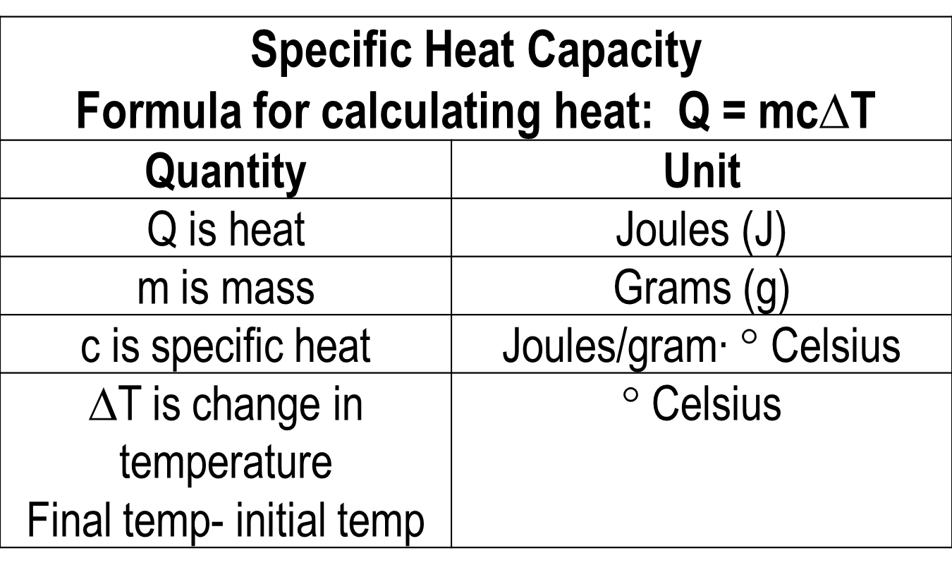
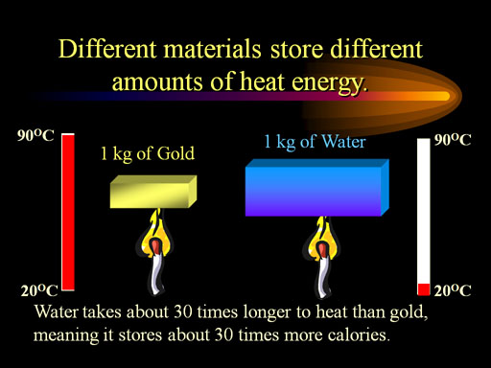
ENERGY

Slide 8
ENERGY
Q = m C_{p}ΔT
Change in temperature
Heat
Specific heat
Mass

Slide 9
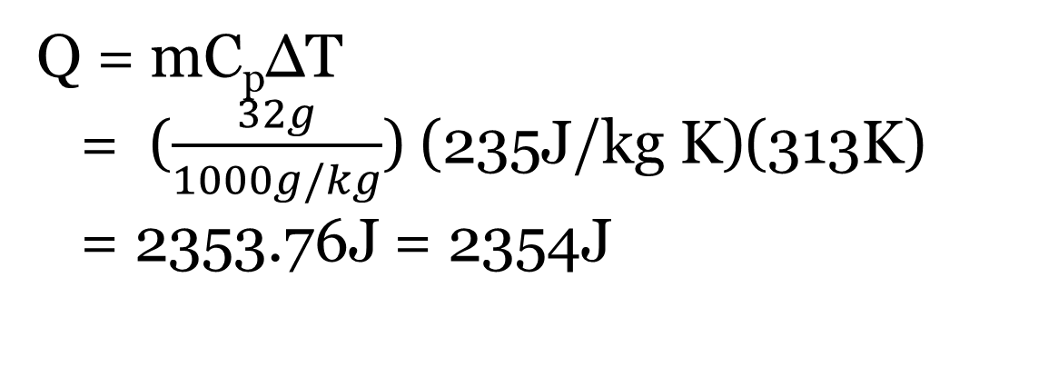
ENERGY
Practice:
The temperature of a 32g silver spoon increases from 20°C to 60°C. If silver has a specific heat of 235J/kg K. what is the change in thermal energy (heat) of the spoon?
Mass = 32g
C_{p} = 235J/kg K
ΔT = 60°C - 20°C
= 40°C
K = 273 +°C = 313K
Q = ?
Q = mC_{p}ΔT
= ($\frac{32g}{1000g/kg}$) (235J/kg K)(313K)
= 2353.76J = 2354J

Slide 10
ENERGY
Three Methods of Heat Transfer
Method of heat transfer | Description | Example
Conduction | Heat transfer by direct contact | Burning your hand by touching a hot pan.
Convection | Heat transfer through fluids (gas or liquid) | Wind currents. Heating and cooling system in our homes and buildings.
Radiation | Heat transfer through open space (vacuum) | The hood of a car getting hot on a summer day.

Slide 11
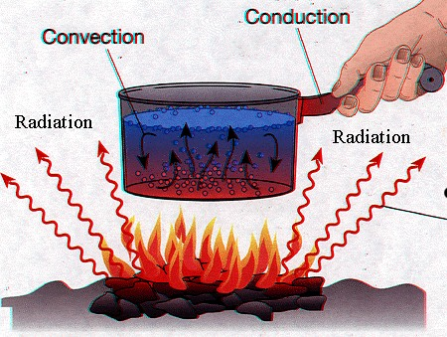
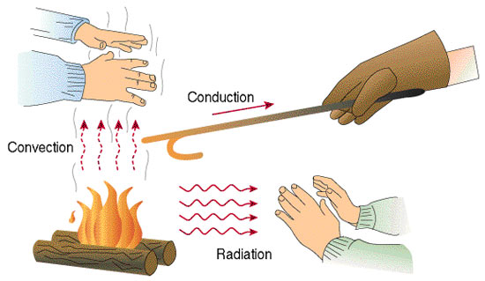
ENERGY

Slide 12
ENERGY
Insulator | Conductor
Material that does not allow heat/charge to pass easily. | Material that allows heat/charge to pass easily.
Examples: wood, plastic, rubber, air, fiberglass, fleece, thermal underwear | Examples: Metals such as copper, silver, gold, aluminum
Poor conductor | Poor insulator
Heat travels from a warmer material to a colder material.

Slide 13
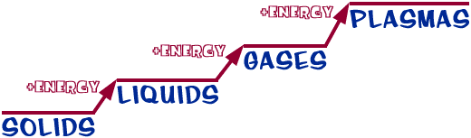

ENERGY
Energy determines the state of matter.

Slide 14
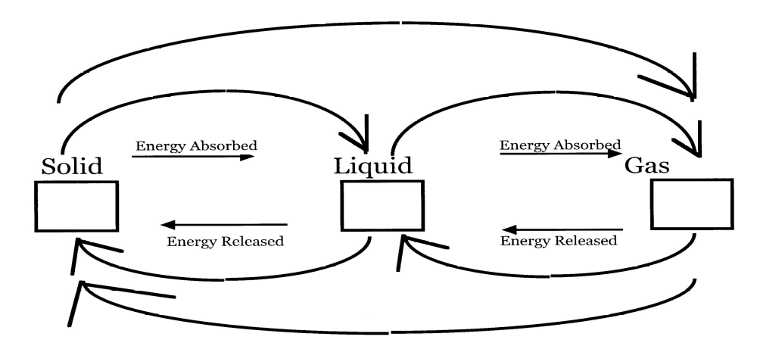
ENERGY
Label the phase changes below. Tell which reactions are endothermic and which are exothermic.

Slide 15
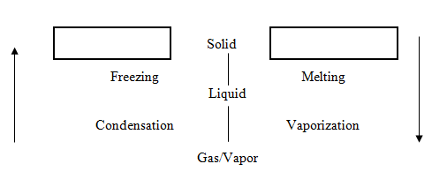
ENERGY
Exothermic
Endothermic

